Slide 1
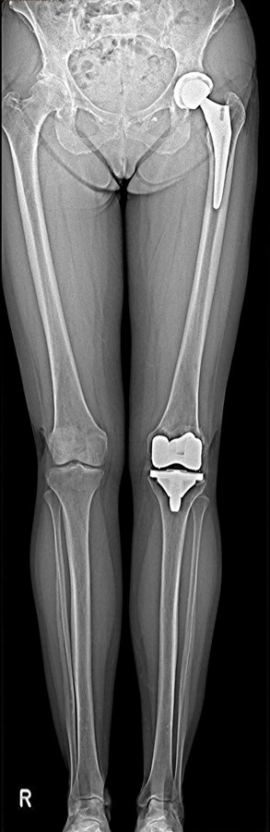
Factors affecting leg- length at various levels, including the knee
Multitom Rax True2scale Body Scan¹ clinical case
Orthopedic Hospital Schloss Werneck, Germany
StudyID: 5aag676
1 Option

Slide 2
Background
Total hip arthroplasty (THA)
Gold-Standard procedure to plan THA¹
X-ray image acquisition: Pelvis overview
      Lying or weight-bearing (optimal)
      Acquired in a.P. or including a second view lat.
Measurements to plan THA (incl. resulting leg-length)
1
      Reference line within the pelvis,
      e.g., at the pelvic teardrop
2
      Parallel to the reference line, a second line is placed
      at the femoral bone, e.g., at the greater trochanter
3
      If the parallel line does not align with both reference points,
      the parallel difference is set equal to the leg-length discrepancy
2
3
Disadvantages
      Only indirect measurement of leg-length possible
      (true length only measurable with whole leg image)
      If additional CT acquisition is done (i.e., for 3D preoperative planning),
      patient is not in weight-bearing position
1
The products/features (mentioned herein) are not commercially available in all countries.
Their future availability cannot be guaranteed. | 1 THA: total hip arthroplasty

Slide 3
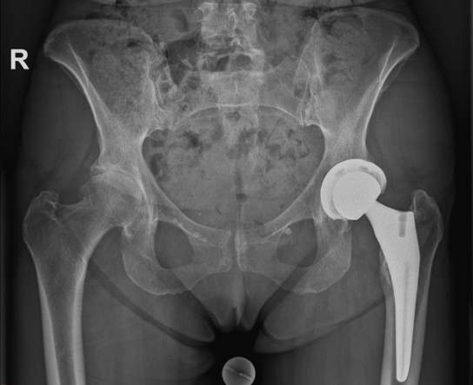
Clinical background
Patient
Sex
Female
Year of birth
1963
BMI
16.3 kg/m²
StudyID: 5aag677
Anamnesis
Already treated with a left total knee endoprosthesis. The right knee also shows advanced, but so far painless, degeneration. Presentation with bilateral coxarthrosis (left more than right). At that time, following conventional planning, a left total hip endoprosthesis was implanted. The patient now presents again for implantation
on the opposite side.
The products/features (mentioned herein) are not commercially available in all countries.
Their future availability cannot be guaranteed.

Slide 4
Clinical background and indication for Multitom Rax True2scale Body Scan¹
Patient
Sex
Female
Year of birth
1963
BMI
16.3 kg/m²
Anamnesis
Already treated with a left total knee endoprosthesis. The right knee also shows advanced, but so far painless, degeneration. Presentation with bilateral coxarthrosis (left more than right). At that time, following conventional planning, a left total hip endoprosthesis was implanted. The patient now presents again for implantation
on the opposite side.
Indication for True2scale Body Scan¹
Left side: Fully implanted lower extremity, right side: still in its original condition. The necessity of True2scale Body Scan1 to include all levels in the planning of leg length, especially in cases of pathologies or different states of reconstruction at various levels.
The products/features (mentioned herein) are not commercially available in all countries.
Their future availability cannot be guaranteed. | 1 Option

Slide 5
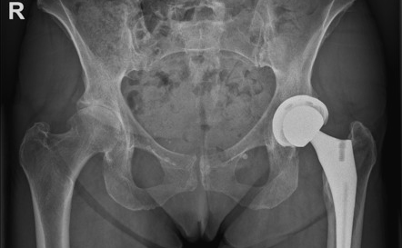
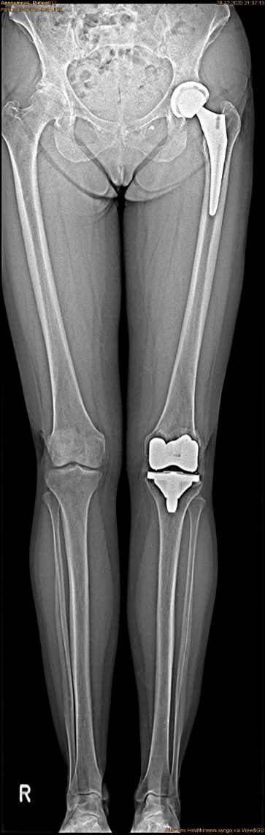
Multitom Rax True2scale Body Scan¹
Differences Pelvis Overview vs. T2S¹
True2scale Body Scan¹
a.p. using upright S protocol
StudyID: 5aag677
StudyID: 5aag676
Leg-length discrepancy | 2 mm
Scan range | 86.6 cm
Scan time | 10.8 sec
Tube voltage | 81 kV
Current time product | 54 mAs
Dose area product | 9.2 µGy⋅m²
2 mm
2 mm
Gold-standard
Pelvis overview
Leg-length discrepancy | 2 mm
Tube voltage | 81 kV
Current time product | 14.4 mAs
Dose area product | 54.7 µGy⋅m²
The products/features (mentioned herein) are not commercially available in all countries.
Their future availability cannot be guaranteed. | 1 Option

Slide 6
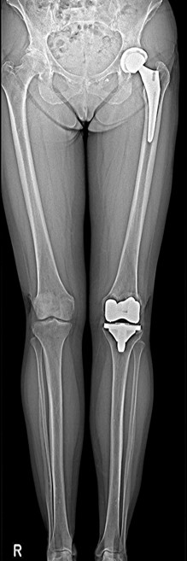
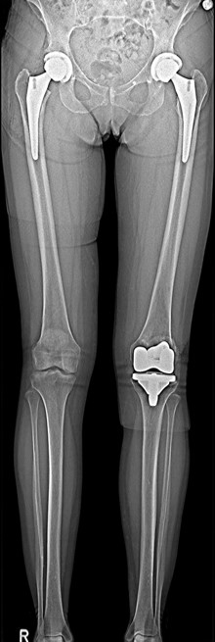
Multitom Rax True2scale Body Scan¹
Diagnostic Findings & Results
Results
True2scale Body Scan¹ revealed a 2 mm leg-length discrepancy.
StudyID: 5aag676
StudyID: 5aag675
Follow-up scan after revision
Uncomplicated implantation with almost equal leg length,
with a 6 mm discrepancy on the left side. This leaves some
space for the treatment of the left knee in the further course.
Pre-surgery
Post-surgery
The products/features (mentioned herein) are not commercially available in all countries.
Their future availability cannot be guaranteed. | 1 Option

Slide 7
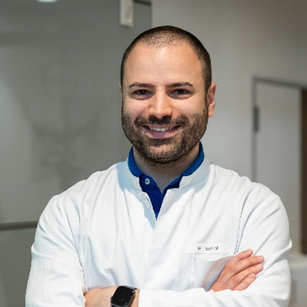
“The T2S scan provides us with
a seamless and distortion-free overview across many levels.” ¹
Manuel Scholl, MD
Orthopedic Hospital Schloss Werneck, Germany
1 The statements by Siemens Healthineers customers described herein are based on results that were achieved in the customer’s unique setting. Since there is no “typical” hospital and many variables exist (e.g., hospital size, case mix, level of IT adoption) there can be no guarantee that other customers will achieve the same results.

Slide 8
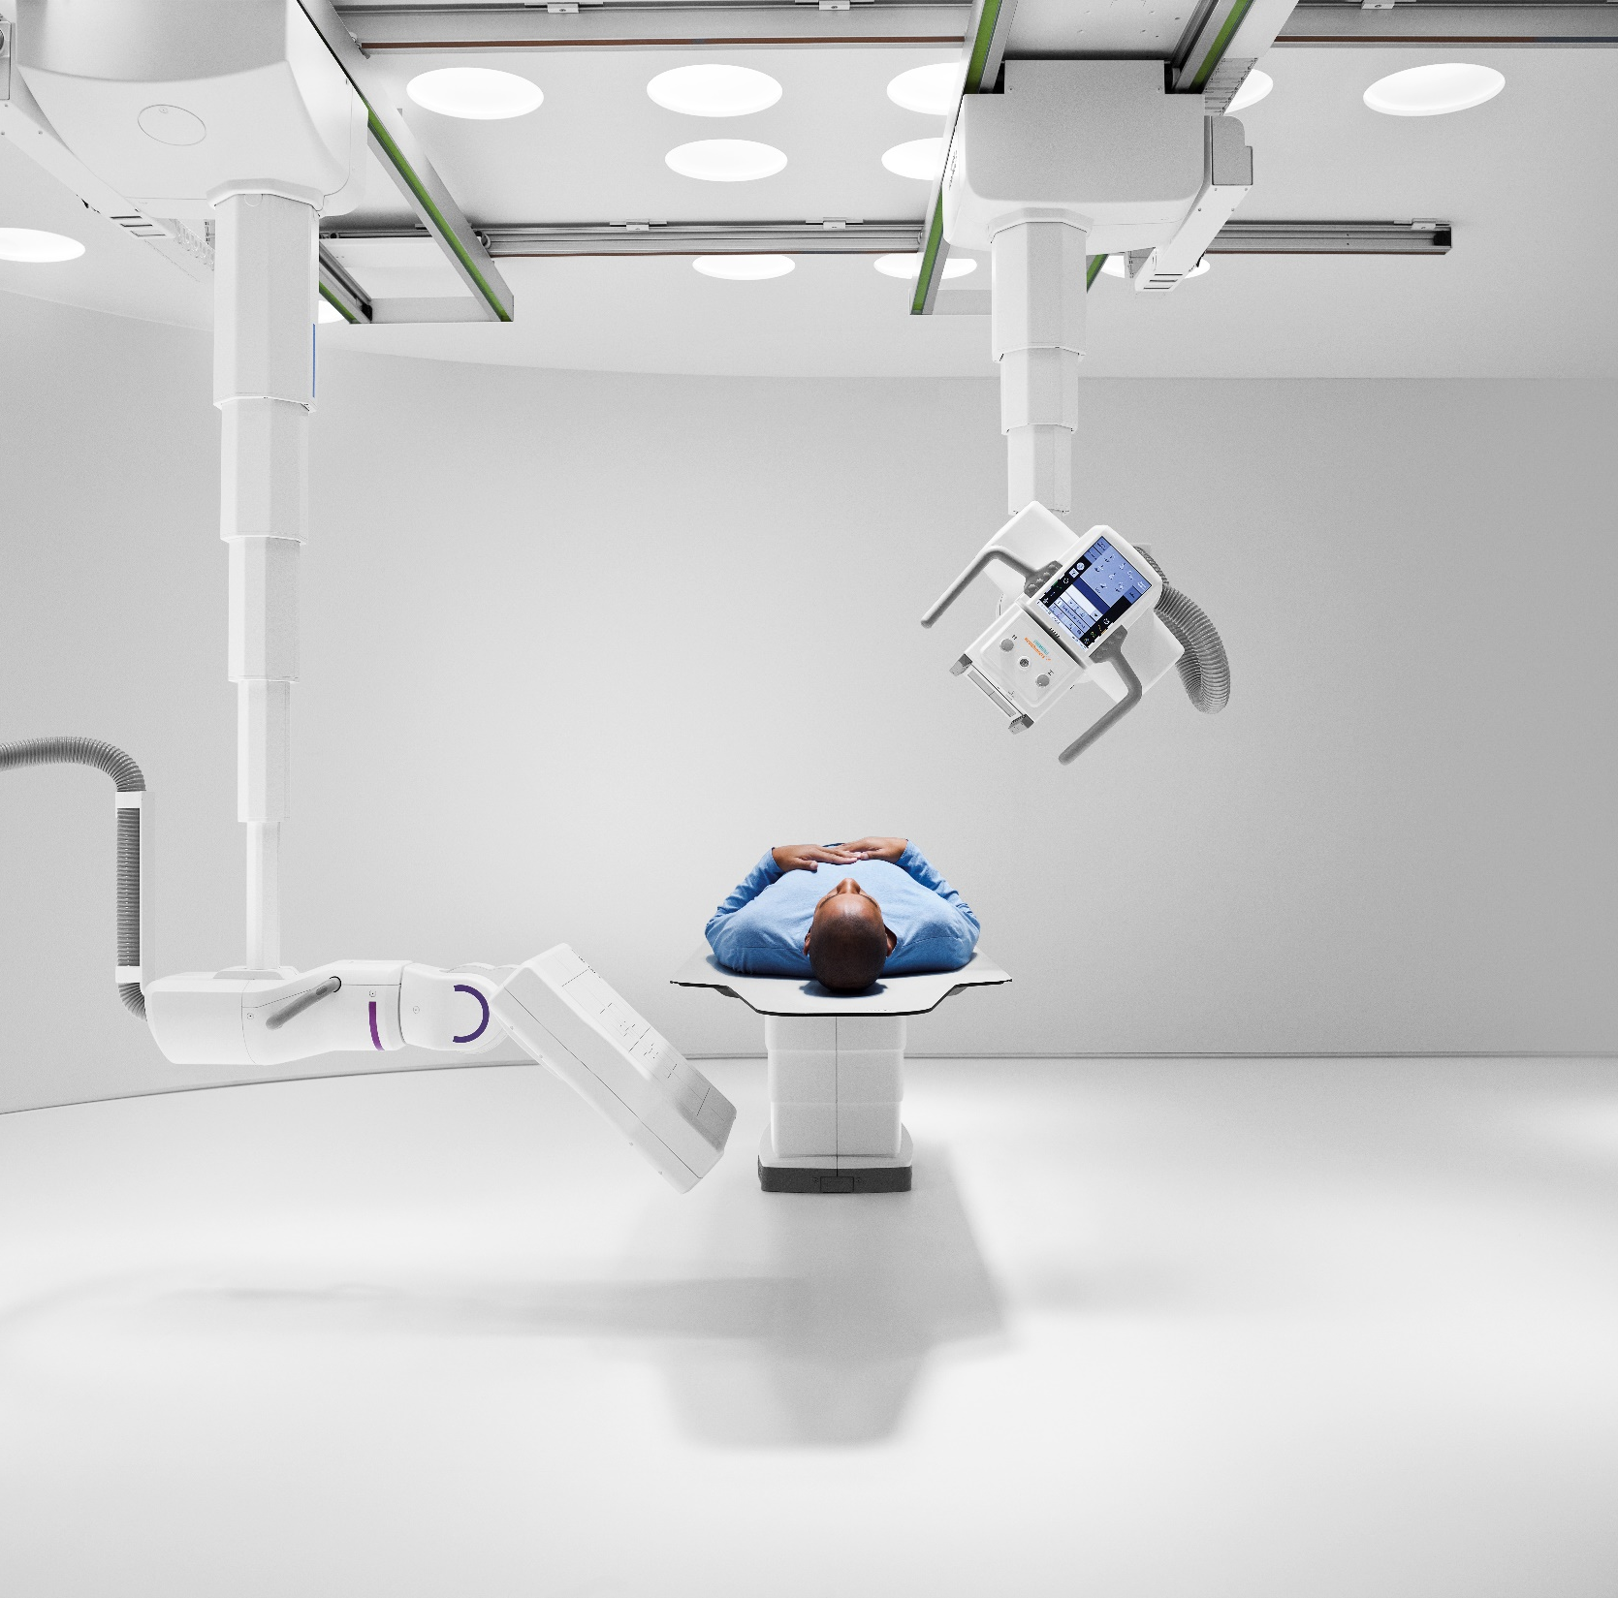
The products/features (mentioned herein) are not commercially available in all countries. Their future availability cannot
be guaranteed. True2scale Body Scan
is an option.
Results from case studies are not predictive of results in other cases. Results in other cases may vary.
Manuel Scholl is employed by an institution that receives financial support from Siemens Healthineers for collaborations.

