Slide 1
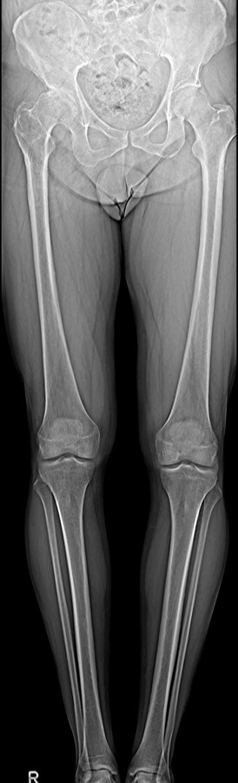
Blurred anatomical landmarks
Multitom Rax True2scale Body Scan¹ clinical case
Orthopedic Hospital Schloss Werneck, Germany
StudyID: 5aag664
1 Option

Slide 2
Background
Total hip arthroplasty (THA)
Gold-Standard procedure to plan THA¹
X-ray image acquisition: Pelvis overview
      Lying or weight-bearing (optimal)
      Acquired in a.P. or including a second view lat.
Measurements to plan THA (incl. resulting leg-length)
1
      Reference line within the pelvis,
      e.g., at the pelvic teardrop
2
      Parallel to the reference line, a second line is placed
      at the femoral bone, e.g., at the greater trochanter
3
      If the parallel line does not align with both reference points,
      the parallel difference is set equal to the leg-length discrepancy
2
3
Disadvantages
      Only indirect measurement of leg length possible
      (true length only measurable with whole leg image)
      If additional CT acquisition is done (i.e., for 3D preoperative planning),
      patient is not in weight-bearing position
1
The products/features (mentioned herein) are not commercially available in all countries.
Their future availability cannot be guaranteed. | 1 THA: total hip arthroplasty

Slide 3
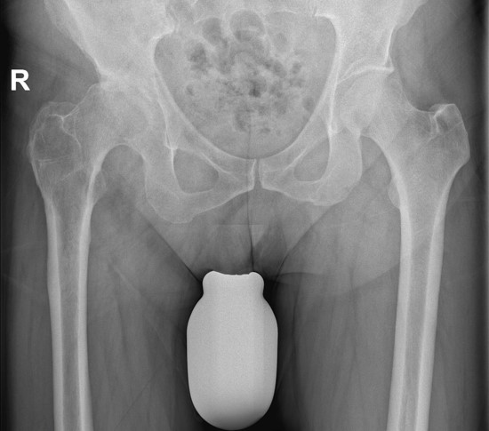
Clinical background
Patient
Sex
Male
Year of birth
1967
BMI
26.3 kg/m²
StudyID: 5aag666
Anamnesis
Status post corrective osteotomy in 1981 with a leg-length discrepancy of 1 cm.
The patient experiences significant suffering and severe restriction of movement.
On the pelvis overview, the anatomical landmarks are markedly blurred,
resulting in reduced planning accuracy due to the difficulty in identifying them.
The products/features (mentioned herein) are not commercially available in all countries.
Their future availability cannot be guaranteed.

Slide 4
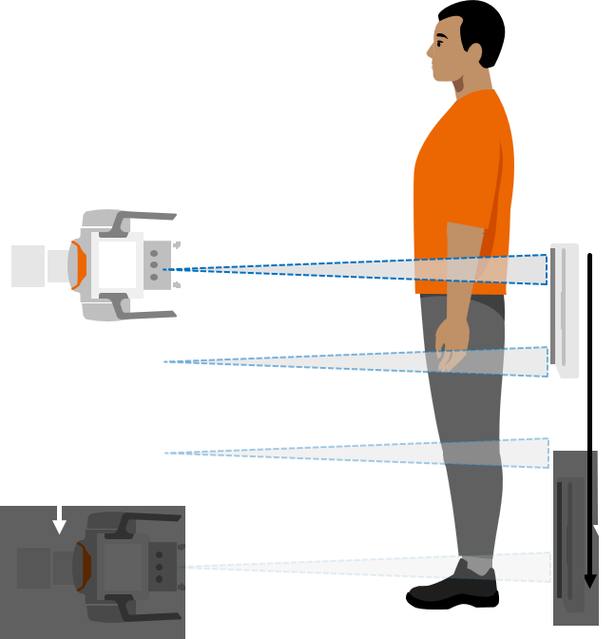
Clinical background and indication for Multitom Rax True2scale Body Scan¹
Patient
Sex
Male
Year of birth
1967
BMI
26.3 kg/m²
Anamnesis
Status post corrective osteotomy in 1981 with a leg-length discrepancy of 1 cm.
The patient experiences significant suffering and severe restriction of movement.
On the pelvis overview, the anatomical landmarks are markedly blurred,
resulting in reduced planning accuracy due to the difficulty in identifying them.
Indication for True2scale Body Scan¹
Use of True2scale Body Scan1 to reduce planning inaccuracies.
The products/features (mentioned herein) are not commercially available in all countries.
Their future availability cannot be guaranteed. | 1 Option

Slide 5
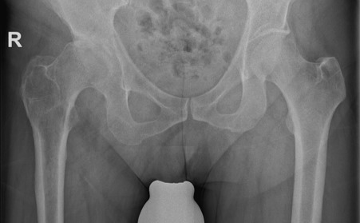
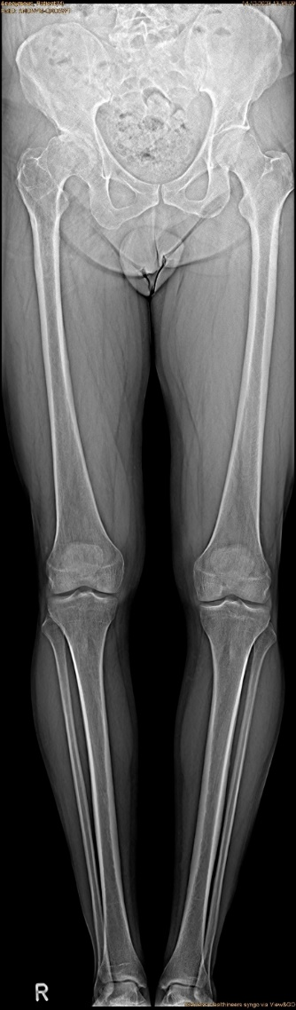
Multitom Rax True2scale Body Scan¹
Differences Pelvis Overview vs. T2S¹
True2scale Body Scan¹
a.p. using upright L protocol
StudyID: 5aag666
StudyID: 5aag664
Leg-length discrepancy | 15 mm
Scan range | 104.2 cm
Scan time | 13.1 sec
Tube voltage | 81 kV
Current time product | 497 mAs
Dose area product | 97.4 µGy⋅m²
11 mm
15 mm
Gold-standard
Pelvis overview
Leg-length discrepancy | 11 mm
Tube voltage | 90 kV
Current time product | 12 mAs
Dose area product | 158.2 µGy⋅m²
The products/features (mentioned herein) are not commercially available in all countries.
Their future availability cannot be guaranteed. | 1 Option

Slide 6
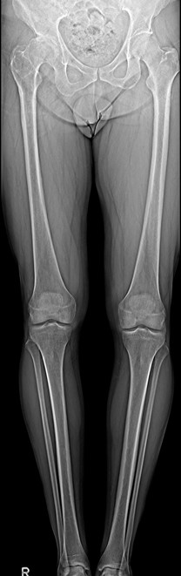
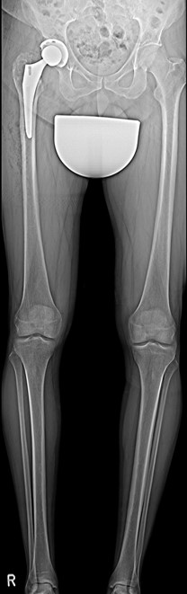
Multitom Rax True2scale Body Scan¹
Diagnostic Findings & Results
Results
True2scale Body Scan¹ reveals that the previously assumed
leg-length discrepancy is greater than 11 mm (15 mm)
StudyID: 5aag664
StudyID: 5aag665
      Revision surgery
Follow-up scan after revision
Uncomplicated surgical course with equalized leg length postoperatively (less than 5 mm difference).
Pre-surgery
Post-surgery
The products/features (mentioned herein) are not commercially available in all countries.
Their future availability cannot be guaranteed. | 1 Option

Slide 7
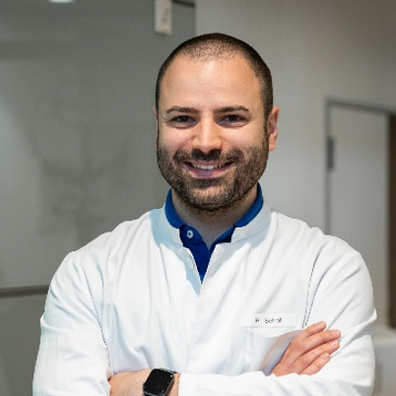
“The T2S scan provides planning confidence in complex anatomical situations by offering a good overall view.”¹
Manuel Scholl, MD
Orthopedic Hospital Schloss Werneck, Germany
1 The statements by Siemens Healthineers customers described herein are based on results that were achieved in the customer’s unique setting. Since there is no “typical” hospital and many variables exist (e.g., hospital size, case mix, level of IT adoption) there can be no guarantee that other customers will achieve the same results.

Slide 8
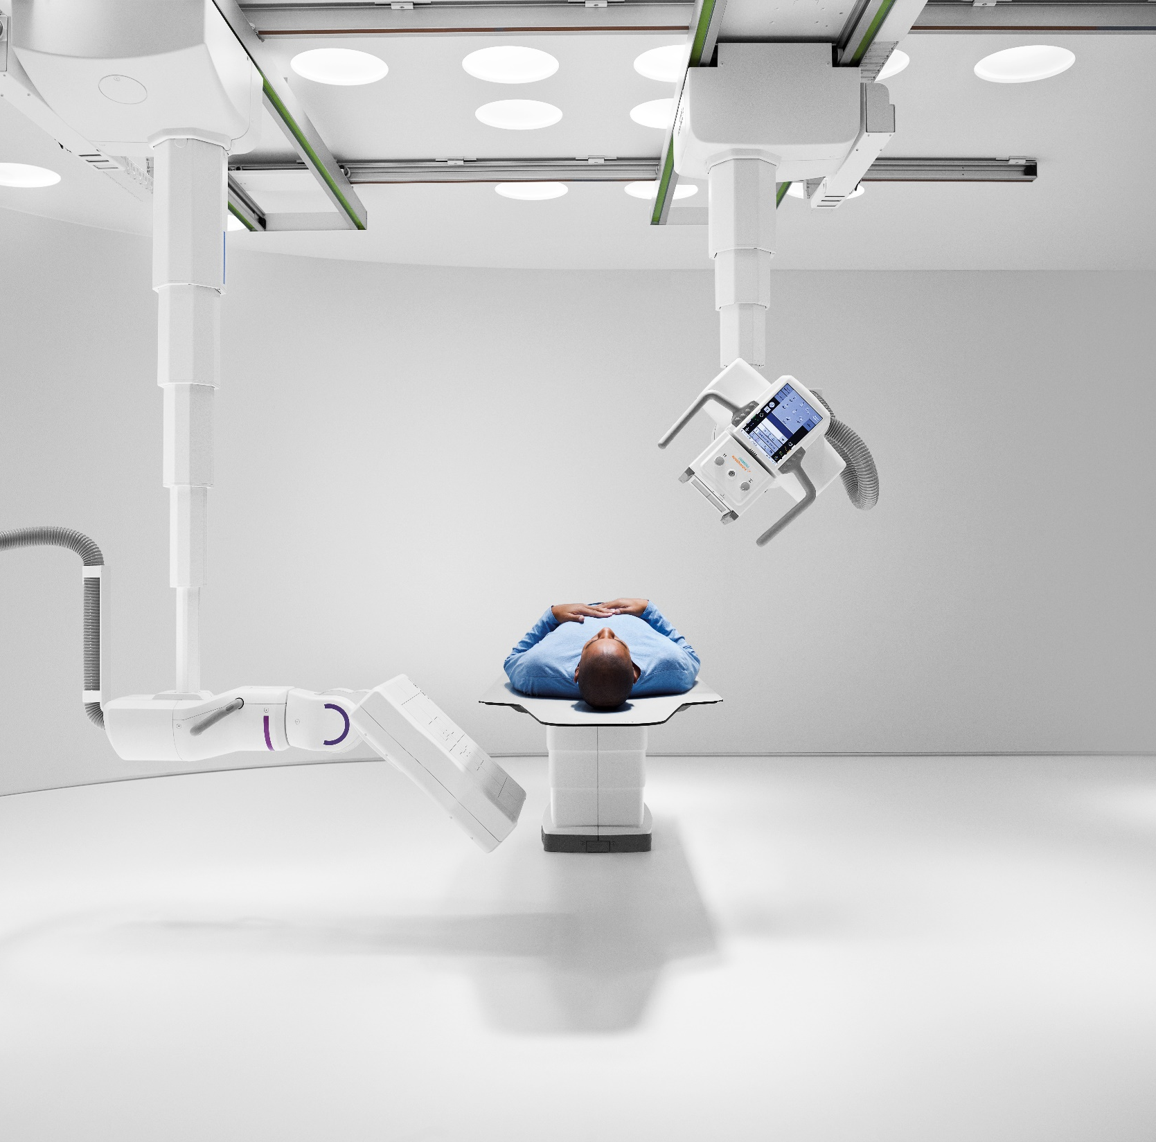
The products/features (mentioned herein) are not commercially available in all countries. Their future availability cannot
be guaranteed. True2scale Body Scan
is an option.
Results from case studies are not predictive of results in other cases. Results in other cases may vary.
Manuel Scholl is employed by an institution that receives financial support from Siemens Healthineers for collaborations.

