Slide 1
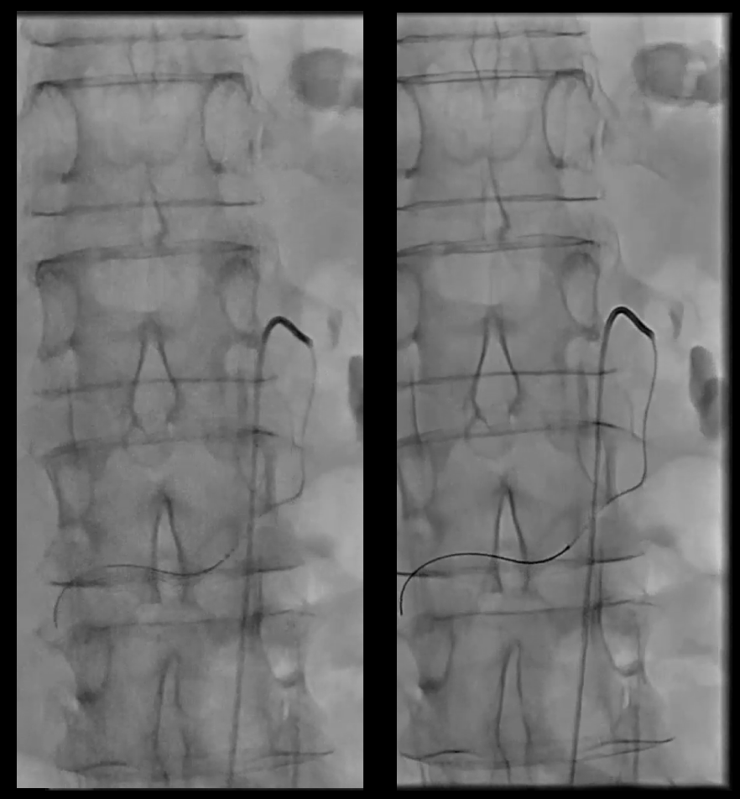
OPTIQ AI
Clinical Case Collection
Interventional Radiology
without OPTIQ AI
with OPTIQ AI

Slide 2
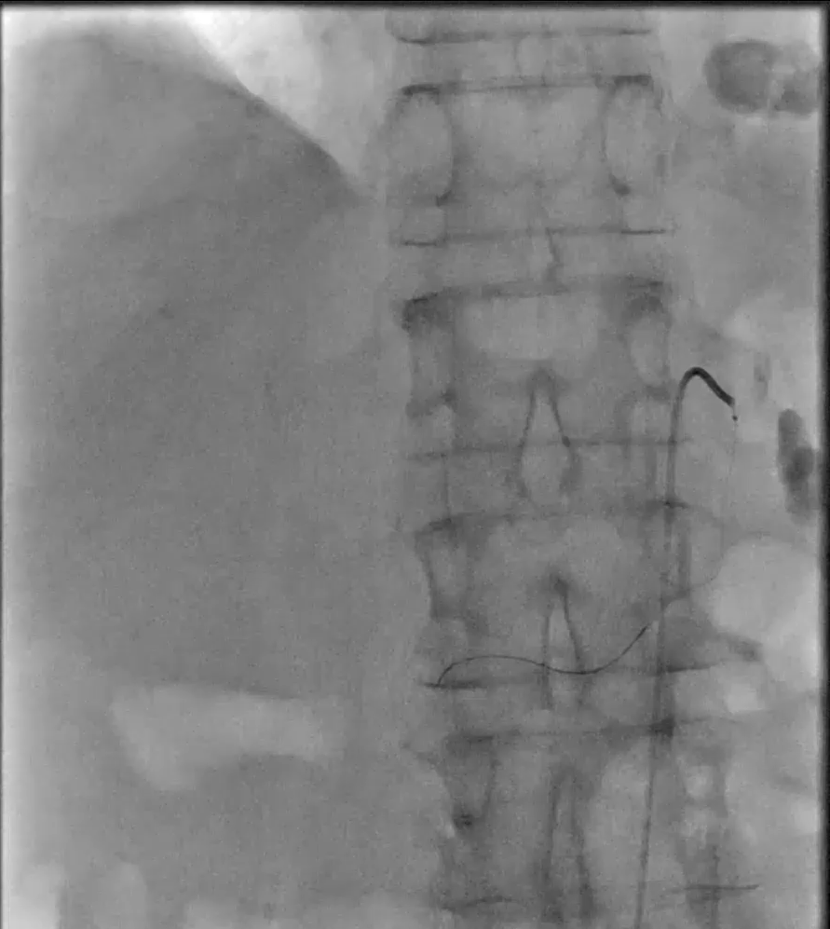

OPTIQ AI in Interventional Radiology
Selective internal radiotherapy (SIRT)
Fluoroscopy without OPTIQ AI
Fluoroscopy with OPTIQ AI
Courtesy of Prof. Bernhard Meyer, MD, Hanover Medical School, Hanover, Germany
Gigalix imaging chain
Advanced Therapies I AT-26-063
Notes:
Case 2208
Case 2208

Slide 3
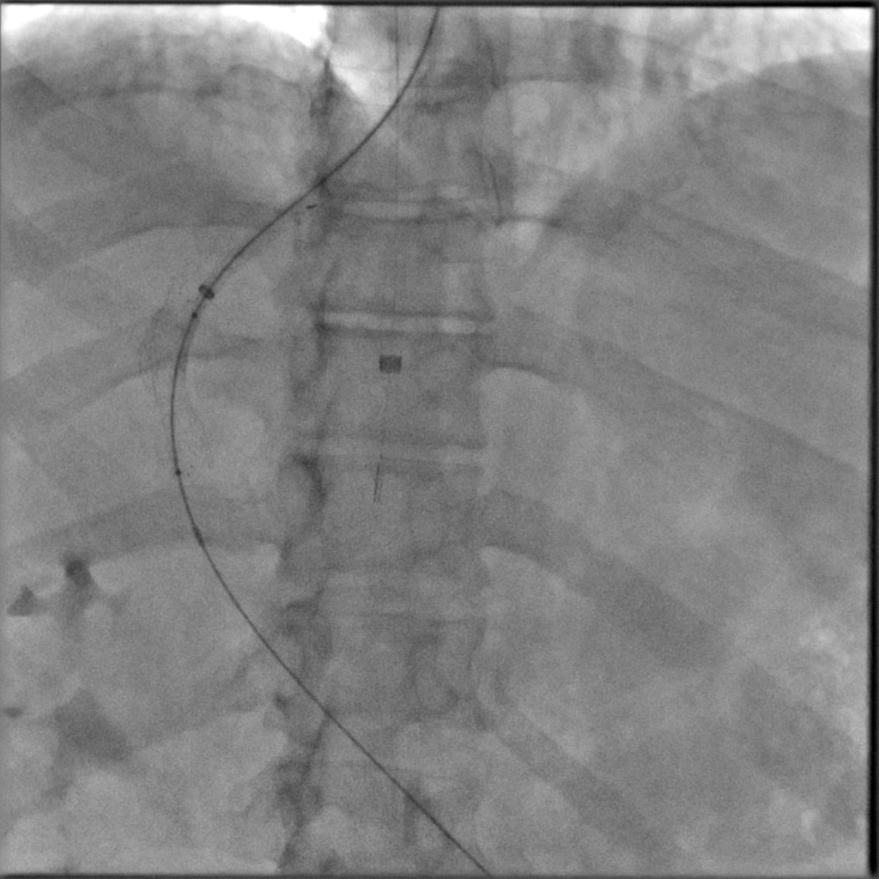

OPTIQ AI in Interventional Radiology
Transjugular intrahepatic portosystemic shunt (TIPS)
Fluoroscopy without OPTIQ AI
Fluoroscopy with OPTIQ AI
Courtesy of Prof. Bernhard Meyer, MD, Hanover Medical School, Hanover, Germany
Gigalix imaging chain
Advanced Therapies I AT-26-063
Notes:
Case 2828

Slide 4
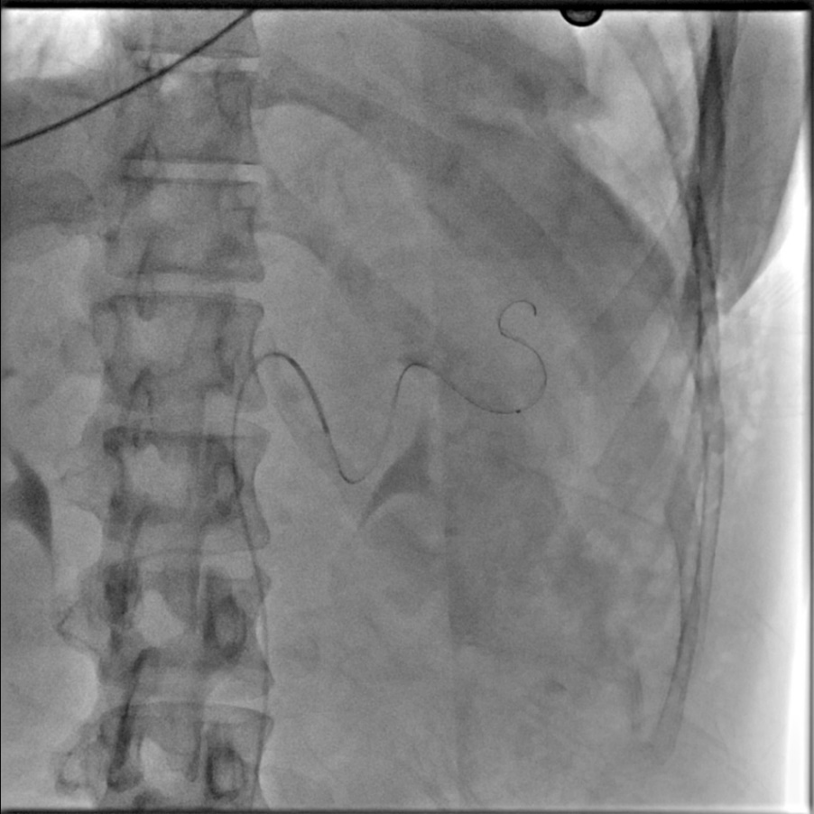

OPTIQ AI in Interventional Radiology
Splenic artery embolization
Fluoroscopy without OPTIQ AI
Fluoroscopy with OPTIQ AI
Clinical Info
Microcatheter
BMI<30
Courtesy of UnityPoint Health Iowa Methodist Medical Center, Des Moines, IA, USA
Gigalix imaging chain
Advanced Therapies I AT-26-063
Notes:
Case 1691

Slide 5
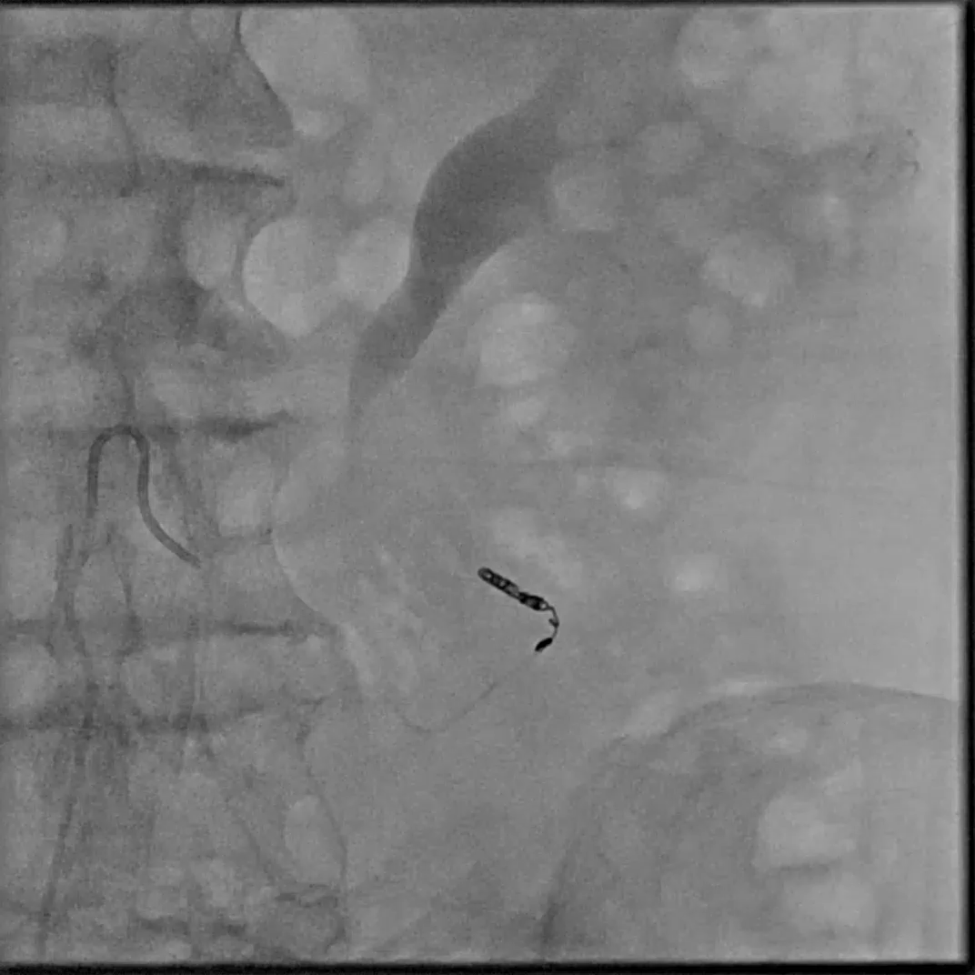

OPTIQ AI in Interventional Radiology
Gastrointestinal bleeding embolization
Fluoroscopy without OPTIQ AI
Fluoroscopy with OPTIQ AI
Clinical Info
Microcatheter
BMI<30
Courtesy of St Luke's University Hospital (Monroe Campus), Stroudsburg, PA, USA
Gigalix imaging chain
Advanced Therapies I AT-26-063
Notes:
Case 2289

Slide 6
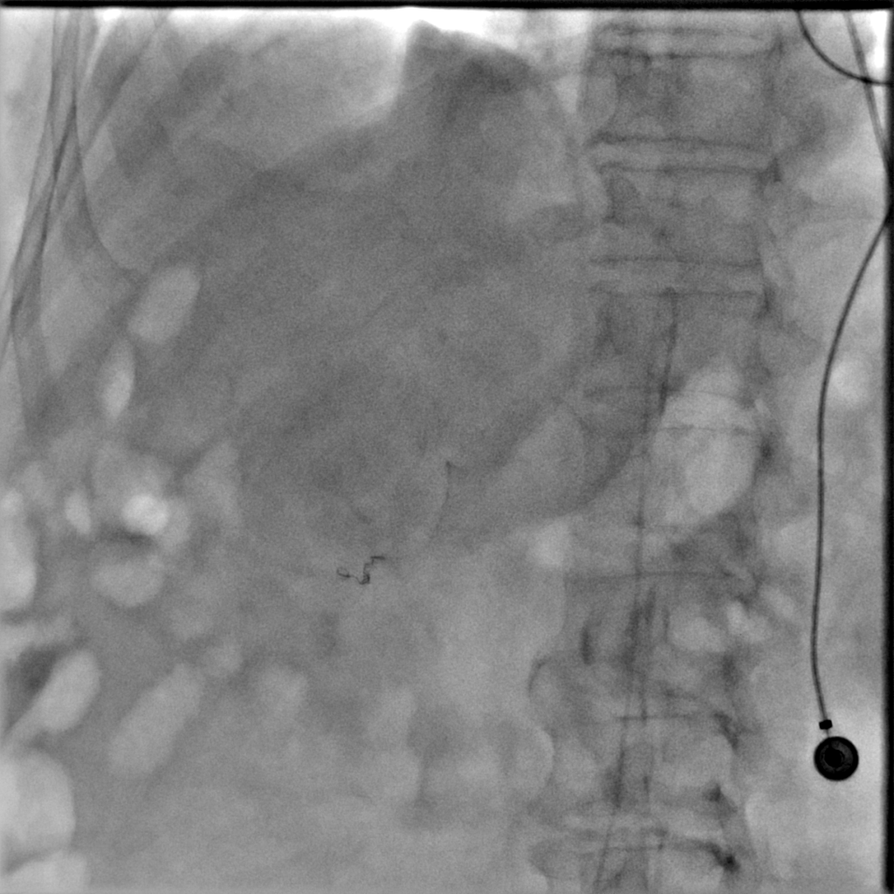
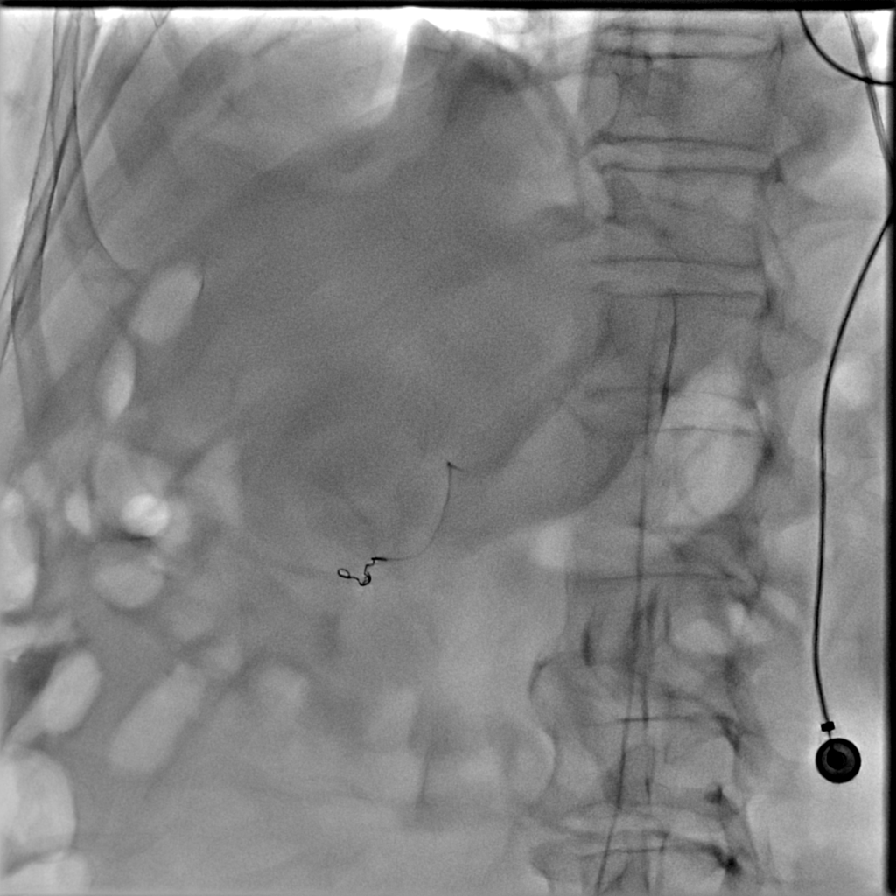
OPTIQ AI in Interventional Radiology
Renal artery embolization
Fluoroscopy without OPTIQ AI
Fluoroscopy with OPTIQ AI
Clinical Info
Microcatheter
BMI<30
Courtesy of UnityPoint Health Iowa Methodist Medical Center, Des Moines, IA, USA
Gigalix imaging chain
Advanced Therapies I AT-26-063
Notes:
Case 2840

Slide 7
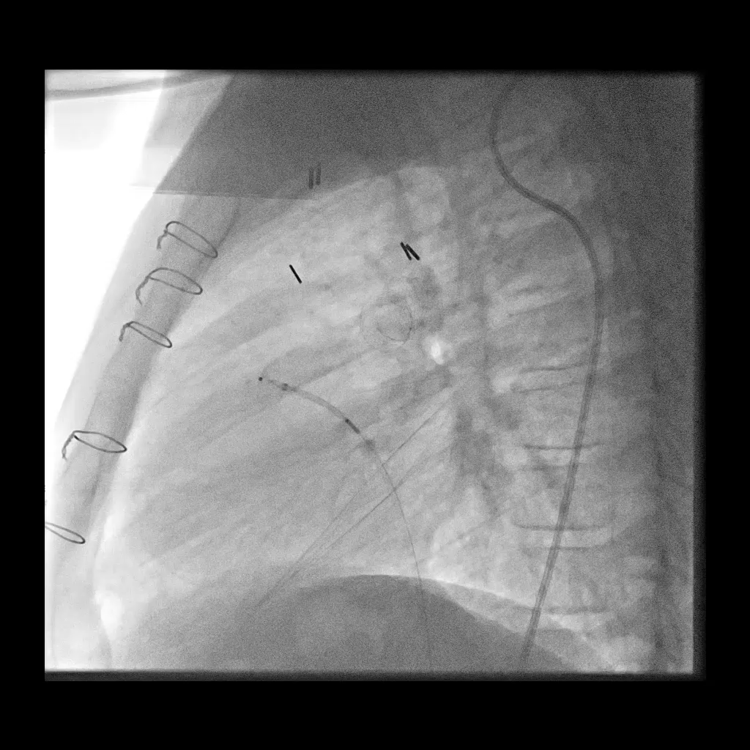
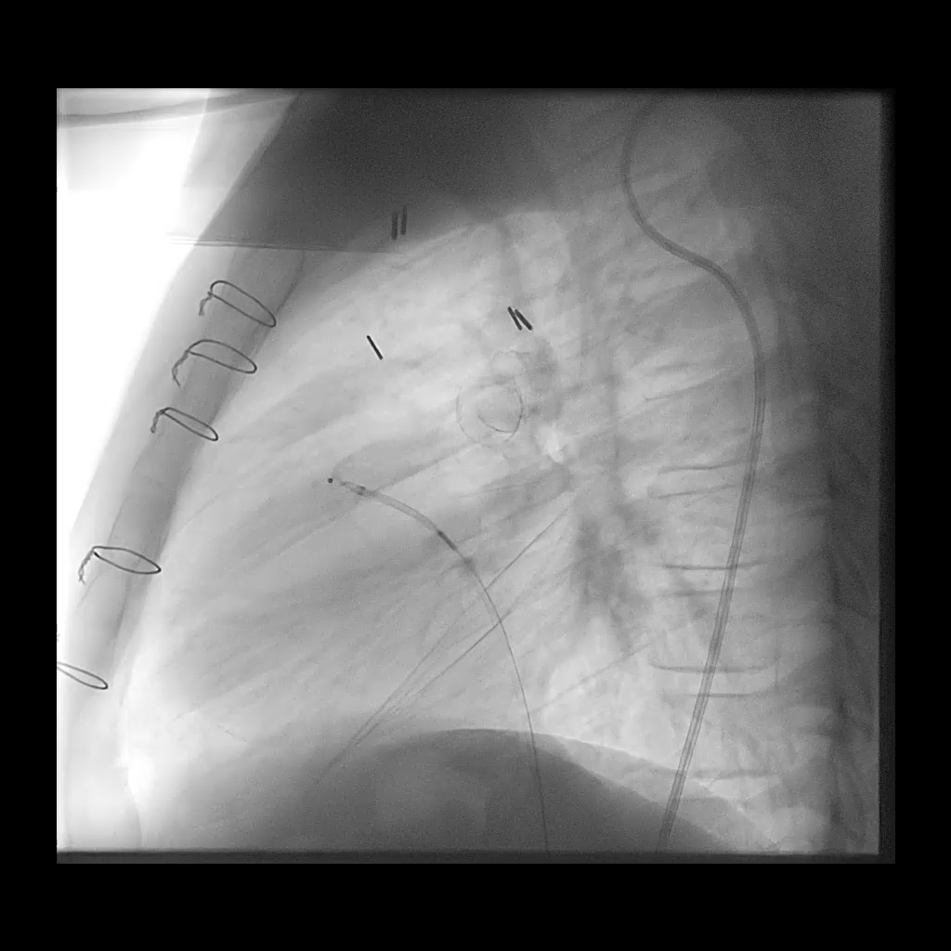
OPTIQ AI in Interventional Radiology
Aortic artery intervention (AS,CoA)
Fluoroscopy without OPTIQ AI
Fluoroscopy with OPTIQ AI
Clinical Info
Pediatrics 2-11y of age
Stent graft, septal occluder
BMI<30
Courtesy of Arkansas Children`s Hospital, USA
Gigalix imaging chain
Advanced Therapies I AT-26-063
Notes:
Case 2649

Slide 8
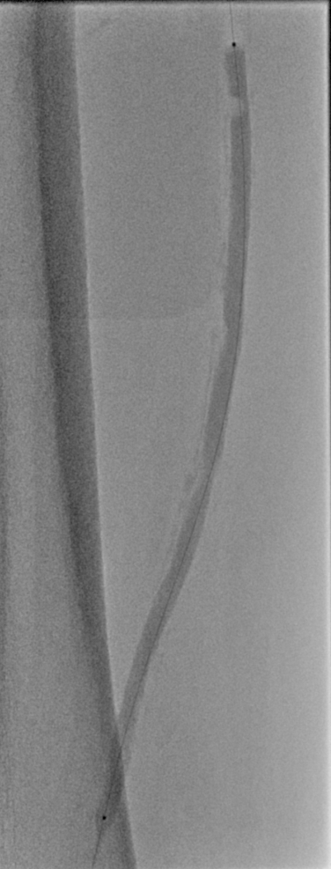
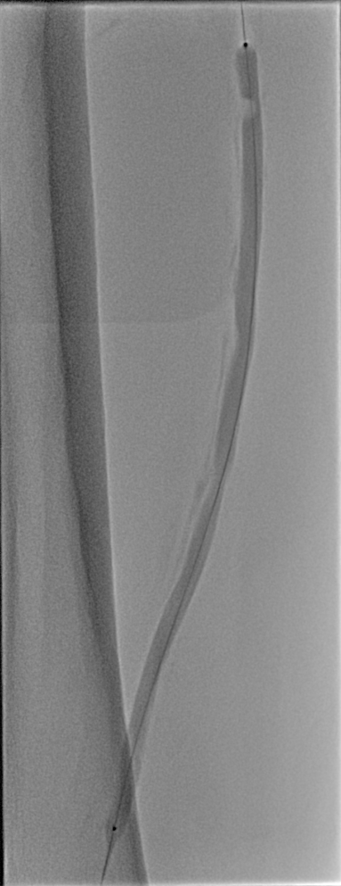
OPTIQ AI in Interventional Radiology
Percutaneous transluminal angioplasty (PTA)
Fluoroscopy without OPTIQ AI
Fluoroscopy with OPTIQ AI
Clinical Info
Atherectomy, Angioplasty
Balloon catheter
BMI<30
Courtesy of Sorin Medical, USA
Gigalix imaging chain
Advanced Therapies I AT-26-063
Notes:
Case 3938

Slide 9
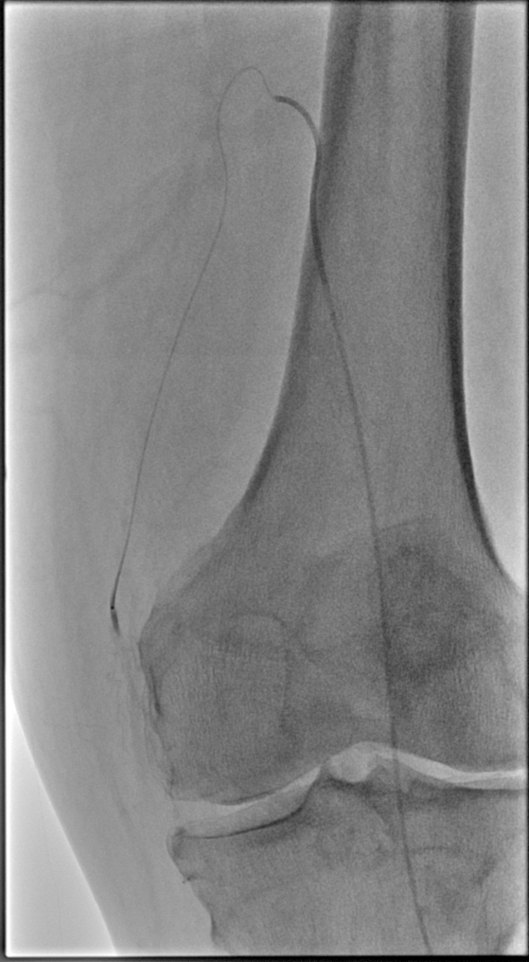

OPTIQ AI in Interventional Radiology
Genicular Artery Embolization (GAE)
Fluoroscopy without OPTIQ AI
Fluoroscopy with OPTIQ AI
Clinical Info
Microcatheter
BMI<30
Courtesy of Sorin Medical, USA
Gigalix imaging chain
Advanced Therapies I AT-26-063
Notes:
Case 4863

Slide 10
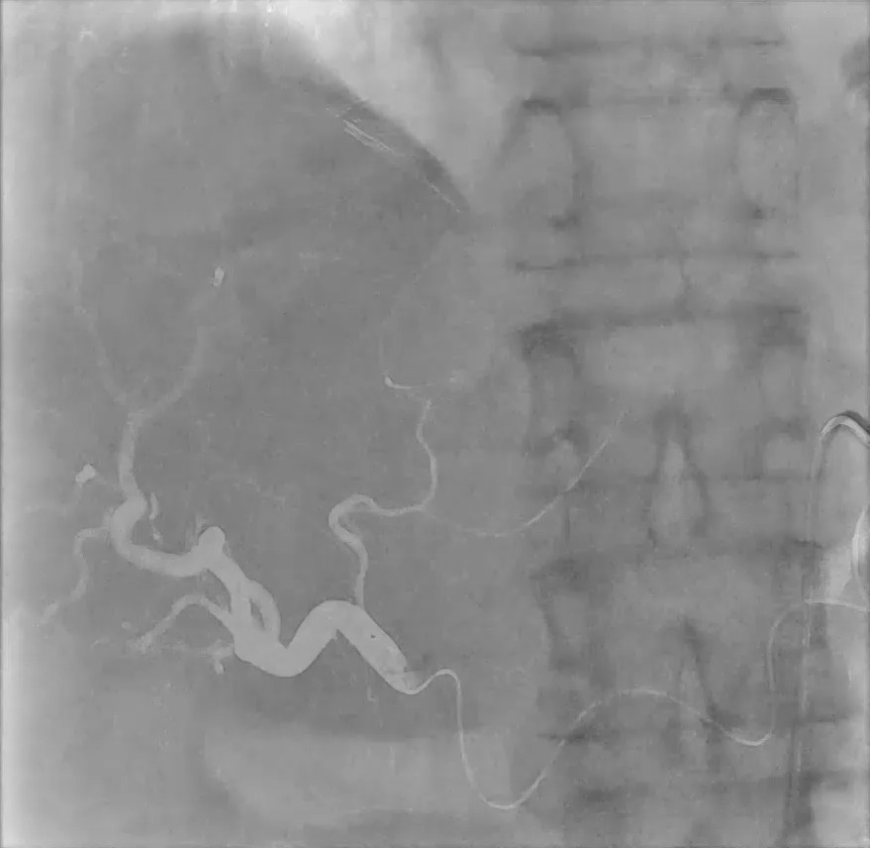
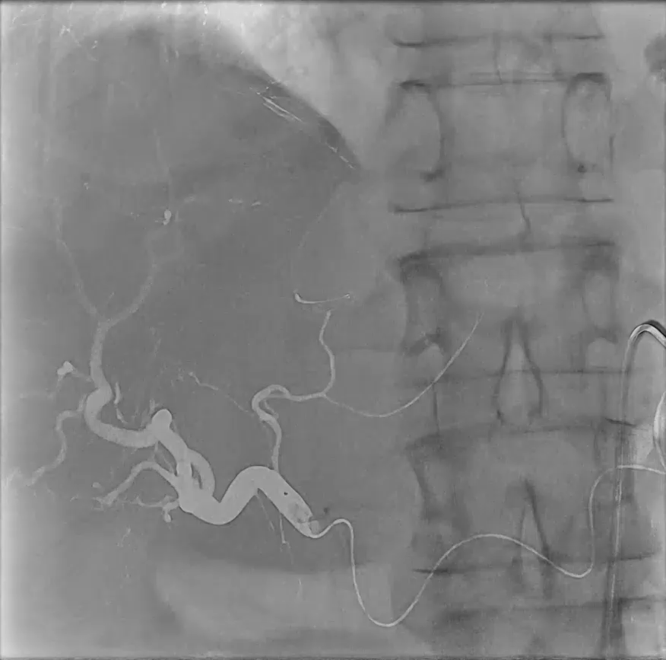
OPTIQ AI in Interventional Radiology
Selective internal radiotherapy (SIRT)
Overlay Ref without OPTIQ AI
Overlay Ref with OPTIQ AI
Courtesy of Prof. Bernhard Meyer, MD, Hanover Medical School, Hanover, Germany
Gigalix imaging chain
Advanced Therapies I AT-26-063

Slide 11
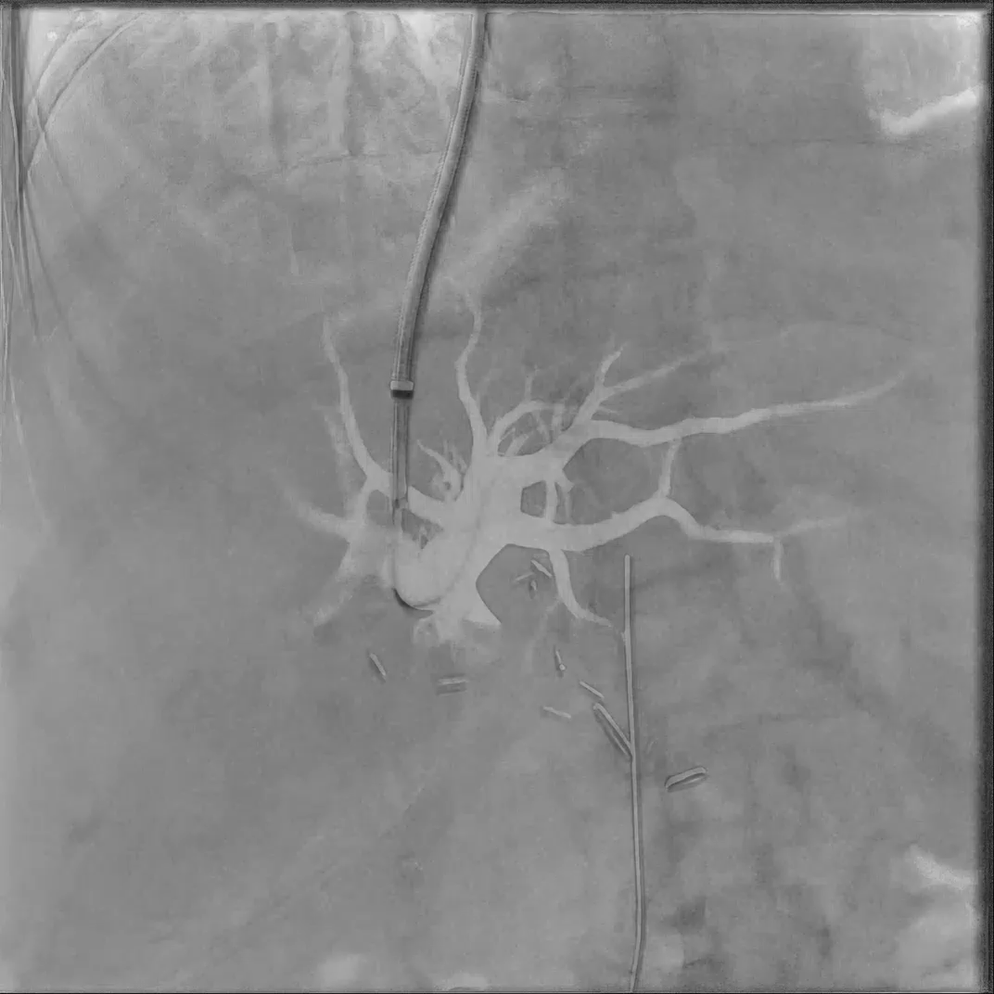
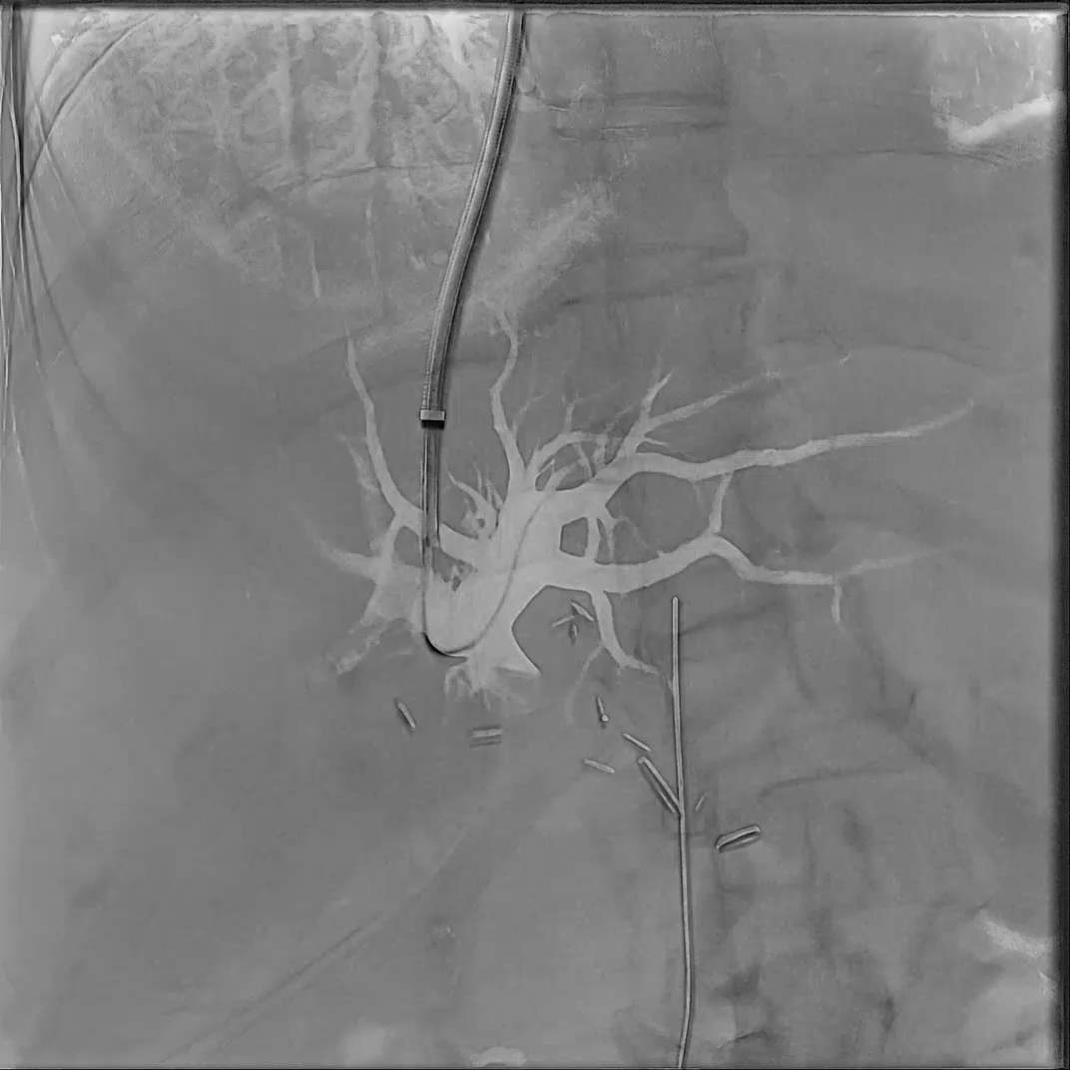
OPTIQ AI in Interventional Radiology
Transjugular intrahepatic portosystemic shunt (TIPS)
Overlay Ref without OPTIQ AI
Overlay Ref with OPTIQ AI
Courtesy of UnityPoint Health Iowa Methodist Medical Center, Des Moines, IA, USA
Gigalix imaging chain
Advanced Therapies I AT-26-063
Notes:
2116 UnityPoint Health Iowa Methodist Medical Center

Slide 12
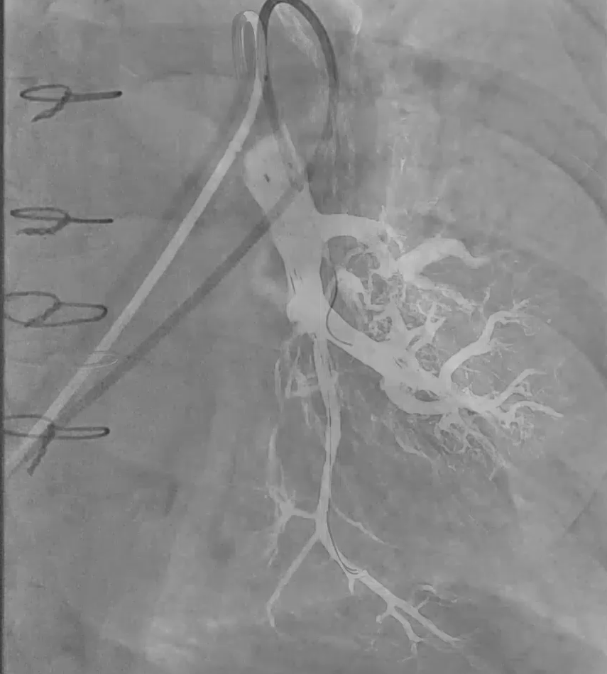
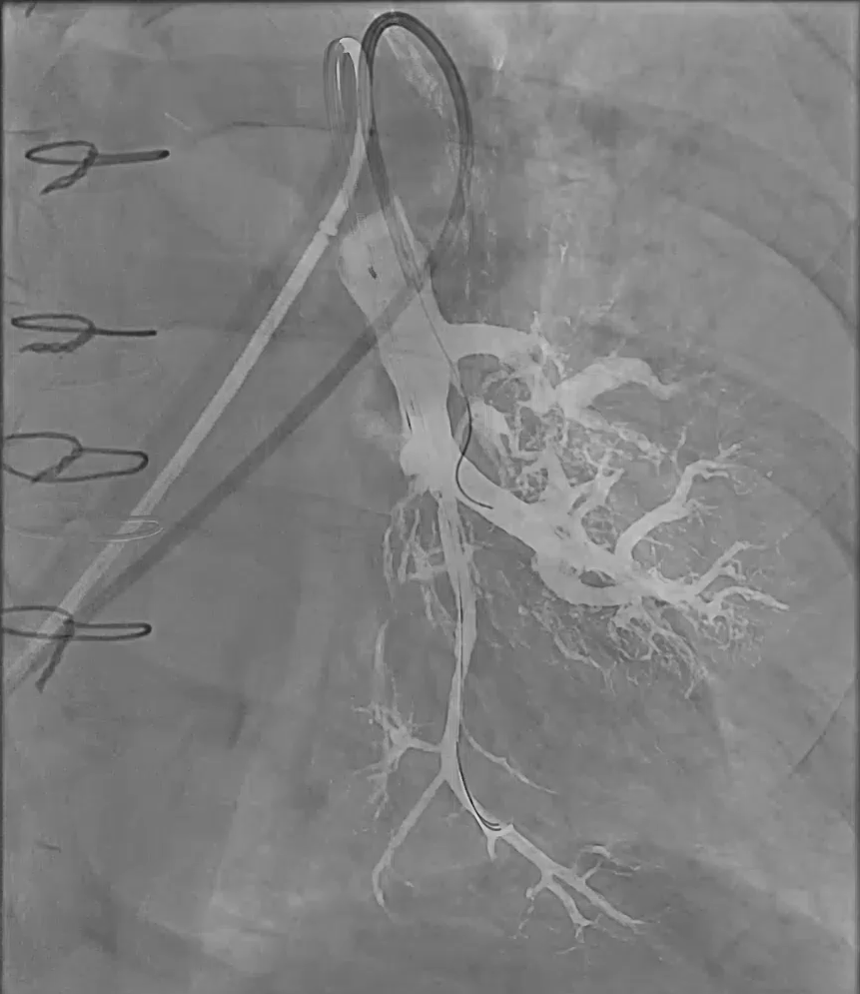
OPTIQ AI in Interventional Radiology
Chronic thromboembolic pulmonary hypertension (CTEPH)
Overlay Ref without OPTIQ AI
Overlay Ref with OPTIQ AI
Courtesy of Prof. Bernhard Meyer, MD, Hanover Medical School, Hanover, Germany
Gigalix imaging chain
Advanced Therapies I AT-26-063
Notes:
Scene 6 MHH

Slide 13
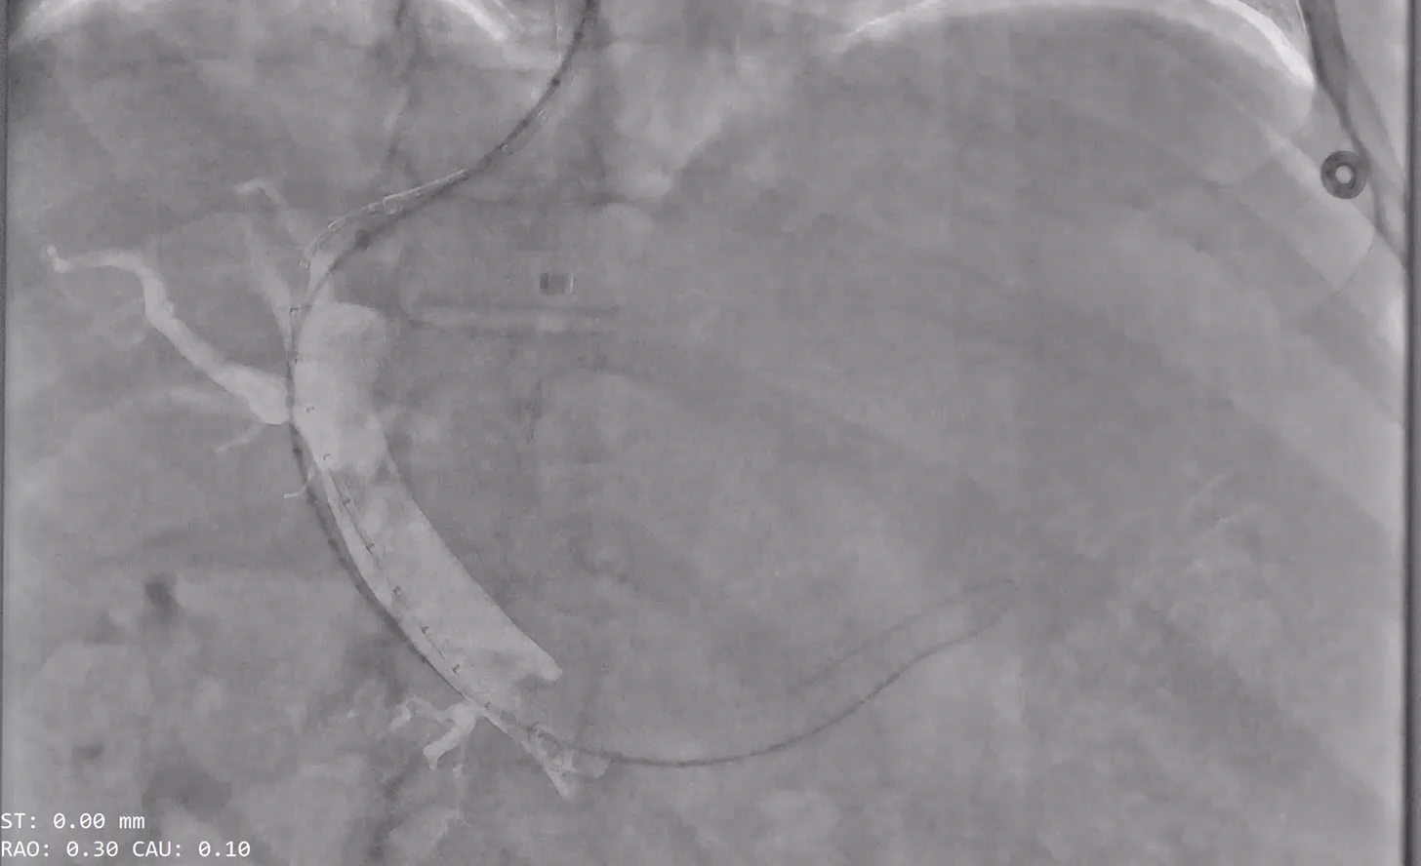
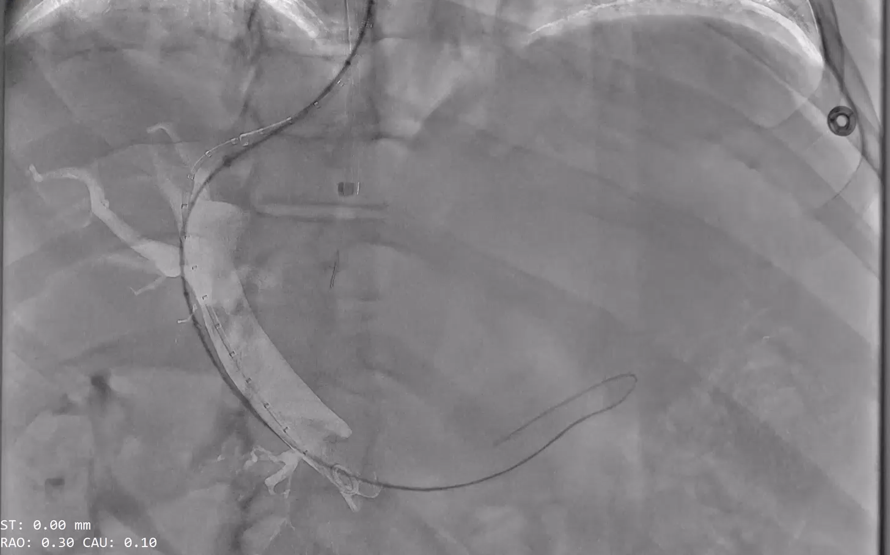
OPTIQ AI in Interventional Radiology
Transjugular intrahepatic portosystemic shunt (TIPS)
Overlay Ref without OPTIQ AI
Overlay Ref with OPTIQ AI
Courtesy of UnityPoint Health Iowa Methodist Medical Center, Des Moines, IA, USA
Gigalix imaging chain
Advanced Therapies I AT-26-063

Slide 14
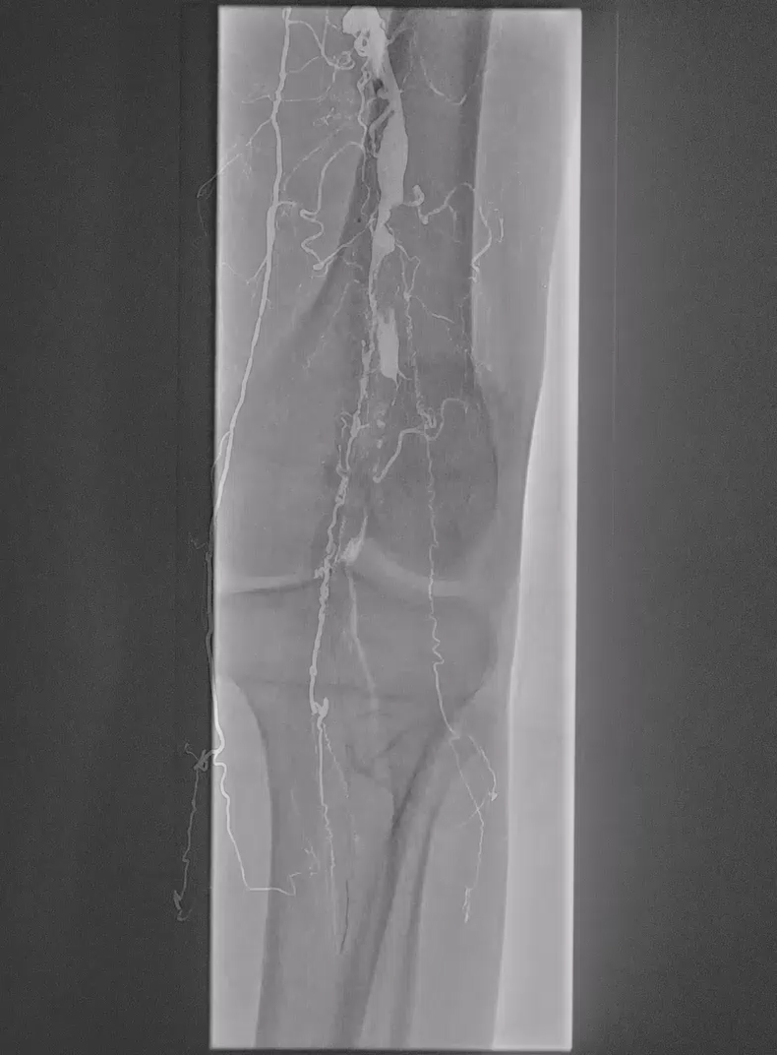
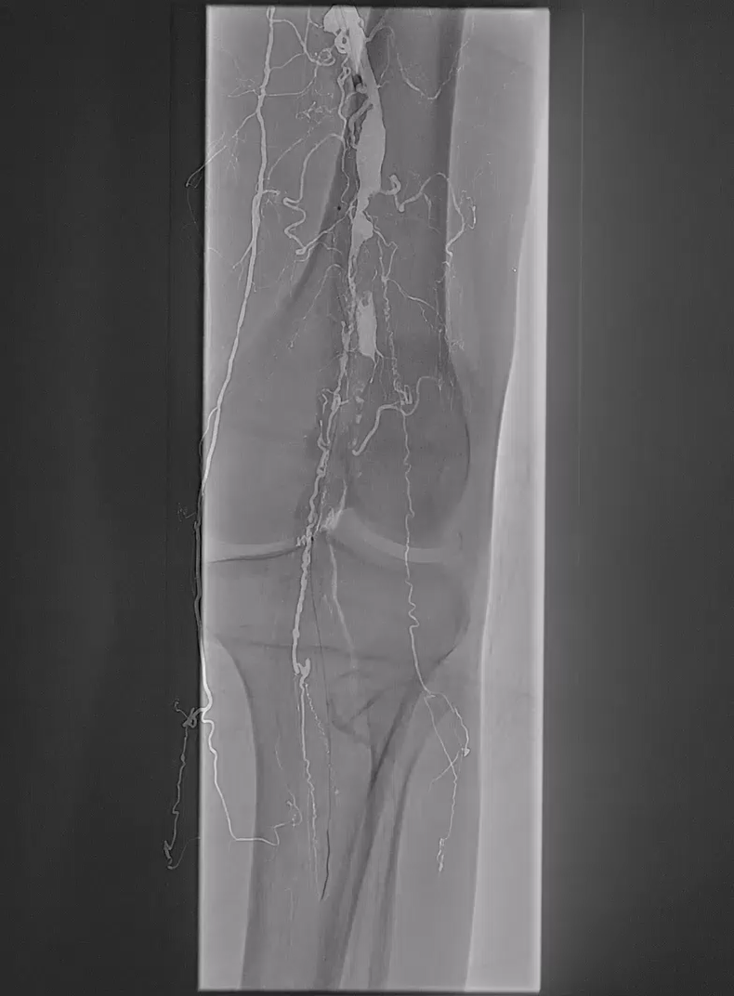
OPTIQ AI in Interventional Radiology
Percutaneous transluminal angioplasty (PTA) / stenting
Overlay Ref without OPTIQ AI
Overlay Ref with OPTIQ AI
Courtesy of St Luke's University Hospital (Monroe Campus), Stroudsburg, PA, USA
Gigalix imaging chain
Advanced Therapies I AT-26-063
Notes:
Case1_Chemo DSA Sc 21
ANGULATION: 0° / 0°
PLANE: A
PATIENT SEX: F
PATIENT WEIGHT: 0.0 kg - 0.0 lb
PATIENT HEIGHT: 0.0 cm - 0 ft / 0 in
II SIZE: 22.0 cm
emo DSA Sc 21 AIN

Slide 15
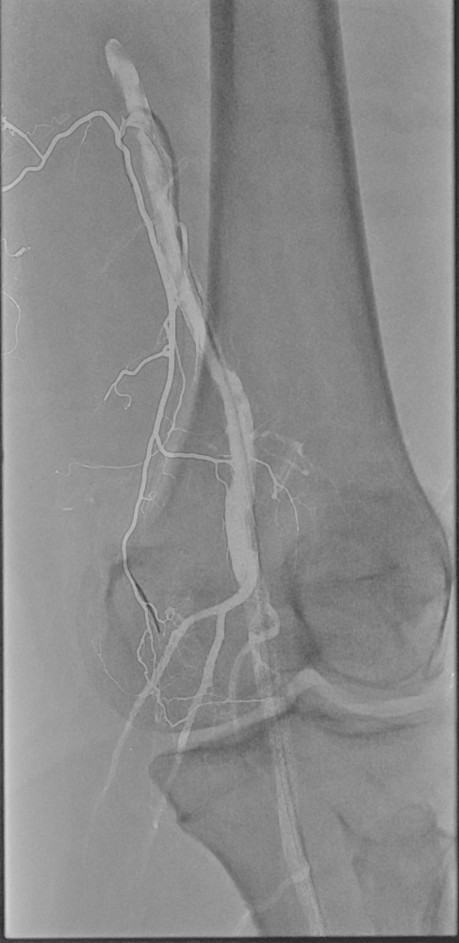

OPTIQ AI in Interventional Radiology
Genicular Artery Embolization (GAE)
Overlay Ref without OPTIQ AI
Overlay Ref with OPTIQ AI
Clinical Info
Microcatheter + Guidecatheter
BMI<30
Courtesy of Sorin Medical, USA
Gigalix imaging chain
Advanced Therapies I AT-26-063

Slide 16
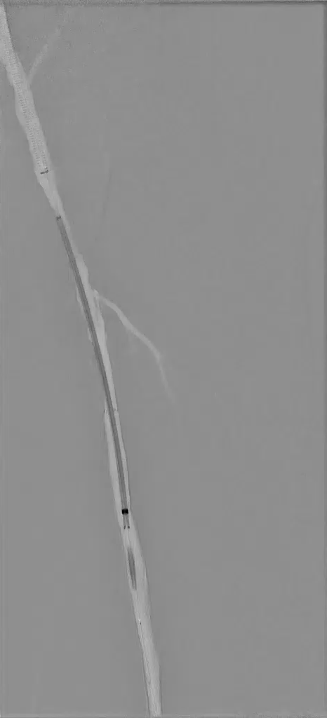
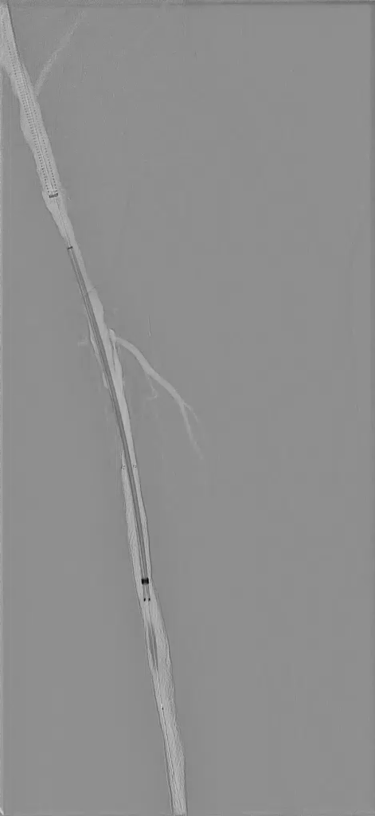
OPTIQ AI in Interventional Radiology
Percutaneous transluminal angioplasty (PTA) / stenting
Overlay Ref without OPTIQ AI
Overlay Ref with OPTIQ AI
Clinical Info
Bare metal stent
BMI<30
Courtesy of St Luke's University Hospital (Monroe Campus), Stroudsburg, PA, USA
Gigalix imaging chain
Advanced Therapies I AT-26-063

Slide 17
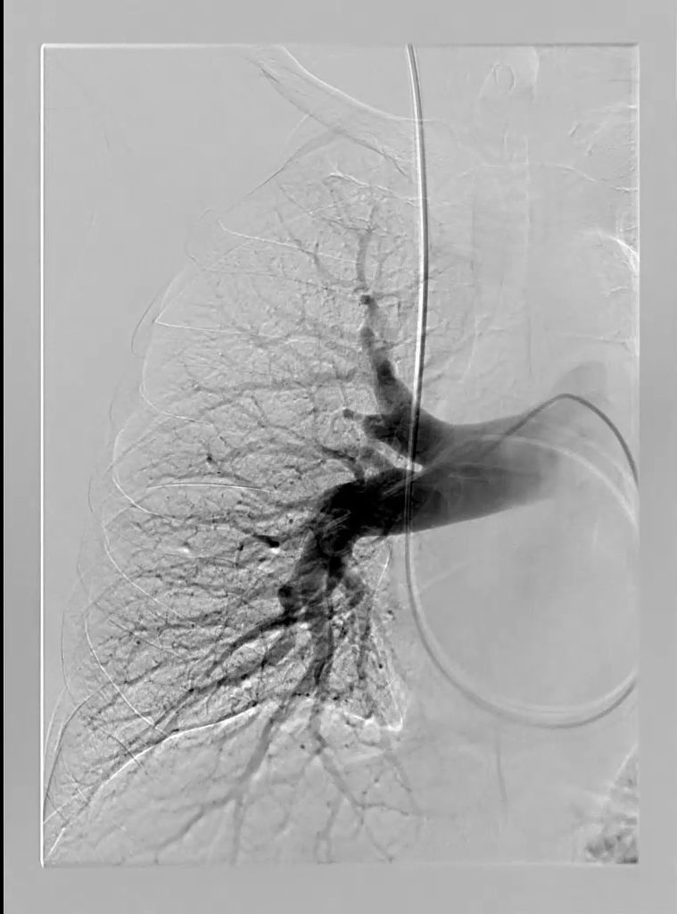
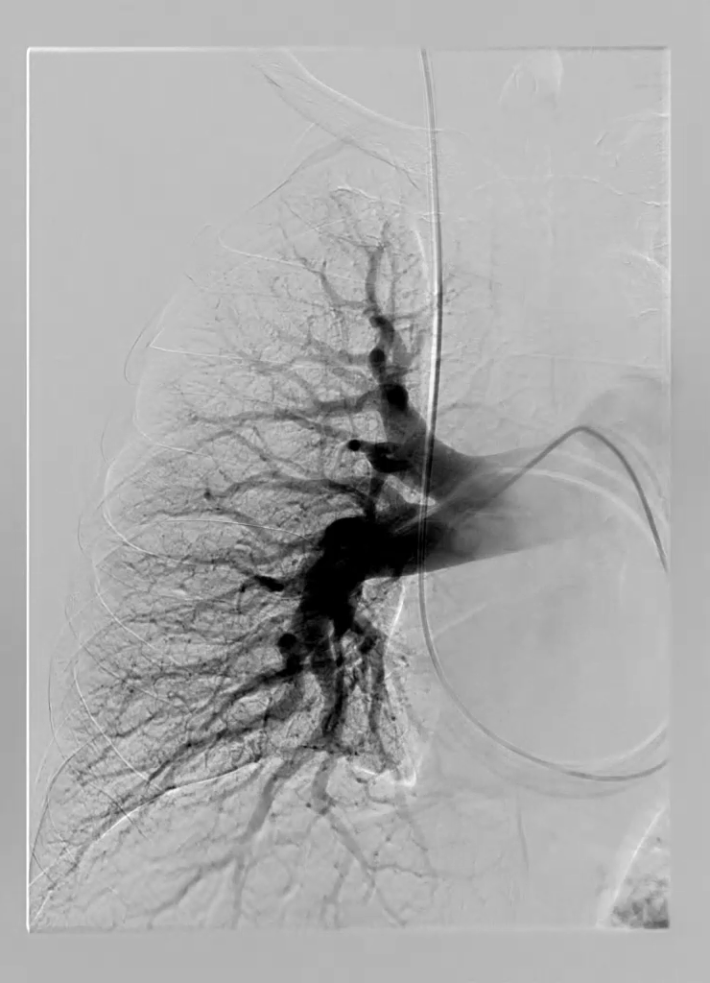
OPTIQ AI in Interventional Radiology
Chronic thromboembolic pulmonary hypertension (CTEPH)
DSA without OPTIQ AI
DSA with OPTIQ AI
Courtesy of Prof. Bernhard Meyer, MD, Hanover Medical School, Hanover, Germany
Gigalix imaging chain
Advanced Therapies I AT-26-063
Notes:
Cases 3 MHH

Slide 18
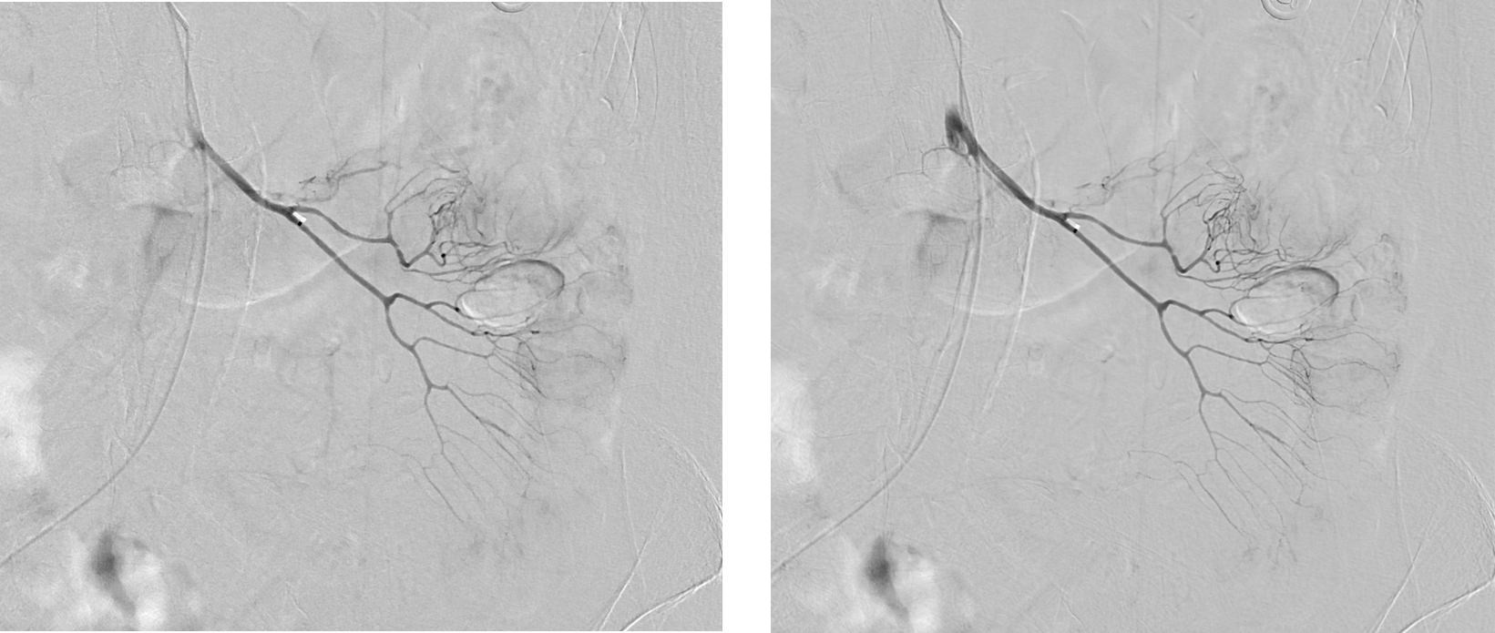
OPTIQ AI in Interventional Radiology
Gastrointestinal bleeding embolization
DSA without OPTIQ AI
DSA with OPTIQ AI
Clinical Info
BMI<30
Courtesy of UnityPoint Health Iowa Methodist Medical Center, Des Moines, IA, USA
Gigalix imaging chain
Advanced Therapies I AT-26-063
Notes:
Case 4264

Slide 19
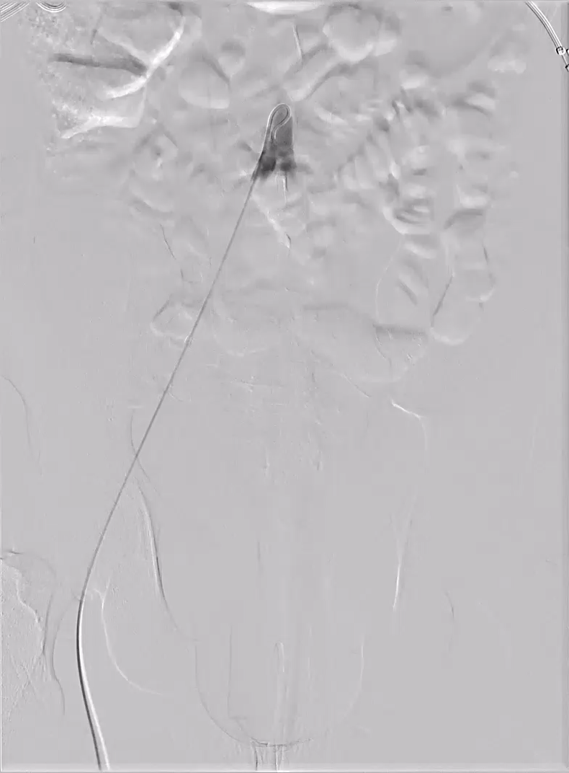
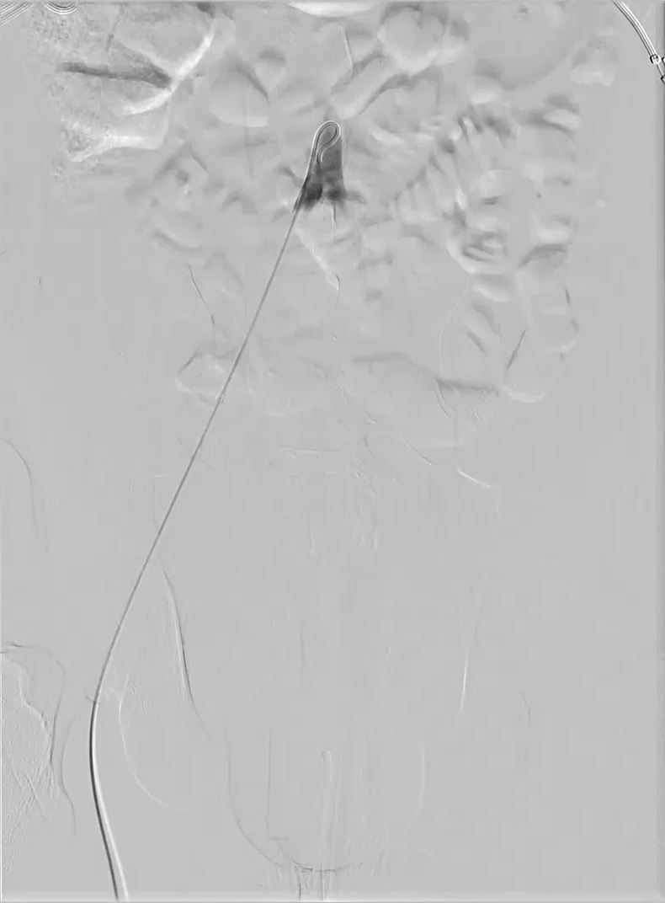
OPTIQ AI in Interventional Radiology
Prostate artery embolization
DSA without OPTIQ AI
DSA with OPTIQ AI
Clinical Info
Pigtail catheter
BMI<30
Courtesy of UnityPoint Health Iowa Methodist Medical Center, Des Moines, IA, USA
Gigalix imaging chain
Advanced Therapies I AT-26-063
Notes:
UPH 4938

Slide 20
Thank you for your enthusiasm!
  Siemens Healthineers Headquarters
  Siemens Healthineers AG
  Siemensstr. 3
  91301 Forchheim
  Germany
  Phone: +49 9191 18-0
  siemens-healthineers.com
On account of certain regional limitations of sales rights and service availability, we cannot guarantee that all products included in this presentation are available through the Siemens sales organization worldwide. Availability and packaging may vary by country and are subject to change without prior notice.

