Slide 1
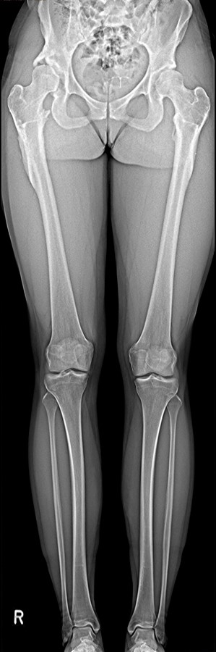
Balancing image precision and radiation dose
Multitom Rax True2scale Body Scan¹ clinical case
Orthopedic Hospital Schloss Werneck, Germany
StudyID: 5aag673
1 Option

Slide 2
Background
Total hip arthroplasty (THA)
Gold-Standard procedure to plan THA¹
X-ray image acquisition: Pelvis overview
      Lying or weight-bearing (optimal)
      Acquired in a.P. or including a second view lat.
Measurements to plan THA (incl. resulting leg-length)
1
      Reference line within the pelvis,
      e.g., at the pelvic teardrop
2
      Parallel to the reference line, a second line is placed
      at the femoral bone, e.g., at the greater trochanter
3
      If the parallel line does not align with both reference points,
      the parallel difference is set equal to the leg-length discrepancy
2
3
Disadvantages
      Only indirect measurement of leg-length possible
      (true length only measurable with whole leg image)
      If additional CT acquisition is done (i.e., for 3D preoperative planning),
      patient is not in weight-bearing position
1
The products/features (mentioned herein) are not commercially available in all countries.
Their future availability cannot be guaranteed. | 1 THA: total hip arthroplasty

Slide 3
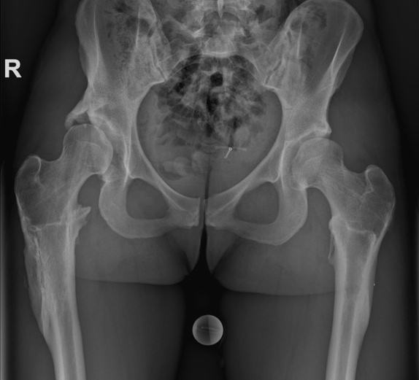
Clinical background
Patient
Sex
Female
Year of birth
1993
BMI
25.7 kg/m²
StudyID: 5aag672
Anamnesis
Status post corrective osteotomies on both sides due to known bilateral hip dysplasia. Severe pain and restricted mobility caused a reduced ability to work.
Surgery necessary on both sides, right first.
The products/features (mentioned herein) are not commercially available in all countries.
Their future availability cannot be guaranteed.

Slide 4
Clinical background and indication for Multitom Rax True2scale Body Scan¹
Patient
Sex
Female
Year of birth
1993
BMI
25.7 kg/m²
Anamnesis
Status post corrective osteotomies on both sides due to known bilateral hip dysplasia. Severe pain and restricted mobility caused a reduced ability to work.
Surgery necessary on both sides, right first.
Indication for True2scale Body Scan¹
Due to the high life expectancy (age 32), special precision is required in surgical care. Additionally, due to the previous diagnoses, the patient's body has already been regularly exposed to x-rays. Therefore, with every following examination, it is important to keep radiation exposure as low as possible.
The products/features (mentioned herein) are not commercially available in all countries.
Their future availability cannot be guaranteed. | 1 Option

Slide 5
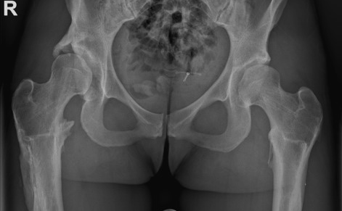
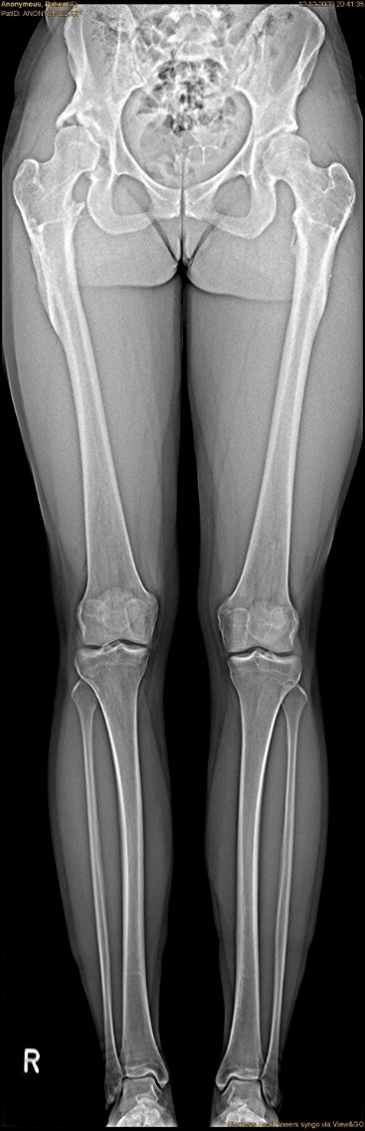
Multitom Rax True2scale Body Scan¹
Differences Pelvis Overview vs. T2S¹
True2scale Body Scan¹
a.p. using upright S protocol
StudyID: 5aag672
StudyID: 5aag673
Leg-length discrepancy | 2 mm
Scan range | 95.1 cm
Scan time | 11.9 sec
Tube voltage | 81 kV
Current time product | 101 mAs
Dose area product | 17.2 µGy⋅m²
4 mm
2 mm
Gold-standard
Pelvis overview
Leg-length discrepancy | 4 mm
Tube voltage | 84.4 kV
Current time product | 25 mAs
Dose area product | 79.1 µGy⋅m²
The products/features (mentioned herein) are not commercially available in all countries.
Their future availability cannot be guaranteed. | 1 Option

Slide 6

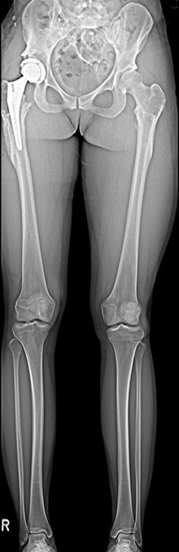
Multitom Rax True2scale Body Scan¹
Diagnostic Findings & Results
Results
With the True2scale Body Scan¹ it was demonstrated that the combination of precision and radiation protection (a factor of 4 – 5 less radiation exposure when imaging the entire lower half of the body compared to pelvis overview) is not mutually exclusive.
StudyID: 5aag673
StudyID: 5aag671
Follow-up scan after revision
Uncomplicated surgical course with enough space
(9 mm) for second implant on left side.
Pre-surgery
Post-surgery
The products/features (mentioned herein) are not commercially available in all countries.
Their future availability cannot be guaranteed. | 1 Option

Slide 7
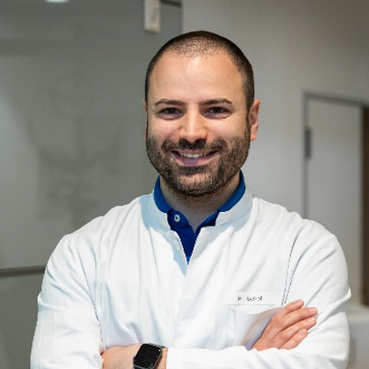
“The T2S scan easily manages
to image entire body regions
while exposing the patient to
only a fraction of the radiation
of previous methods.“¹
Manuel Scholl, MD
Orthopedic Hospital Schloss Werneck, Germany
1 The statements by Siemens Healthineers customers described herein are based on results that were achieved in the customer’s unique setting. Since there is no “typical” hospital and many variables exist (e.g., hospital size, case mix, level of IT adoption) there can be no guarantee that other customers will achieve the same results.

Slide 8
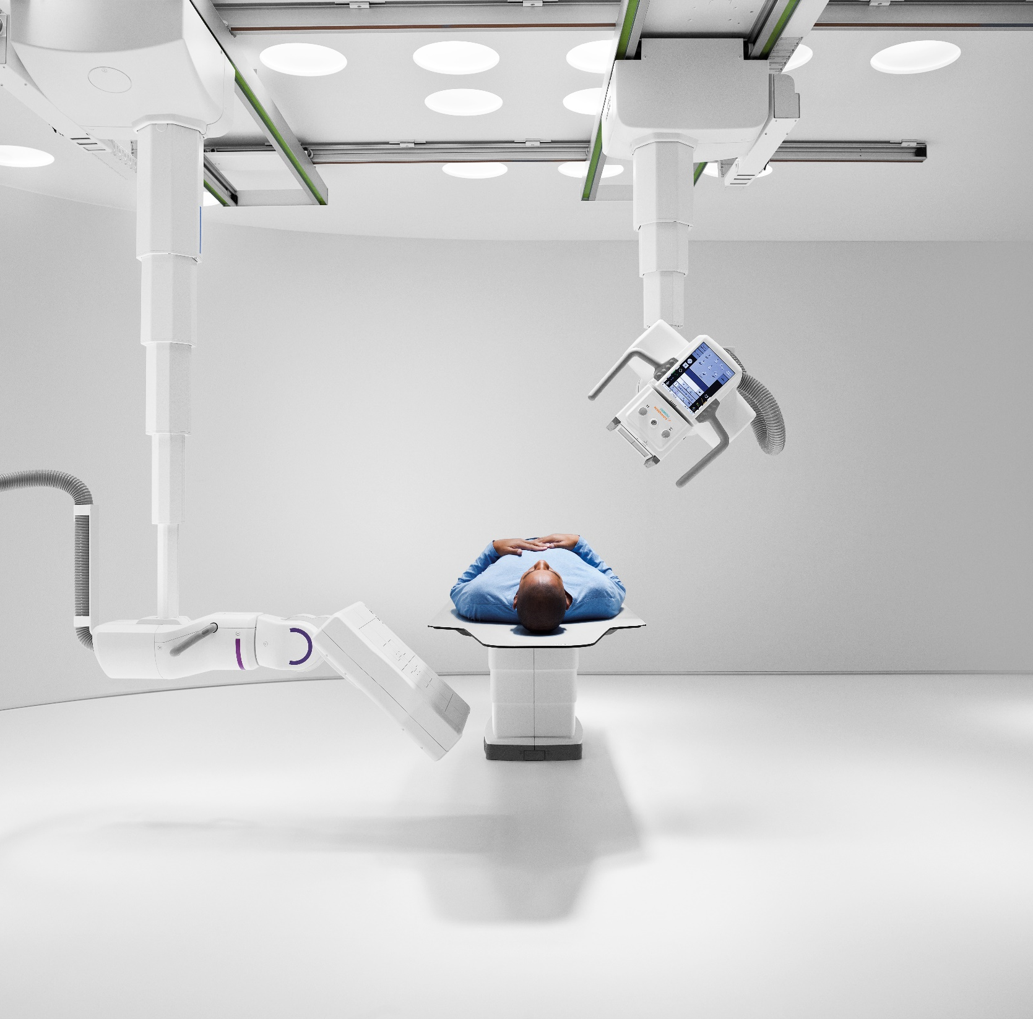
The products/features (mentioned herein) are not commercially available in all countries. Their future availability cannot
be guaranteed. True2scale Body Scan
is an option.
Results from case studies are not predictive of results in other cases. Results in other cases may vary.
Manuel Scholl is employed by an institution that receives financial support from Siemens Healthineers for collaborations.

