Slide 1
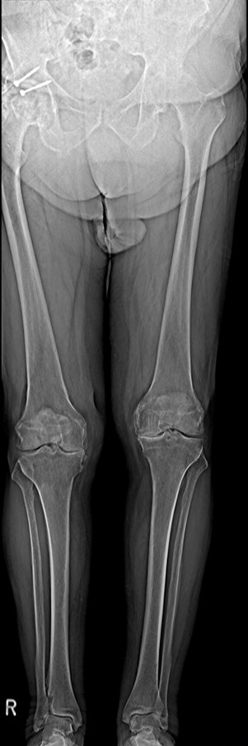
Restricted view of overall anatomy
Multitom Rax True2scale Body Scan¹ clinical case
Orthopedic Hospital Schloss Werneck, Germany
StudyID: 5aag667
1 Option

Slide 2
Background
Total hip arthroplasty (THA)
Gold-Standard procedure to plan THA¹
X-ray image acquisition: Pelvis overview
      Lying or weight-bearing (optimal)
      Acquired in a.P. Or including a second view lat.
Measurements to plan THA (incl. resulting leg-length)
1
      Reference line within the pelvis,
      e.g., at the pelvic teardrop
2
      Parallel to the reference line, a second line is placed
      at the femoral bone, e.g., at the greater trochanter
3
      If the parallel line does not align with both reference points,
      the parallel difference is set equal to the leg-length discrepancy
2
3
Disadvantages
      Only indirect measurement of leg length possible
      (true length only measurable with whole leg image)
      If additional CT acquisition is done (i.e., for 3D preoperative planning),
      patient is not in weight-bearing position
1
The products/features (mentioned herein) are not commercially available in all countries.
Their future availability cannot be guaranteed. | 1 THA: total hip arthroplasty

Slide 3
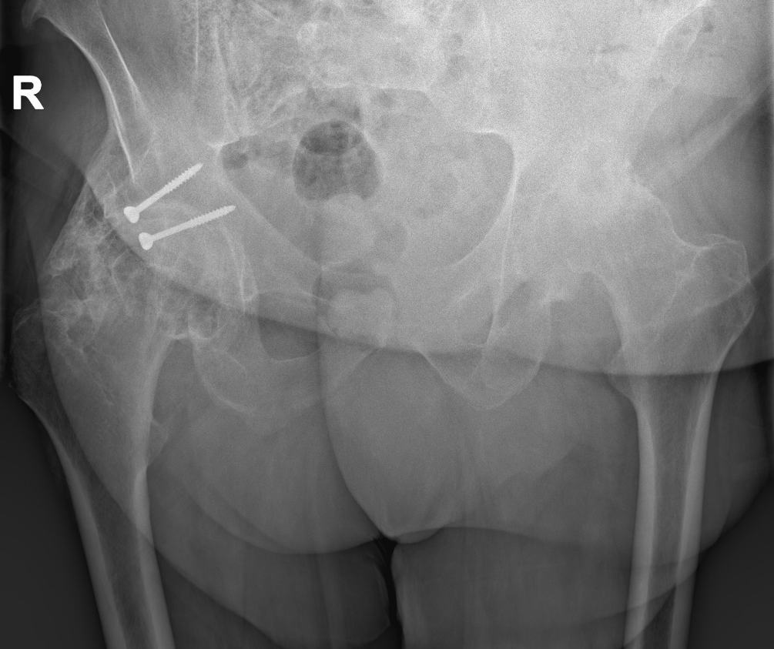
Clinical background
Patient
Sex
Male
Year of birth
1948
BMI
44.1 kg/m²
StudyID: 5aag668
Anamnesis
Status post a traffic accident in 1983 with a screwed acetabular fracture,
severe bilateral coxarthrosis, leg-length discrepancy, and pronounced
flexion contracture of the right hip with a forward-bent upper body.
Tape measure suggests a leg-length discrepancy of 3 cm.
The cause of the leg-length discrepancy cannot be definitively
assigned to one side due to the degree of destruction of both hips.
The products/features (mentioned herein) are not commercially available in all countries.
Their future availability cannot be guaranteed. | 1 THA: total hip arthroplasty

Slide 4
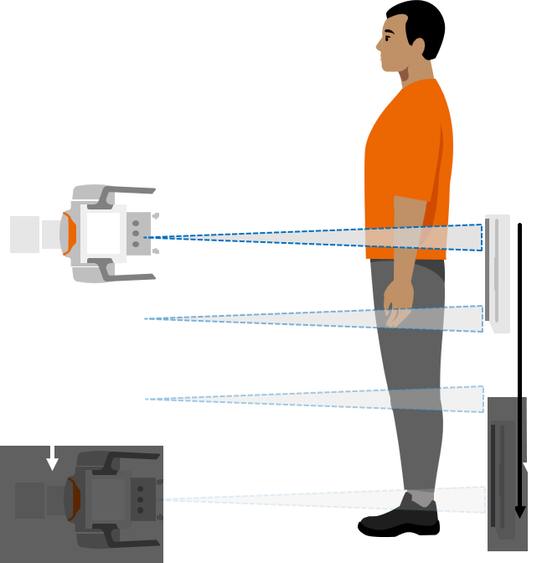
Clinical background and indication for Multitom Rax True2scale Body Scan¹
Patient
Sex
Male
Year of birth
1948
BMI
44.1 kg/m²
Anamnesis
Status post a traffic accident in 1983 with a screwed acetabular fracture,
severe bilateral coxarthrosis, leg-length discrepancy, and pronounced
flexion contracture of the right hip with a forward-bent upper body.
The cause of the leg-length discrepancy cannot be definitively
assigned to one side due to the degree of destruction of both hips.
Indication for True2scale Body Scan¹
Use of True2scale Body Scan¹ to plan surgery and identify
the correct side causing the leg-length discrepancy.
The products/features (mentioned herein) are not commercially available in all countries.
Their future availability cannot be guaranteed. | 1 Option

Slide 5

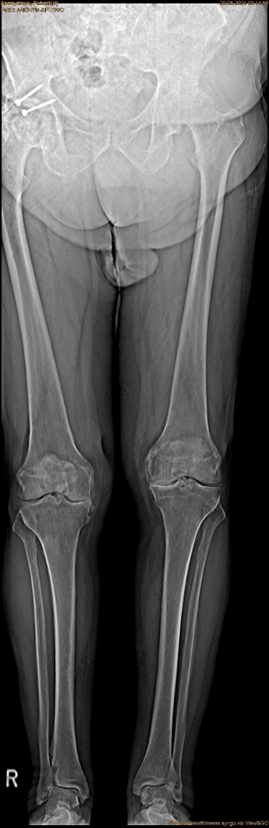
Multitom Rax True2scale Body Scan¹
Differences Pelvis Overview vs. T2S¹
True2scale Body Scan¹
a.p. using upright XL protocol
StudyID: 5aag668
StudyID: 5aag667
Leg-length discrepancy | 8 mm
Scan range | 101.8 cm
Scan time | 12.7 sec
Tube voltage | 81 kV
Current time product | 429 mAs
Dose area product | 89.7 µGy⋅m²
4 mm
?
8 mm
Gold-standard
Pelvis overview
Leg-length discrepancy | 4(?) mm
Tube voltage | 112.7 kV
Current time product | 59 mAs
Dose area product | 161.4 µGy⋅m²
The products/features (mentioned herein) are not commercially available in all countries.
Their future availability cannot be guaranteed. | 1 Option

Slide 6

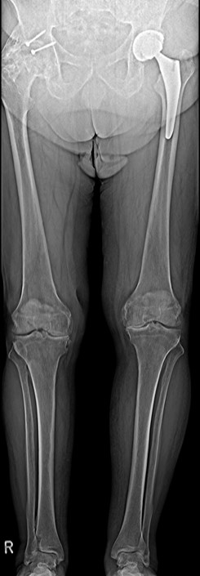
Multitom Rax True2scale Body Scan¹
Diagnostic Findings & Results
Results
True2scale Body Scan¹ reveals that, surprisingly, only a small anatomical leg-length discrepancy of about 8 mm is observed, whereas previously 3 cm had been measured with a tape measure. Additionally, the knee joints were found to be
at different heights. Therefore, the cause of the leg-length discrepancy is functional and not anatomical.
StudyID: 5aag667
StudyID: 5aag669
Follow-up scan after revision
Uncomplicated surgical course with equalization of leg-length postoperatively (less than 5 mm difference).
Pre-surgery
Post-surgery
The products/features (mentioned herein) are not commercially available in all countries.
Their future availability cannot be guaranteed. | 1 Option

Slide 7

“The T2S scan can help
to distinguish functional
from anatomical deficits.”¹
Manuel Scholl, MD
Orthopedic Hospital Schloss Werneck, Germany
1 The statements by Siemens Healthineers customers described herein are based on results that were achieved in the customer’s unique setting. Since there is no “typical” hospital and many variables exist (e.g. hospital size, case mix, level of IT adoption) there can be no guarantee that other customers will achieve the same results.

Slide 8
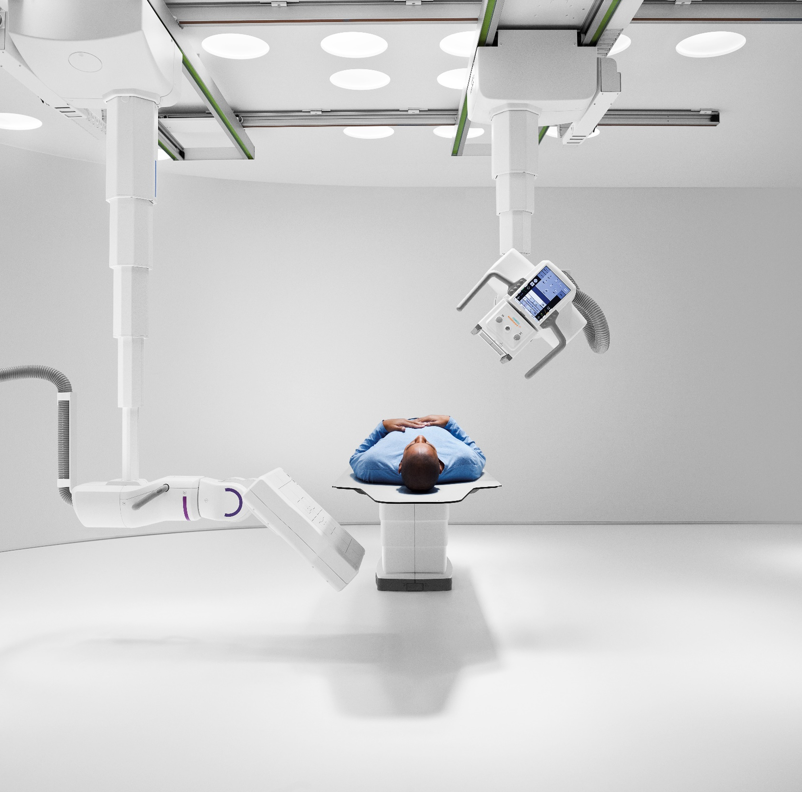
The products/features (mentioned herein) are not commercially available in all countries. Their future availability cannot
be guaranteed. True2scale Body Scan
is an option.
Results from case studies are not predictive of results in other cases. Results in other cases may vary.
Manuel Scholl is employed by an institution that receives financial support from Siemens Healthineers for collaborations.

