Slide 1

Multitom Rax Social Posts
Marketing Toolkit
English, February 2026

Slide 2
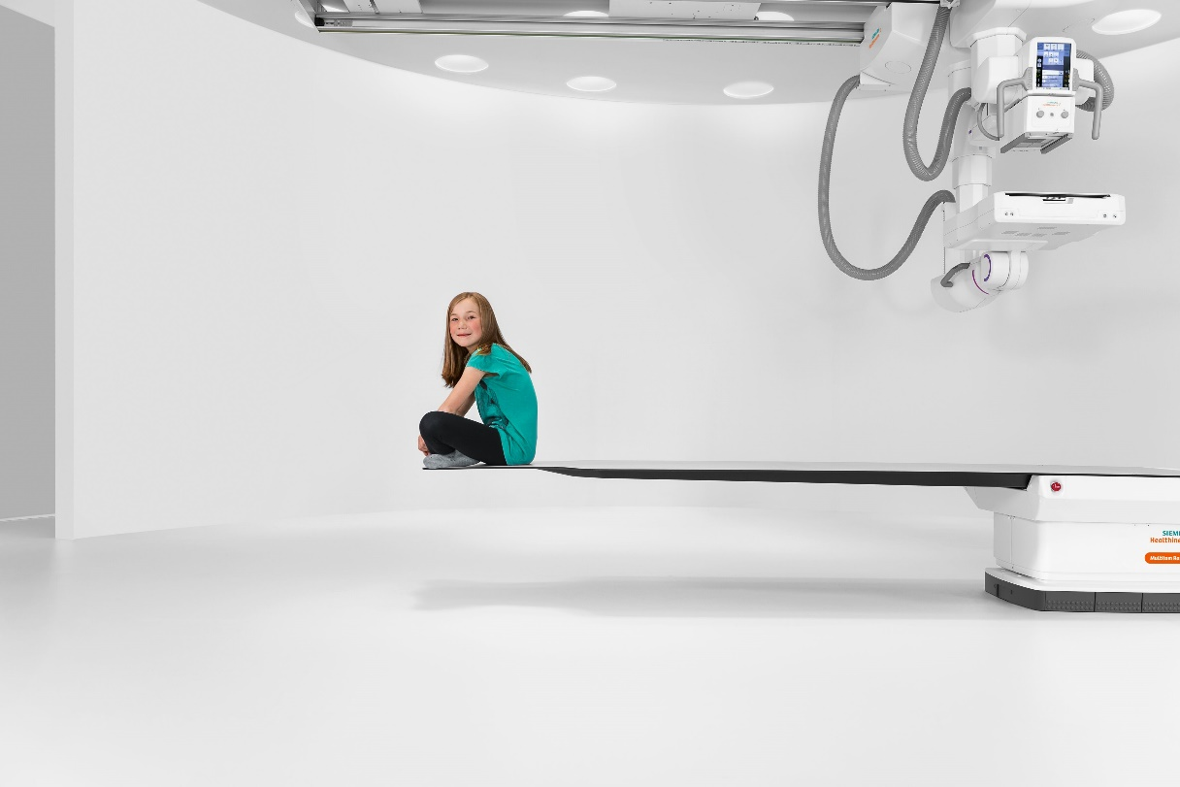
Pediatrics Post
Big news for our youngest patients!
We’re excited to now offer imaging on the Multitom Rax—a child‑friendly, low‑dose Twin Robotic X‑ray system designed to reduce repositioning, ease anxiety, and support fast, comfortable exams. Its advanced Real3D and True2Scale capabilities give our pediatric specialists clear insights with less stress for kids and families.
✨ Better comfort. Fast exams. Great accuracy for small anatomies.

Slide 3
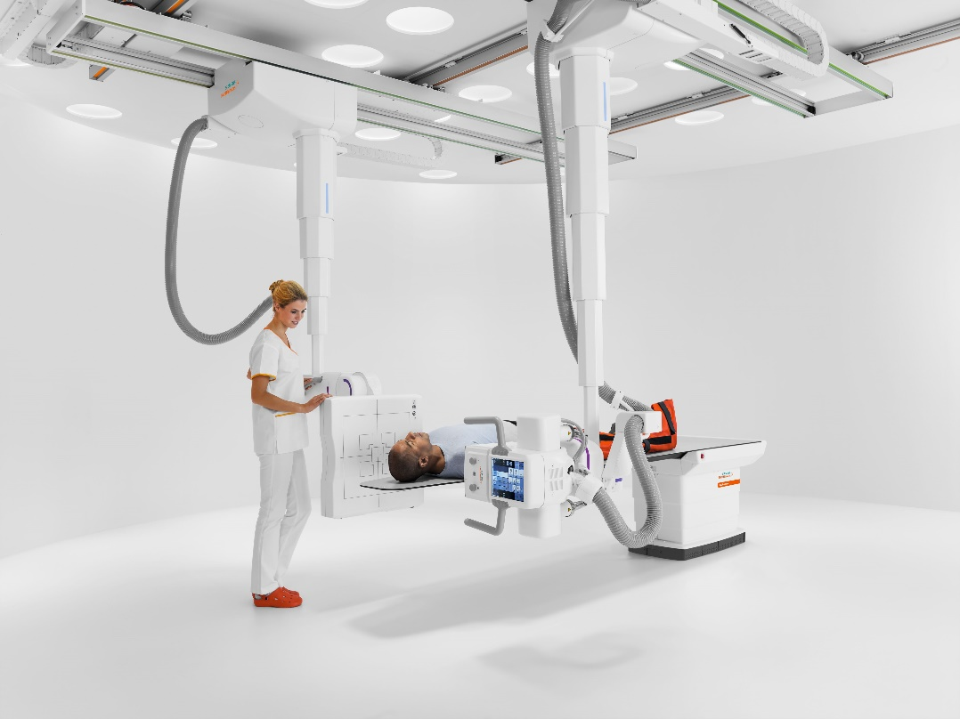
Trauma Care Post
Now live in our Emergency Department: Multitom Rax.
This next generation robotic X ray system delivers precise 2D, fluoroscopic, and Real3D imaging with minimal patient movement—critical for trauma cases where every second matters. Its flexible robotic positioning helps us evaluate fractures and critical injuries quickly and comfortably, right at the point of care.
⚡ Speed, precision, and improved patient experience—exactly when it matters most.

Slide 4
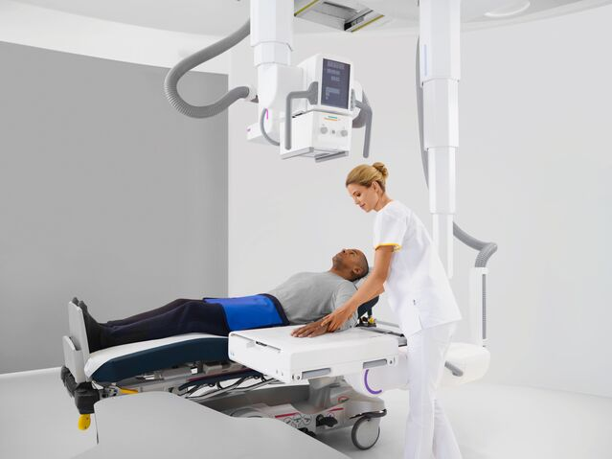
Orthopedics Post
Transforming orthopedic imaging starts today.
With our newly installed Multitom Rax, we can now capture high resolution 2D, fluoroscopic, and Real3D bone imaging—including weight bearing and True2Scale full body views—to support accurate assessments of joints, extremities, and complex deformities. Less repositioning, more diagnostic clarity.
🦴 Sharper orthopedic insights to support patient outcomes.

