Slide 1
Move knowledge,
not staff.
syngo Virtual Cockpit – your solution for remote scanning
#caredelivery
¹ syngo Virtual Cockpit is not commercially available in all countries. Due to regulatory reasons its future availability cannot be guaranteed. Precondition: Expert-i enabled modality from Siemens Healthineers.
² Appropriately trained personnel operating under applicable federal, state, and local laws as to the specific imaging modality(ies), including radiation and contrast.

Slide 2



The future of imaging is challenging:
Key topics
Staff shortage
Having enough expert technologists on your staff is key for offering complex procedures and resolving bottle-necks. However, such personnel may be expensive and difficult to find.
Patient satisfaction
With reduced expertise comes a reduction in scheduling flexibility. This may mean that patients can't get an appointment or may have a long waiting time.
Cost pressure
Efficient care delivery is all about patient flow. This requires scheduling flexibility as well as experts who can ensure protocol standardization and consistent image quality.

Slide 3
Hospitals are increasingly understaffed
Workforce demand-supply
gap grows every year by
14%
Increasing demand
Workload +2.7% p.a.
Flattening resources
Employees +1.2% p.a.
2017
Deficit
45,000
employees
2027
Deficit
163,000 employees
Example NHS, United Kingdom¹
1) NHS, “Facing the Facts, Shaping the Future: A draft health and care workforce strategy for England to 2027”, 2017
Notes:
Talking points
Demand for healthcare provision has been on the rise globally, this trend is going to accelerate, depicted by the upper curve in this diagram.
Consequently, the demand for medical staff is projected to accelerate in the future, too
For example, Public Health England (an executive agency of the Department of Health and Social Care in the United Kingdom) estimates the demand for healthcare services for the United Kingdom to grow by 2.7% annually
The increase in demand not only in the United Kingdom but worldwide is driven by, e.g.
Population is constantly getting older, providing for their care will put a severe strain on medical resources (Percentage aged 65 and older in global population to double by 2030“ Source: An Aging World: 2015, United States Census Bureau)
Burden of chronic diseases is rapidly increasing worldwide. In 2001, chronic diseases contributed to approx. 46% of the global burden of disease. The proportion of the burden of chronic diseases is expected to increase to 60% by 2020.
Chronic diseases are driven by e.g. ageing, rapid unplanned urbanization, and globalization of unhealthy lifestyles
Higher patient expectations incl. medical tourists who want better medical care - advanced technology, better quality of care, and quicker access to medically necessary therapies
Information overload, affecting almost everybody in the healthcare system, driven by 2 factors
Growing amount of patient data, specifically in longitudinal studies, e.g. earlier studies
Rapidly growing amount of health knowledge – scientific and popular
Increasing complexity, resulting from compliance to more strict regulations
Growing presence of prevention such as screening programs, e.g. low dose CT screening for lung cancer
At the same time, staff in healthcare is constraint, depicted in the lower curve of the diagram
For example, Public Health England estimates the resources available for the United Kingdom to grow by 1.2% annually only
Resources in healthcare are scarce not only in the United Kingdom but worldwide, and some forces restricting available human resources are, e.g.
Shortage of trained, qualified healthcare professionals, especially physicians and nurses, igniting a “war for talent”, e.g. and healthcare providers undertaking efforts to attract employees from other areas/countries, e.g. NHS tries to attract medical employees from outside the UK
Aging workforce, translating into
a) Retirement waves upcoming, between today and 2030 the generation of baby boomers will be crossing into the over-65 group
b) Availability constraints e.g. parents working part time, preferably without shifts
Urbanization, leading to staff shortages particularly in rural areas
Increasing financial pressure - hospitals need to improve their operational efficiency and productivity to maintain their cost ratios and returns for their owners and investors
For 2017, Public Health England (an executive agency of the Department of Health and Social Care in the United Kingdom) reported a gap of 45,000 medical employees in the NHS in Great Britain in 2017
Public Health England estimates, that this gap will rapidly grow to 165,000 medical employees in 2027, which corresponds to an annual growth of 14% - so it will become increasingly difficult to serve the demand of the population with the resources available
United Kingdom-based publisher BioMed Central estimates a global shortage of more than 15m healthcare workers in 2030
Main messages
Hospitals are increasingly understaffed and there is a mismatch in workforce demand and supply today
This gap is projected to grow significantly and transformational changes will be required to sustainably solve this dilemma

Slide 4
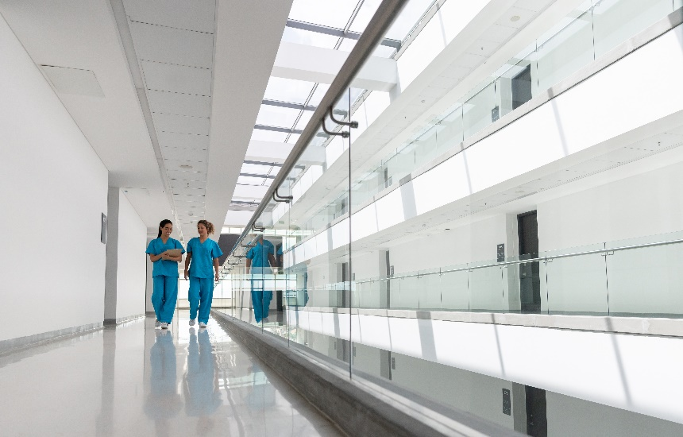


Healthcare providers all over the world need to deliver clinical outcomes and standardize their processes despite staff shortages
4
Staff shortages
Patient satisfaction
Cost pressure
15%
of radiographer jobs are unfilled in the U.K.¹
61%
have continued their search for a healthcare provider to find an earlier appointment²
21%
drop in U.S. Medicare spending on diagnostic imaging over 4 years³
¹⁾ "No Time! How Staff Shortages Are Hitting Patient Care," Cancerworld
²⁾ "2017 Patient Access Journey Report," Kyruus
³⁾ "Medical Imaging: Is the Growth Boom Over?" Harvey L. Neiman Health Policy Institute
Author | Department
4

Slide 5
We enable healthcare providers to increase value by…
Expanding
precision medicine
Transforming
care delivery
Improving
patient experience
Digitalizing
healthcare
Notes:
HOOD05162002913858
(re-use: HOOD05162002823352)
Main Messages
That is why we will continue to partner with our customers throughout health care’s transformational journey towards more value, enabling them to achieve better outcomes at lower costs by:
Expanding precision medicine - Precise diagnosis to foster individualized prevention and therapy
Transforming care delivery - Accessible and highly-efficient healthcare delivery leveraging established and new care models
Improving patient experience - Improved patient experience across the continuum of care
Digitalizing healthcare - Enabled by digital technologies

Slide 6
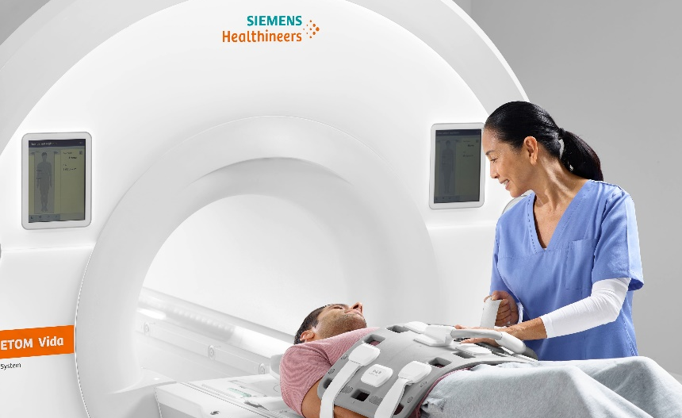
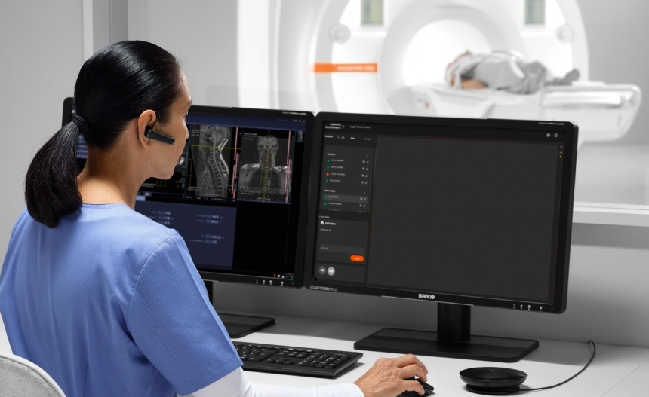
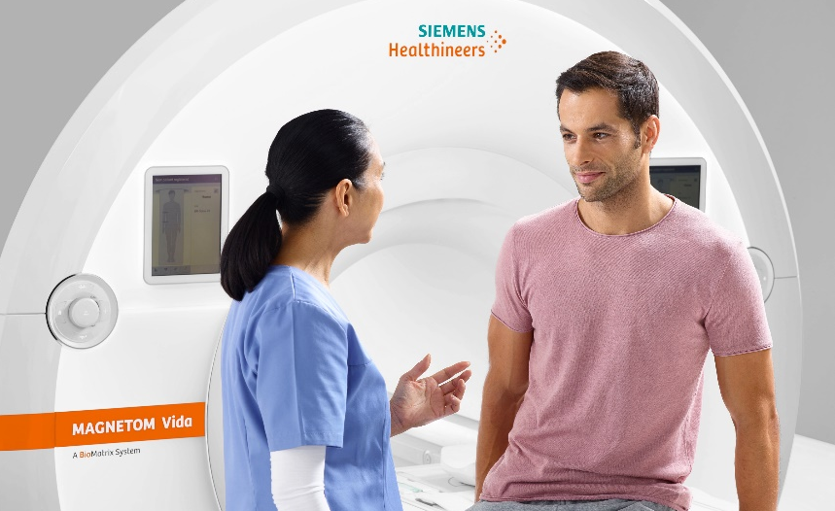

syngo Virtual Cockpit:
Transforming care delivery
Boost confidence
You can rethink teamwork, increase workforce productivity, bridge bottle-necks, and ensure high-quality care. All the while, staff members feel
more confident and competent.
Enhance patient satisfaction
You can offer all procedures at all locations: your experts are virtually available everywhere.¹ Patients get more convenient access and receive appointments more quickly.
Relieve cost pressure
You can achieve higher productivity, greater diagnostic consistency, and generate additional revenue by offer-ing advanced procedures at every location.
¹ Prerequisites include: Internet connection to clinical network, DICOM compliance, meeting of minimum hardware requirements, and adherence to local data privacy regulations.

Slide 7

syngo Virtual Cockpit
Your software for remote scanning
syngo Virtual Cockpit enables experienced technologist from your own network to operate your scanner fleet or provide comprehensive scanning assistance to colleagues – regardless of their physical location.
Core features:
Real-time knowledge sharing
Live video, audio, and chat functions
Simultaneous collaboration with up to three scanning workplaces
For MR, mMR, CT, mCT and SPECT scanners¹
¹ from Siemens Healthineers supporting Expert-i
Notes:
Core features:
One experienced technologist can
collaborate with up to three scanning workplaces simultaneously
Restrictions:
For MR/CT/MI: triggering contrast injection is not possible from remote
For CT: triggering radiation is not possible from remote

Slide 8


syngo Virtual Cockpit
Two setups in the spotlight
Embedded technologists share knowledge
Experts at centralized site support entire network
  An experienced technologist performs routine scans
  while simultaneously assisting up to three colleagues
  at other sites.
  Experts at a dedicated centralized site provide support
  for technologists at various sites across an entire network.

Slide 9
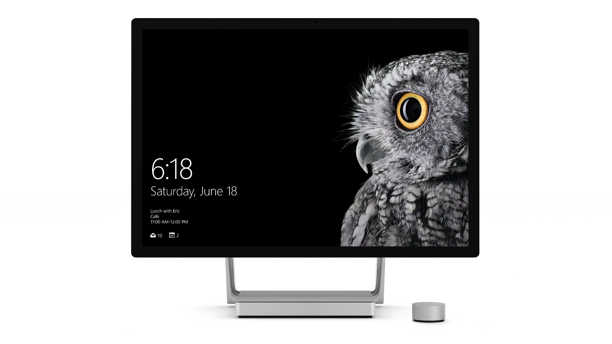
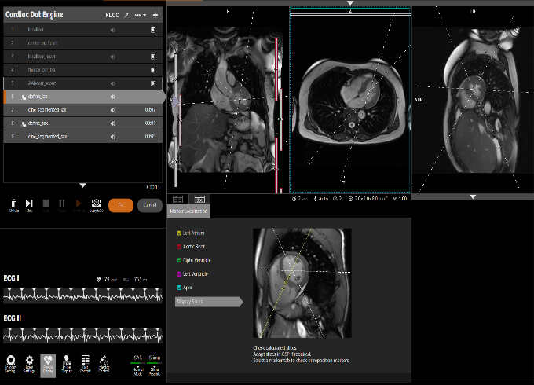
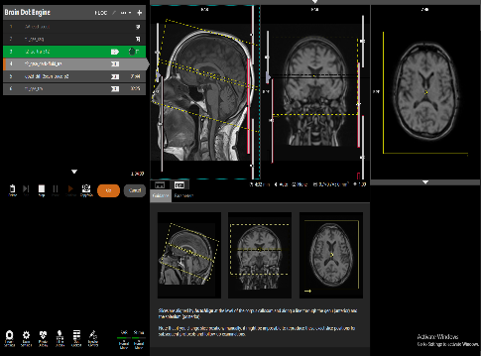
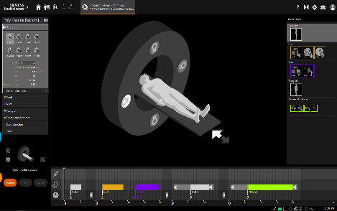
syngo Virtual Cockpit
Expert’s workplace at a glance
3
4
3
4
1
3
1
4
2
2
2
1
Communication
3
Patient camera²
2
Control panel¹
4
Contrast monitor
¹ Expert-i client
² Not intended for patient positioning
Notes:
Experts can remotely assist up to three scans simultaneously. Each modality is displayed in a dedicated segment of the screen¹ and gets its own chat window.
The user name of each technologist is always visible.

Slide 10
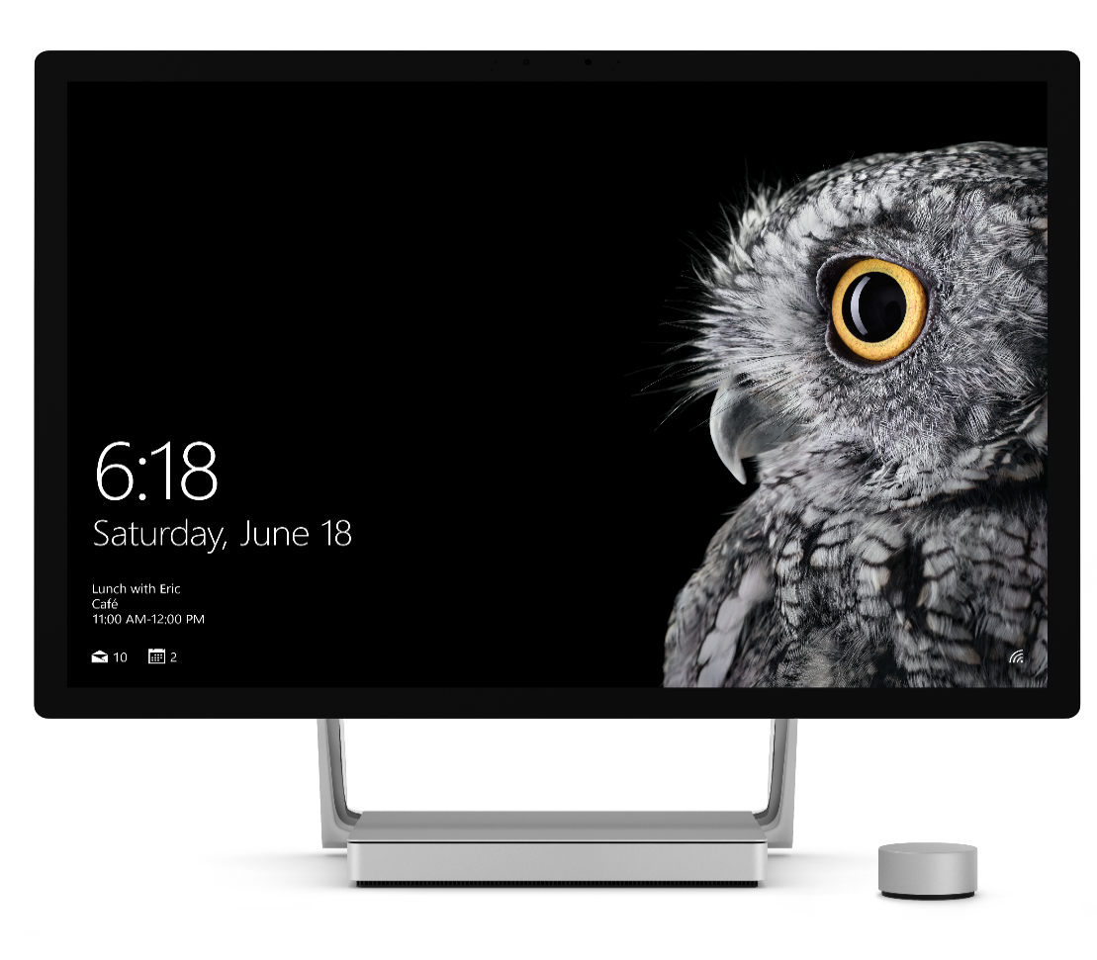
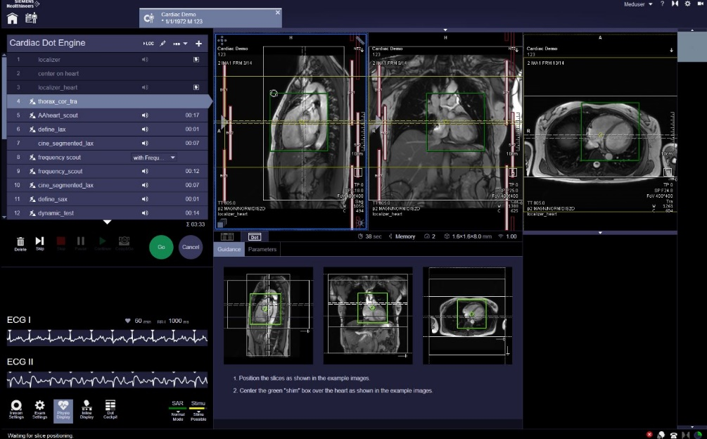


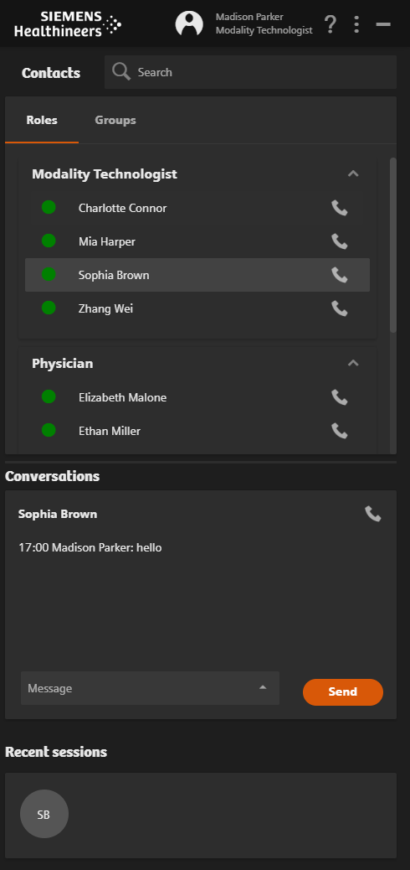
syngo Virtual Cockpit
Modality operator’s workplace at a glance
MRI workplace
Chat window on additional PC
(e.g. RIS client)

Slide 11
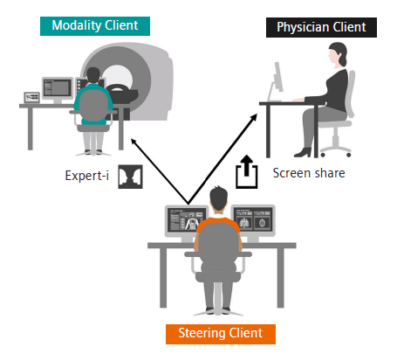
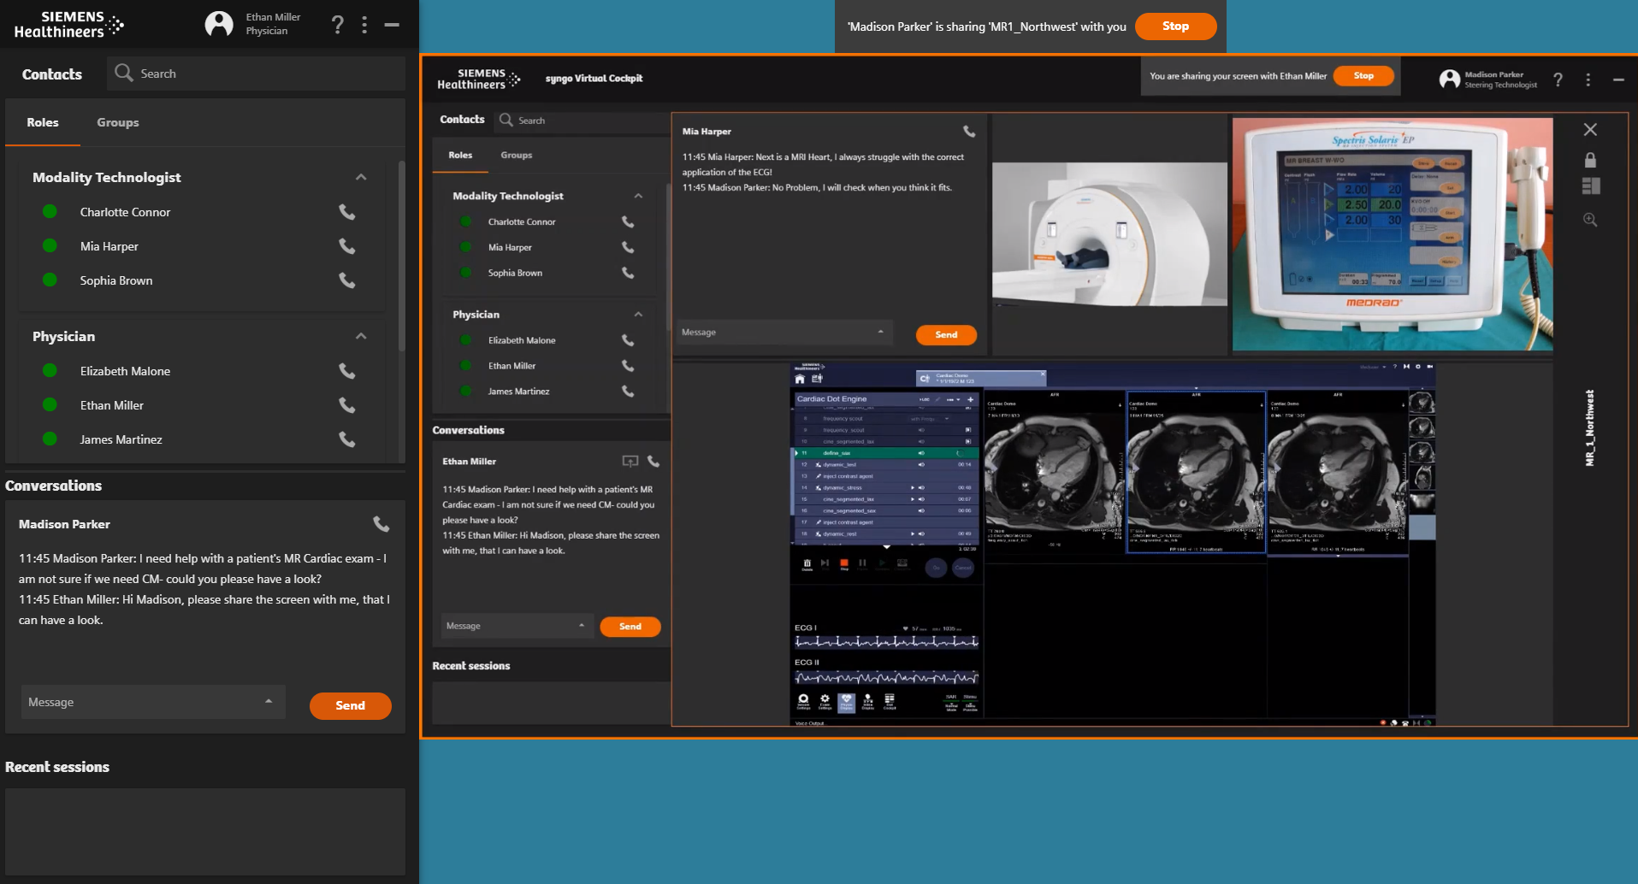
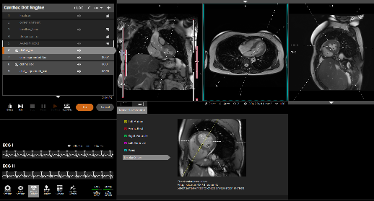
syngo Virtual Cockpit
Physician`s workplace
The Steering Technologists is connected to a modality workplace.
The screen sharing functionality allows the Steering Technologist to share one screen of the modality workplace with the physician.
The Physician can view, chat and call.

Slide 12


syngo Virtual Cockpit
Scope of Application
Home Office ¹
Routine Optimization
Emergency
syngo Virtual Cockpit
Training
Physician Support
Bottleneck Management
Complex Examinations
Mobile Scanning
Special Use Cases
¹ Connection needs to fulfill minimum bandwidth and latency requirements. Prerequisite is a secure VPN connection to the department network

Slide 13
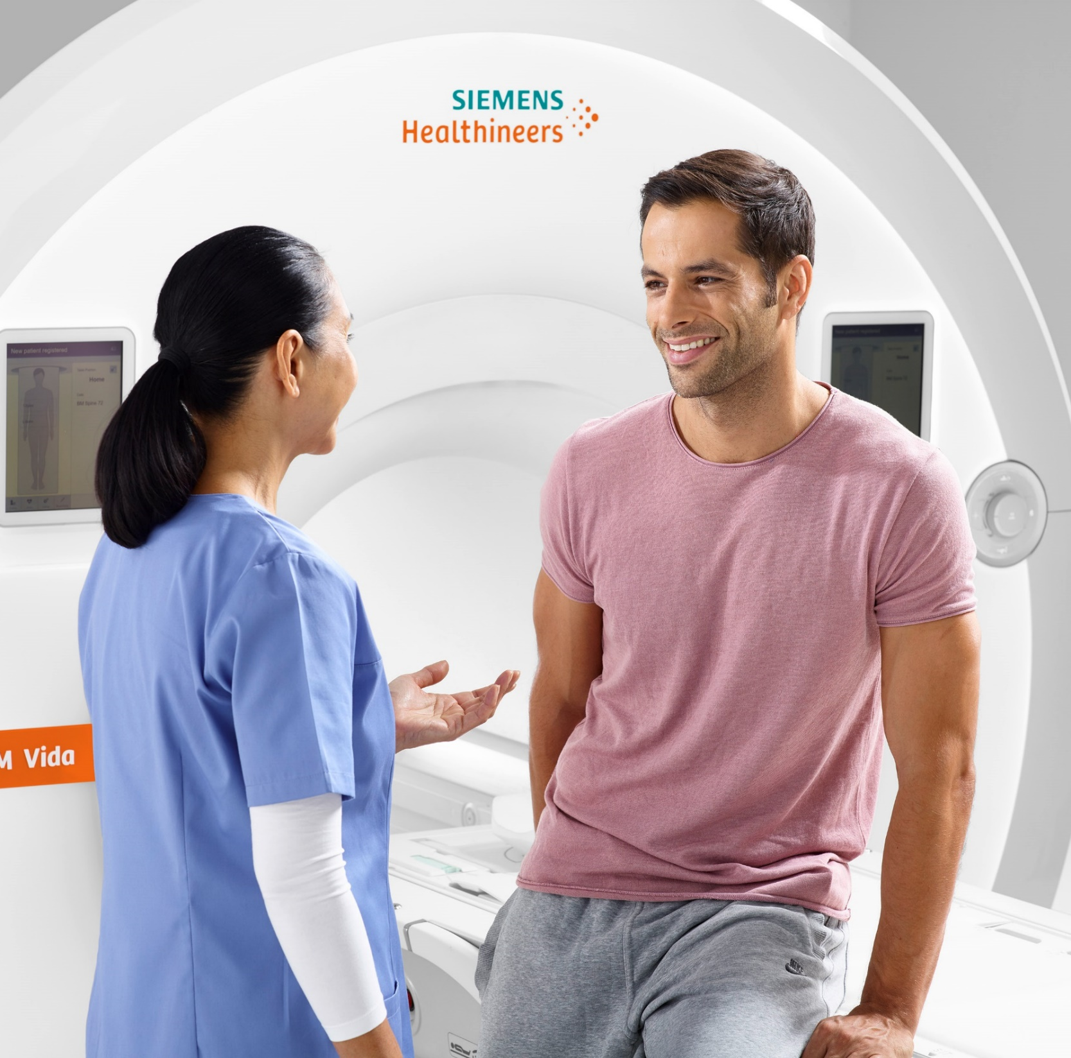
One solution
for many scenarios
syngo Virtual Cockpit

Slide 14
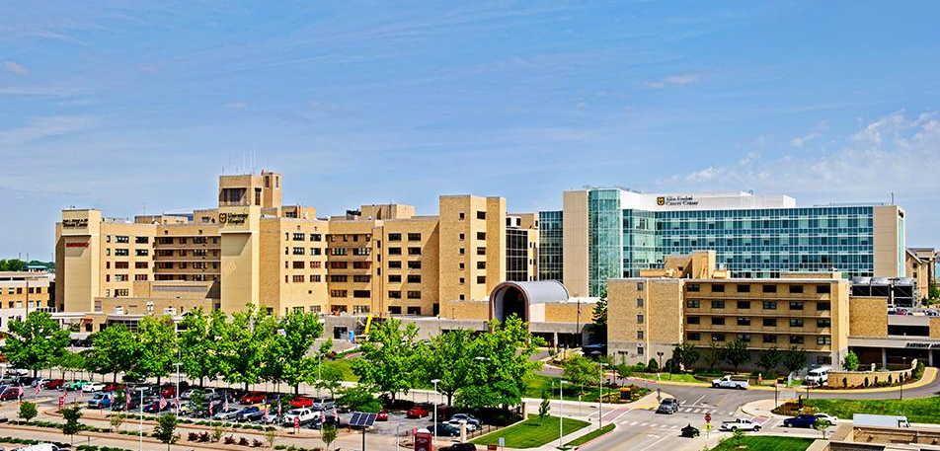




Transforming care delivery: Improving healthcare quality and access through digital solutions
Radiology Network
Challenge
Healthcare delivery
Provide consistent, high-quality care across the region from 5.30am to 11pm & on-call with shortage of Expert Technologist
Education & Workforce Development
Onboarding new employees – up to 6 months
Increase process efficiency
MR Supervisor & Super-Users need to commute between locations
Protocol alignment time consuming.
University of Missouri Health Care
Columbia, MO USA
“Having the ability for MU Health Cares`s expert technologists to be virtually connected whenever and wherever needed, increases our patient access to care inside and outside at MU Health Care, as well as across the state of Missouri.”
Curran Eigelberger, Project Lead at MU Health Care for syngo Virtual Cockpit
Solution
More flexible working hours to manage bottlenecks & offer support to “on-call” technologists
Simplified training support of less-experienced colleagues
Remote support² & protocol alignment provided by an expert working from a centralized steering workplace and cross scanners
Benefits
3 sites
More time
Get direct support therefore improved patient satisfaction through increased appointment availability at all 3 sites
For the MR supervisor focusing on the needs of the workflow, his team and their patients, no travelling needed

Slide 15

Transforming care delivery
Expand complex MRI exams access without growing existing staff
Radiology Network
Challenge
Extend clinical capabilities
Extensive cardiac examina-tions only offered at 1 site
Increase process efficiency
Experts travelling to
various sites
Improve access to care
Cardiac patients travelling
to site where examination is offered
Solution
Pediatric and congenital cardiac examinations now available at 3 separate sites
MR supervisors support all 3 sites (Altamonte-, Apopka-, Celebration Hospital) from
one single location
Appointment availability increased for patients across 3 sites from day 1
Optimized virtual workflow training provides a customized plan to minimize the risk of safety incidents by driving virtual workflow knowledge across the institution
Advent Health, Orlando, USA
“Our patients are experiencing improved access to care – outpatients can get scanned closer to home or work and inpatients do not need to be transferred to our main hospital.”
Ann Hester, MRI Service Line Modality Manager
Benefits
+ 35%
3 sites
More time
Growth in cardiac examination revenue
Improved patient satisfaction through increased appointment availability at all 3 sites
For the MR supervisor focusing on the needs of his team and their patients, no travelling needed
The results by Siemens Healthineers customers described herein are based on results that were achieved in the customer's unique setting. Since there is no “typical” hospital and many variables exist (e.g. hospital size, case mix, level of IT adoption), it cannot be guaranteed that other customers will achieve the same results.
Notes:
Challenges at the outset:
Scanning 6am to 11pm & on-call – over 7 sites
Extensive cardiac examinations only offered at 1 site
Expert travelling to sites
Cardiac patients travelling to site where examination offered
Protocols differ from scanner to scanner
Onboarding new employees – 6 – 12 months

Slide 16

Transforming care delivery
Deliver medical service for a population of 100 million
Standalone Imaging Center covering entire population of Shandong Province
Challenge
Extend clinical capabilities
Lack of senior technologists
Complex examinations are not able to executed at rural hospital
Increase process efficiency
Missing standardized scanning protocols
Improve access to care
Patients travelling
to site where examination is offered
Solution
Complex examinations can now be offered also at rural hospitals
Standardized scanning protocols across all connected sites lead to more precise diagnoses
Simplified training support of less-experienced colleagues
After the scan is completed, it will be diagnosed remotely² by senior doctors. Now they have a remote service for the entire image chain, which has solved the lack of experienced personnel, especially the lack of advanced technologists.
Shandong Medical Imaging Research Institute, China
“In the medical institution sVC is used to connect experienced technologists with techs. from primary clinics . When the staff encounters complex cases, they can turn to the senior techs. or doctors in the sVC center to assist them in scanning, using remote operation.”
...
Benefits
More
Faster
Better
Growth in number of advanced examination at rural hospitals
Faster diagnosis and treatment for patients in rural areas
Reliable diagnosis due to standardized scan protocols and better image quality at all sites
The results by Siemens Healthineers customers described herein are based on results that were achieved in the customer's unique setting. Since there is no “typical” hospital and many variables exist (e.g. hospital size, case mix, level of IT adoption), it cannot be guaranteed that other customers will achieve the same results.
² Connection needs to fulfill minimum bandwidth and latency requirements. Prerequisite is a secure VPN connection to the department network

Slide 17
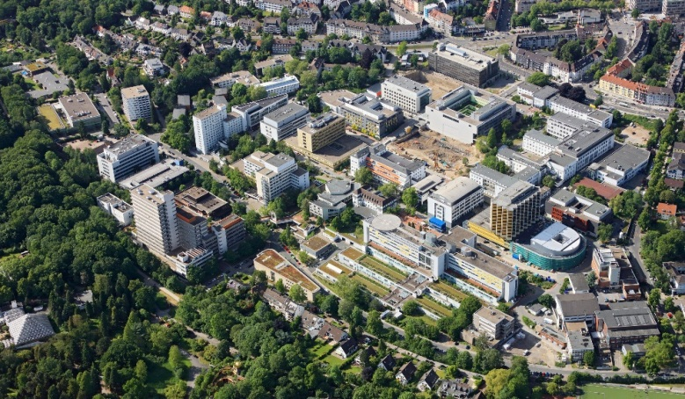
Transforming care delivery
Technologists support from remote in routine and exceptional times
University Hospital Radiology
Challenge
Increase process efficiency
Support challenging and time critical cases during night shifts without wasted time
Protect radiology staff from infection
Drive workforce excellence
Lack of experienced technologists
Long onboarding times
Standardize care
Variations in exam quality
Solution
Home office² during night shifts creates the opportunity to deliver diagnoses faster and reduces the stress level of technologists on duty
Moving the staff behind the COVID-19 frontline by doing home office more often
Centralized expert technologists allow changed workflow at the scanners with less qualified staff
Centralized expert technologists deliver continuous best image quality
Institute of Diagnostic and Interventional Radiology and Neuroradiology,
University Hospital Essen, Essen, Germany
„One major advantage of syngo Virtual Cockpit is the chance as a technologist to work from home.“
Anton S. Quinsten, Chief Radiographer
Benefits
~ 90 scans
- 25%
Home Office
~ 90 scans per day are
supported remotely by high
qualified expert technologists
Access to different scanner types and a wide range of examinations in the centralized set up leads to reduced onboarding time of new staff.
Home office for technologists speed up the process in radiology while protecting their valuable time and the risk of infections
The results by Siemens Healthineers customers described herein are based on results that were achieved in the customer’s unique setting. Since there is no “typical” hospital and many variables exist (e.g. hospital size, case mix, level of IT adoption) it cannot be guaranteed that other customers will achieve the same results.
² Connection needs to fulfill minimum bandwidth and latency requirements. Prerequisite is a secure VPN connection to the department network.
Notes:
Customer permission: available

Slide 18
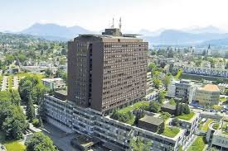
Transforming care delivery
Increased number of examined cardiac patients
Radiology Network
Challenge
Increase process efficiency
Radiologists drive to another hospital (20 kilometers) to support
Cardiac CTs once a week
Improve access to care
Patients who need urgent cardiac CTs must be transported to the main hospital
Standardize care
Homogenize exam protocols over all sites
Solution
Cardiac CTs at remote² sites can be supported from the main hospital at any time
Exam protocols are improved and standardized across all connected sites and scanners
Lucerne Cantonal Hospital,
Radiology Network, Lucerne, Swiss
“syngo Virtual Cockpit allows us to connect remote sites from our main site here in Lucerne fastly and without time lag.”
Dr. J. Fornaro, Head of CT
Benefits
More
productive time
Better
patient care
Standardization
Radiologist can stay in one location to support cardiac CTs. The time normally spent on the road is used for productivity now
Increased number of
examined cardiac patients
Exam protocols are standardized across all sites
The results by Siemens Healthineers customers described herein are based on results that were achieved in the customer’s unique setting. Since there is no “typical” hospital and many variables exist (e.g. hospital size, case mix, level of IT adoption) it cannot be guaranteed that other customers will achieve the same results.
² Connection needs to fulfill minimum bandwidth and latency requirements. Prerequisite is a secure VPN connection to the department network.
Notes:
Customer permission: Skradde?

Slide 19
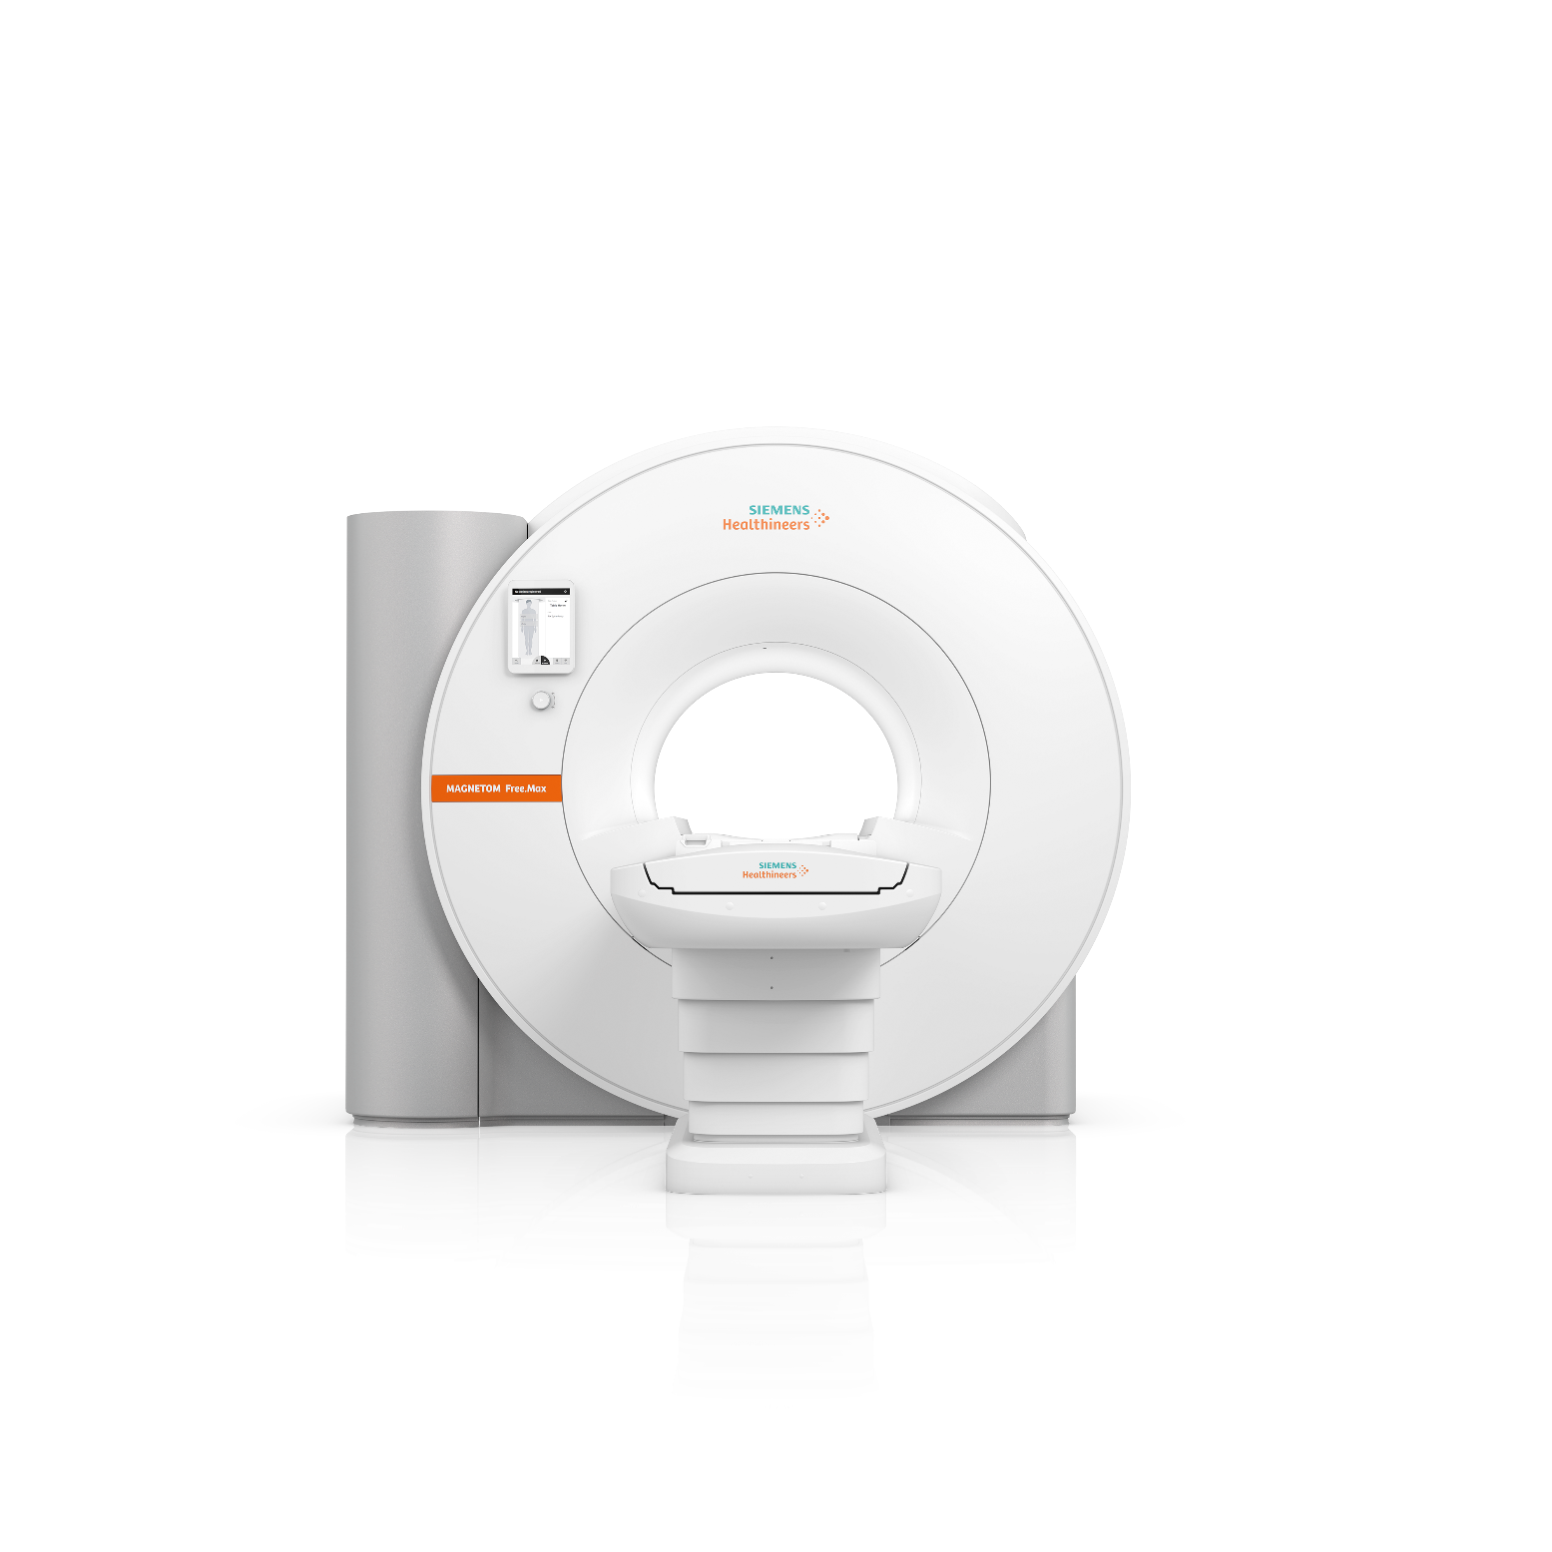
syngo Virtual Cockpit
@ MRI

Slide 20
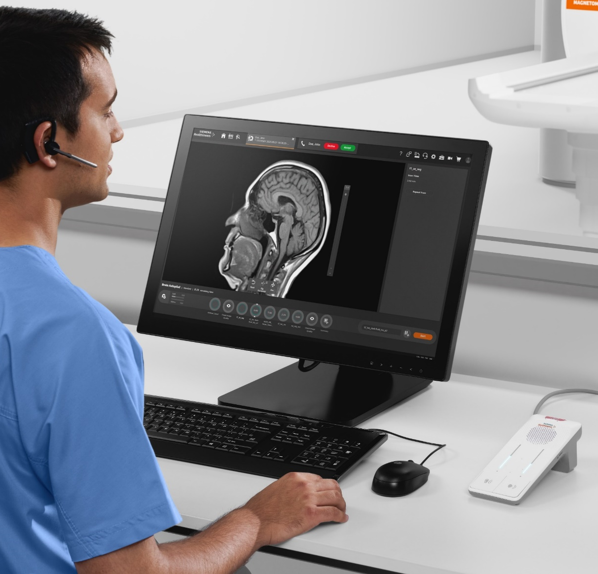
syngo Virtual Cockpit at MAGNETOM Free.Max
Designed to be directly integrated into the scanner console¹
A connection to a supervisor before or during a scan is easy and medical staff in daily working routines can benefit from their experienced colleagues who can quickly and individually help everyone.
1 into myExam Autopilot and Assist.
Notes:
syngo Virtual Cockpit is architecturally integrated into myExam Autopilot and Assist. This gives user remote scanning assistance. E.g. for special examinations, for case specific support, or training.
Users get access to expert colleagues who can help or even take over control of the scan – remotely. This works for all body regions and protocols and even works between different locations at your institution.
No extra modality client needed

Slide 21
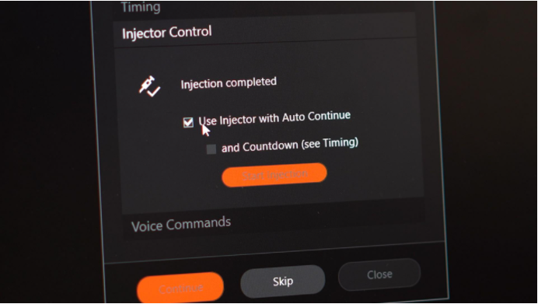
Simplified & synchronized MR contrast injection & scanning from remote
MR-Injector coupling via Imaging System Interface¹ (ISI) is designed to:
support scenarios such as remotely assisted scans with the syngo Virtual Cockpit
save time
improve operational efficiency
reduce stress
With the ISI workflow, it is planned to synchronize the application of contrast agent and start of MR scan: the user just has to press one button on the MR console -> “Start Injection”, instead of manually injecting contrast on the injector console while giving breath-hold commands to the patient.
¹ The products/features (here mentioned) are not commercially available in some countries. Due to regulatory reasons their future availability cannot be guaranteed. Please contact your local Siemens organization for further details.
The information shown herein refers to products of 3rd party manufacturer’s and thus are in their regulatory responsibility. Please contact the 3rd party manufacturer for further information.
Notes:
Simplified & synchronized MR contrast injection & scanning
MR-Injector coupling via ISI is a joint development by Bayer and Siemens Healthineers. It substantially simplifies synchronized contrast injection and scanning by guiding the user through an intuitive workflow with clicks and interactions reduced to the essence. Instead of multiple, time-critical interactions on different consoles (MR host, Injector console, Intercom with Patient), everything is controlled with a few clicks from the MR console. By also supporting remote operation scenarios, ISI may help to provide advanced contrast-enhanced imaging services in remote areas – instead of enforcing patients to travel to distant, centralized expert centers.
ISI is a device that connects the MR scanner workstation to the injector workstation. It enables the injector and scanner to efficiently communicate and synchronize, ensuring appropriate scan timing and simplified workflow resulting in enhanced clinical capabilities.
With the ISI workflow, it is planned to synchronize the application of contrast agent and start of MR scan: the user just has to press one button on the MR console -> “Start Injection”, instead of manually injecting contrast on the injector console while giving breath-hold commands to the patient. Advanced workflow such as scans with delay between injection and scan start are also planned to be supported.

Slide 22
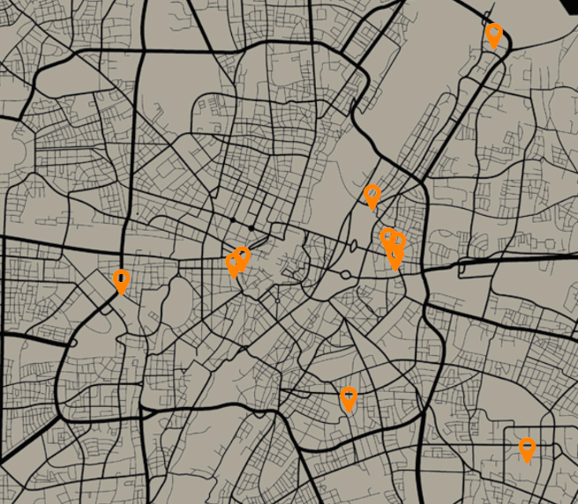

Eliminate commuting with central remote access to manage support in scan procedures of your imaging fleet
Today’s marathon to manage certain scans across the fleet is wasting resources and can lead to under utilized scanners.
Central scan support via remote access enables high quality of care, fully utilized scanners and no lost in revenue for skipped complex procedures.

Slide 23

Eliminating underutilized scanning devices
Ø Cost per Senior Technologist
USA
Ø $ 22,400
$ 93,50/hour
Assume
20h/month travelling time
to harmonize MR protocols
across five sites
spending for
“unproductive”
labor per year
(240 × 93,50 $)
240 h/year
1 Assumptions: cost per Ø annual income of a senior technologist* = 82k USD; 82k USD + estimated employee on-costs = 187k USD; Ø 8h/d at 250 working days = 2000h/year => 93,50 USD/h
Source: https://www.salaryexpert.com/salary/job/mri-technologist/united-states

Slide 24
Maximize reimbursement for complex examinations (USA)
Number of complex examinations¹ per week skipped due to missing expert² for advanced scans
Ø $ 222,000
Lost of revenue per year
at one scanner
(260 × 854 $)
5
Assume
Average reimbursement for complex MRI examinations
$ 854²/examination
² Assumptions: Ø reimbursement in 2018 for complex MRI examinations according to the Centers for Medicare & Medicaid Services. Single payments varied from $200,71 to $3818,59.
Source: https://www.cms.gov/Medicare/Medicare-Fee-for-ServicePayment/HospitalOutpatientPPS/Hospital-Outpatient-Regulations-and-Notices-Items/CMS-1678-FC.html?DLPage=1&DLEntries=10&DLSort=2&DLSortDir=descending
52 working weeks x 7 examinations= 260
Complex examinations for MRI e.g.: Cardiac MRI, MRI Prostate, MRI Brain Perfusion/CSF (Cerebral Spinal Fluid), MRI Breast, MRI Pediatrics, Spectroscopy)
Appropriately trained personnel operating under applicable federal, state, and local laws as to the specific imaging modality(ies), including radiation and contrast.

Slide 25

Technical setup
at a glance
syngo Virtual Cockpit

Slide 26


Hardware and software requirements:
Overview
Steering Technologist
syngo Virtual Cockpit server¹
Assisted modality
PC
2 monitors
Windows 10
Communication device
Windows and Linux
server (physical or virtualized)
PC
1 monitor
Windows 7/8/10
1–2 cameras
Communication device
Up to 100 scanners can be connected
Features built-in cybersecurity controls
essential for modern IT environments
¹ Server requirements can be stated only after the server has been implemented and after system testing results are known

Slide 27
How can we guarantee the security of syngo Virtual Cockpit?
Remote Access Technology
Expert-i enables the remote access and is installed at the scanner
Expert-i is part of the scanner workplace medical device
Local person at scanner needs to explicitly grant full-, or read-only access
Handling of sensitive data
syngo Virtual Cockpit does not process electronic Protected Health Information (ePHI).
Processing of Personally Identifiable Information (PII) is limited to user names.
Sensitive information (PHI/PII) might be present in user editable input fields or in the voice and video streams generated and processed. This information will be transferred over the customer network but not stored persistently.
Authentication authorization controls
For authentication and authorization, syngo Virtual Cockpit supports both, local (on server machine) users and LDAP defined users for user authentication.
A web based Admin Portal allows configuration of modality connections, predefined messages, user roles etc.
Cryptography usage
syngo Virtual Cockpit Infrastructure Server and Clients are based on Microsoft Windows as operating system. Windows has built-in functions for encryption, authentication and message hashing.
Patching strategy
In general Security patches will be provided on a regular basis, after internal validation by Siemens Healthineers. The customer himself should in addition install latest Windows OS Hotfixes unless not blacklisted by SHS in LifeNet.

Slide 28

Business model
syngo Virtual Cockpit

Slide 29

Subscribe for syngo Virtual Cockpit
Our flexible business models
Pay per Scanner
Pay per Hour
Recurring payment - 1, 2, 5 or 7 years contract
Recurring payment – 1 year contract
1-100
    Package size ranges from 1 up to 100 connected scanner
    Tier based
200-600h
    Package size ranges from 200 up to
    600 hours
    Pricing tier based on the No. of scanners connected (max. 100)
=
Service and Support /Evergreen Software Concept (upgrades and updates) included

Slide 30
syngo Virtual Cockpit:
MR scanner compatibility
Scanners that support Expert-i
Scanners with syngo MR software or later
MAGNETOM Systems | Software Version
C!, Concerto, Harmony, Sonata, Symphony | syngo MR A35 and syngo MR A40 line
Avanto, Espree, Symphony a Tim System, Trio a Tim System, Verio | syngo MR B17 and syngo MR B19 line
C2!, ESSENZA, ESSENZA Mobile | syngo MR C15 line
Aera, Avanto, ESSENZA | syngo MR D13 and syngo MR D14 line
Aera, Amira, Avanto, Avanto^{fit}, Biograph mMR, ESSENZA, Prisma, Sempra, Skyra, Skyra^{fit}, Spectra, Terra, Verio | syngo MR E11 line
Altea, Amira, Amira Biomatrix, Lumina, Sempra, Sola, Sola Fit¹, Vida, Vida Fit¹ | syngo MR XA10, syngo MR XA11 and syngo MR XA20¹ line, syngo MR XA12 (for Amira, Sempra) syngo MR XA30(Aera, Skyra, Prisma, Prisma^{fit} with Expert-i version 11)
¹ The products are not commercially available in all countries. Due to regulatory reasons
their future availability cannot be guaranteed.

Slide 31
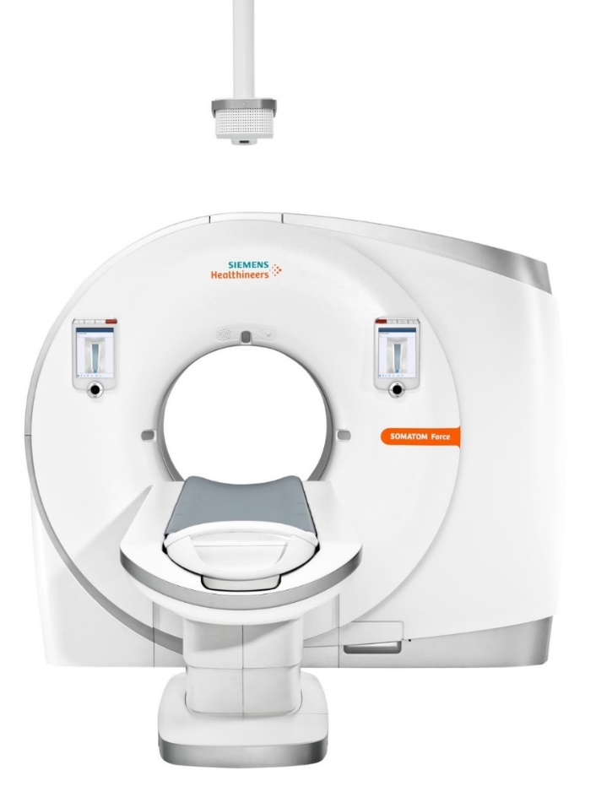
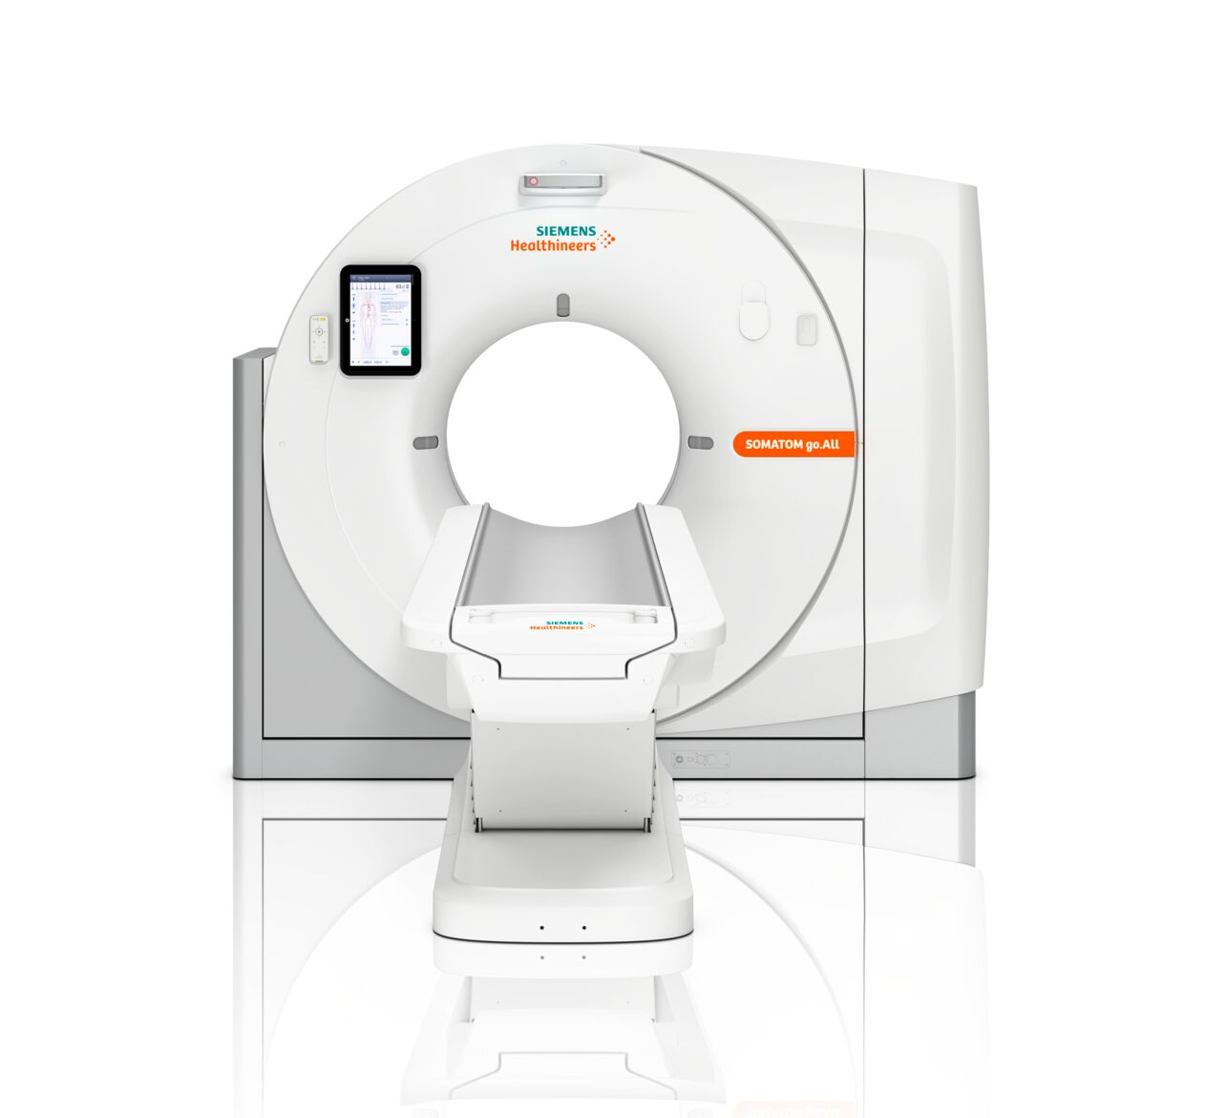
syngo Virtual Cockpit:
CT scanners which are fully compatible for contrast media exams
VA30 for SOM X (SOMATOM go. platform, X.cite)
Somaris 5–based scanners with software version VC50 onwards
Somaris 7–based scanners with software version VB20 onwards
Systems | Software Version
SOMATOM Force, SOMATOM Drive, SOMATOM Edge Plus, SOMATOM Definition Edge, SOMATOM Definition AS, SOMATOM Flash, SOMATOM Confidence RT Pro | Somaris 7 VB20
SOMATOM go.Now, SOMATOM go.Up, SOMATOM go.All, SOMATOM go.Top, X.cite | Somaris X VA30
SOMATOM Perspective, SOMATOM Scope, SOMATOM Emotion | Somaris 5 VC50

Slide 32
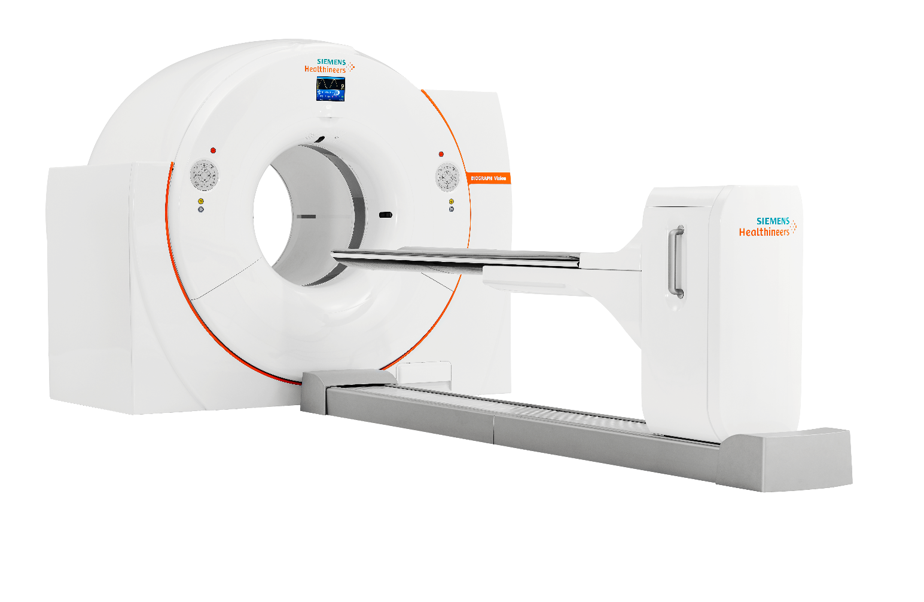
syngo Virtual Cockpit:
PET/CT scanner compatibility
Systems | Software Version
Biograph Vision | from version VG7x onwards
Biograph mCT | from version VG7x onwards
Biograph Horizon | from version VJ2x onwards

Slide 33
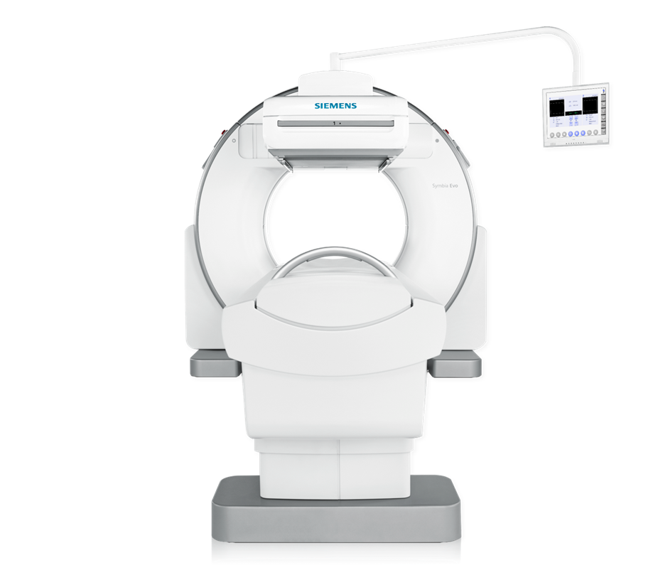
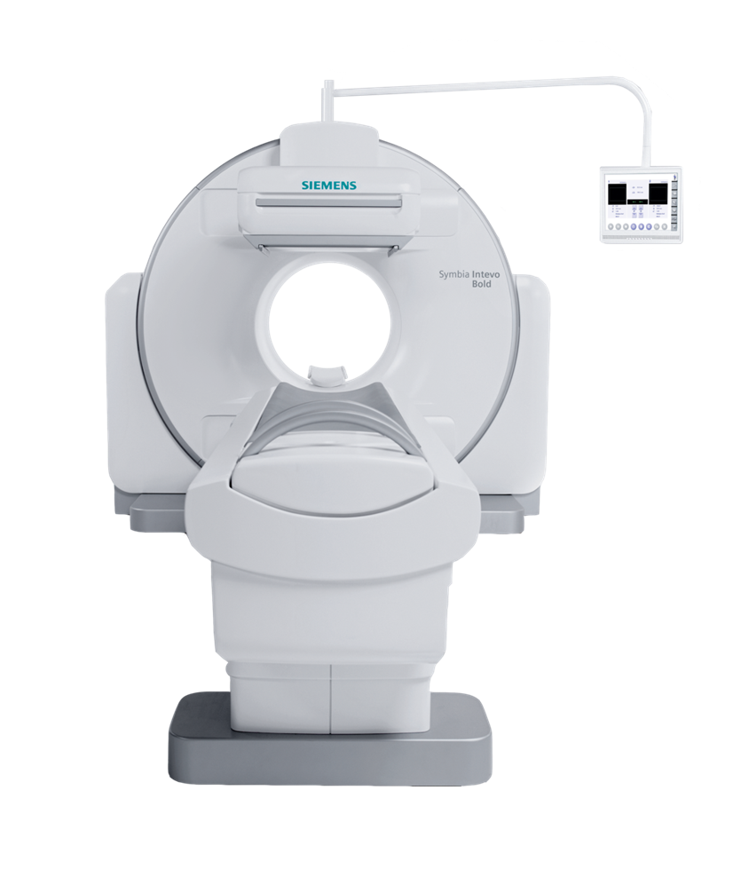
syngo Virtual Cockpit:
SPECT scanner compatibility
Systems | Software Version
SPECT: Symbia S, Symbia E. Symbia Evo, Evo Excel | from version VB22 onwards
SPECT/CT: Symbia T/T2/T6/T16, Intevo Excel/2/6/16, Intevo Bold | from version VB22 onwards
Workstation: Symbia.net | from version VB22 onwards

Slide 34

Additional materials
syngo Virtual Cockpit

Slide 35
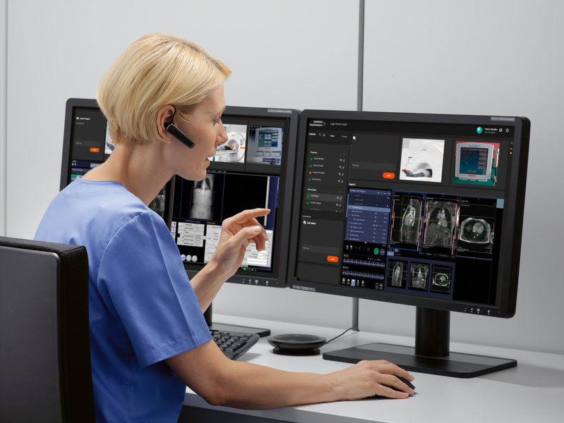
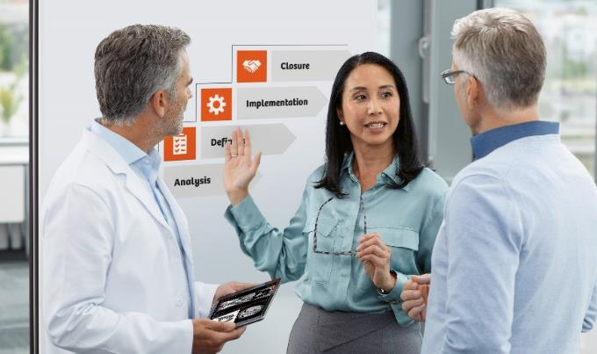
With Optimize Virtual Workflow, you can unleash the potential of syngo Virtual Cockpit from day 1
syngo Virtual Cockpit
is a software solution designed to assist scan procedures from a distance. Expert colleagues receive access to the scanner and can support less experienced technologists via chat, voice, and video. This solution is available for MR, mMR, CT, and PET scanners from Siemens Healthineers.
Optimize Virtual Workflow
is your tailored consulting program targeted to operationalize, enhance, and enable the virtual clinical workflow while incorporating syngo Virtual Cockpit into your imaging environment as quickly as possible.
Simple and seamless transition to syngo Virtual Cockpit
virtual operations and workflow

Slide 36
Optimize Virtual Workflow comprises four steps to the most effective adoption of syngo Virtual Cockpit
Available for compatible MR, mMR, CT, and PET scanners
Analysis
Definition
Implementation
Closure
Current work practices
Advisory on operational measures
Optimal introduction of a virtual scanning workflow with syngo Virtual Cockpit
Target state of an individual training plan
Blended learning techniques e.g., pre-installation online user training and onsite soft skills education
Optimization of virtual scanning techniques
Hands-on approach
State-of-the-art coaching measures
Assistance on interaction between the remote and onsite personnel
Monitoring and fine-tuning of operations
Enablement of a fully integrated optimized virtual workflow
Closure of consulting project
Holistic approach to optimize remote scanning, focusing on both people and processes
Author | Department
36

Slide 37
Thank you for your enthusiasm!
Siemens Healthineers
  SHS DI SY M&S M
  Siemens Healthcare GmbH
  Siemensstr. 3
  91301 Forchheim, Germany
  siemens-healthineers.com
  Petra Kraft
  Phone: +49 (174) 3144075
  petra.kraft@siemens-healthineers.com

