Slide 1
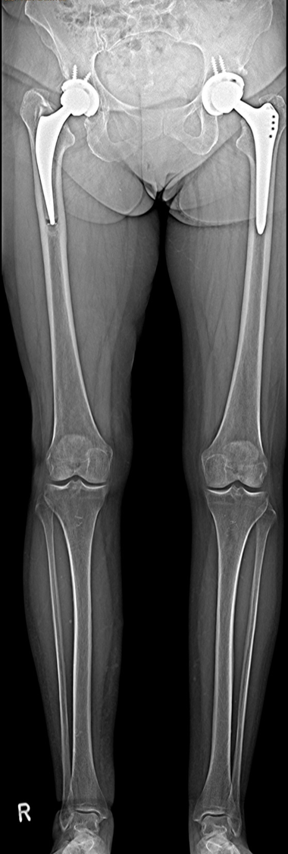
Identifying the causes of leg-length discrepancy
Multitom Rax True2scale Body Scan¹ clinical case
Orthopedic Hospital Schloss Werneck, Germany
StudyID: 5aag660
1 Option

Slide 2
Background
Total hip arthroplasty (THA)
Gold-Standard procedure to plan THA¹
X-ray image acquisition: Pelvis overview
      Lying or weight-bearing (optimal)
      Acquired in a.P. or including a second view lat.
Measurements to plan THA (incl. resulting leg-length)
1
      Reference line within the pelvis,
      e.g., at the pelvic teardrop
2
      Parallel to the reference line, a second line is placed
      at the femoral bone, e.g., at the greater trochanter
3
      If the parallel line does not align with both reference points,
      the parallel difference is set equal to the leg-length discrepancy
2
3
Disadvantages
      Only indirect measurement of leg-length possible
      (true length only measurable with whole leg image)
      If additional CT acquisition is done (i.e., for 3D preoperative planning),
      patient is not in weight-bearing position
1
The products/features (mentioned herein) are not commercially available in all countries.
Their future availability cannot be guaranteed. | 1 THA: total hip arthroplasty

Slide 3
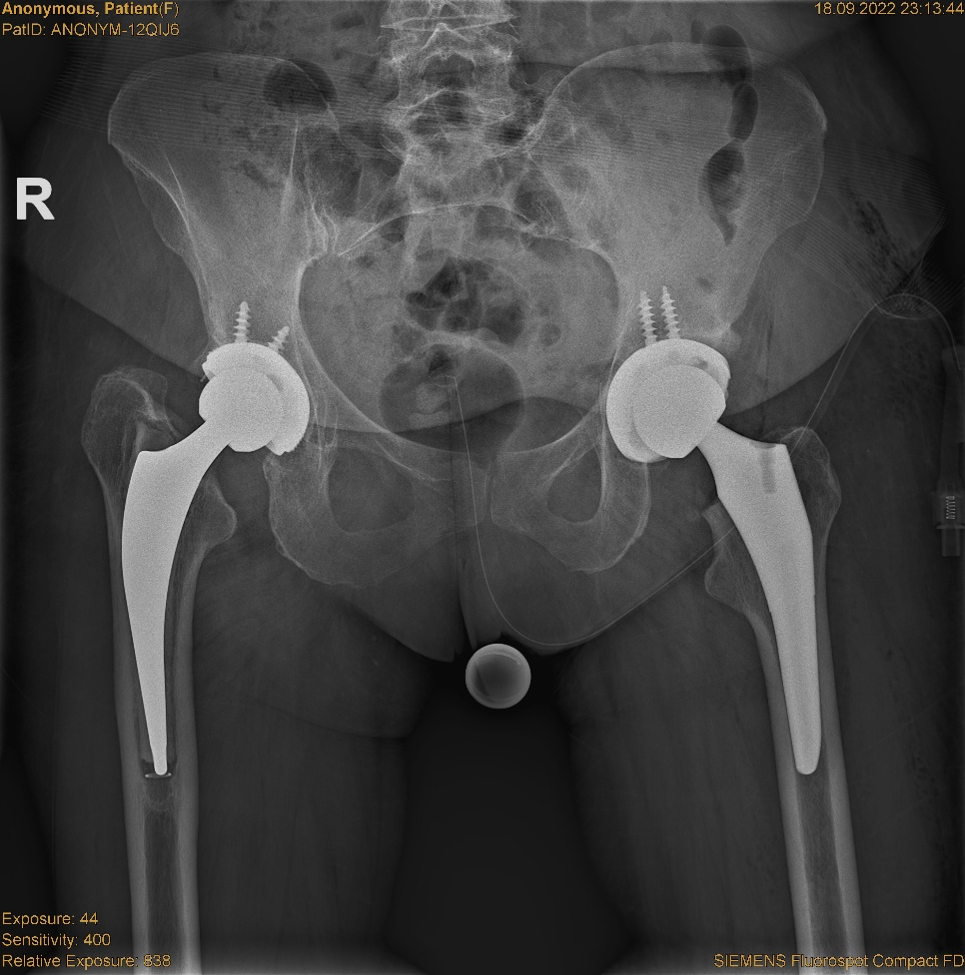
Clinical background
Patient
Sex
Female
Year of birth
1964
Height
165 cm
BMI
25.7 kg/m²
StudyID: 5aag662
Anamnesis
Patient needed renewal implant of left hip to treat osteoarthritis.
After a previous THA¹ implantation on the right, the cemented prosthesis caused increasing complaints during rehabilitation with hip misalignment and gait instability.
Hip overview imaging showed signs of loosening on right implant,
which needs to be replaced after the treatment of the right side.
The products/features (mentioned herein) are not commercially available in all countries.
Their future availability cannot be guaranteed. | 1 THA: total hip arthroplasty

Slide 4
Clinical background
Patient
Sex
Female
Year of birth
1964
Height
165 cm
BMI
25.7 kg/m²
StudyID: 5aag662
Anamnesis
Patient needed renewal implant of left hip to treat osteoarthritis.
After a previous THA¹ implantation on the right, the cemented prosthesis caused increasing complaints during rehabilitation with hip misalignment and gait instability.
Hip overview imaging showed signs of loosening on right implant,
which needs to be replaced after the treatment of the right side.
Leg-length measurement showed a leg-length discrepancy of 39 mm,
but the cause (muscular vs. anatomical) remains questionable.
39 mm
The products/features (mentioned herein) are not commercially available in all countries.
Their future availability cannot be guaranteed. | 1 THA: total hip arthroplasty

Slide 5
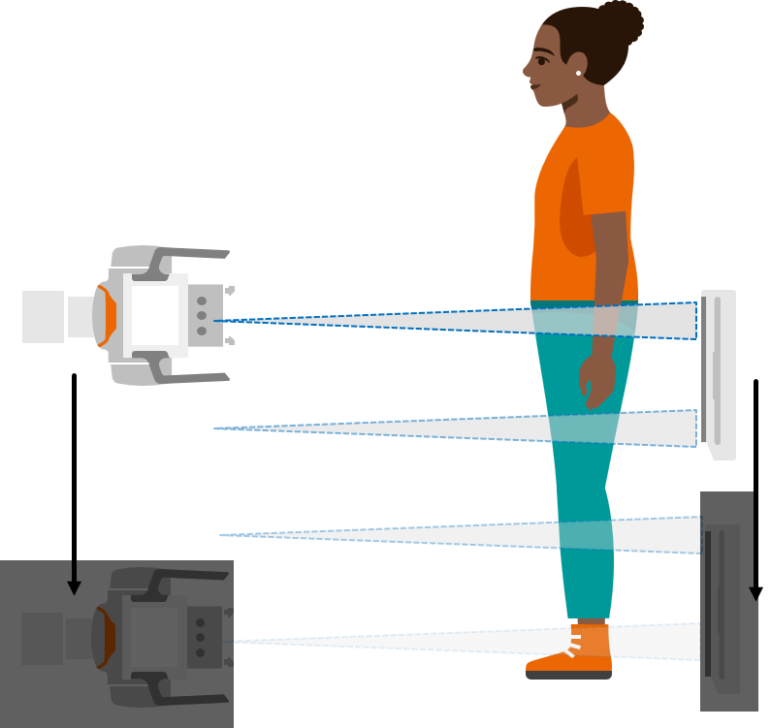
Clinical background and indication for Multitom Rax True2scale Body Scan¹
Patient
Sex
Female
Year of birth
1964
Height
165 cm
BMI
25.7 kg/m²
Anamnesis
Patient needed renewal implant of left hip to treat osteoarthritis.
After a previous THA¹ implantation on the right, the cemented prosthesis caused increasing complaints during rehabilitation with hip misalignment and gait instability.
Hip overview imaging showed signs of loosening on right implant,
which needs to be replaced after the treatment of the right side.
Leg-length measurement showed a leg-length discrepancy of 39 mm,
but the cause (muscular vs. anatomical) remains questionable.
Indication for True2scale Body Scan¹
Exact measurement of whole leg-length to understand
the cause of leg-length discrepancy.
The products/features (mentioned herein) are not commercially available in all countries.
Their future availability cannot be guaranteed. | 1 THA: total hip arthroplasty

Slide 6
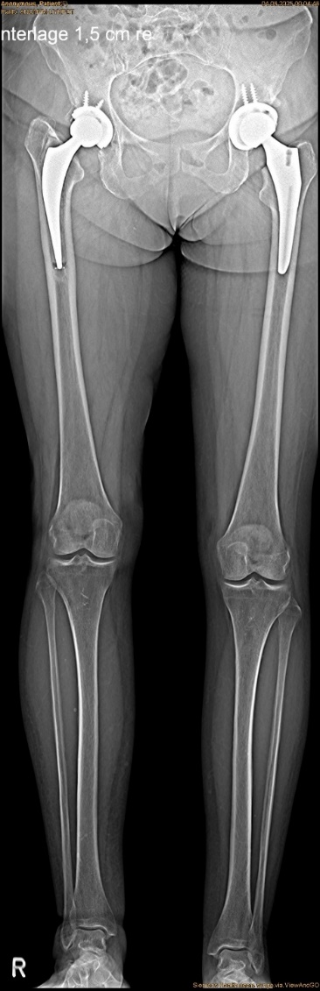
Multitom Rax True2scale Body Scan¹
Differences Pelvis Overview vs. T2S¹
True2scale Body Scan¹
a.p. using upright L protocol
StudyID: 5aag662
StudyID: 5aag661
Leg-length discrepancy | 25 mm
Scan range | 97.8 cm
Scan time | 12.3 sec
Tube voltage | 80.7 kV
Current time product | 444.7 mAs
Dose area product | 86.3 µGy⋅m²
39 mm
Gold-standard
Pelvis overview
Leg-length discrepancy | 39 mm
Tube voltage | 80.9 kV
Current time product | 38.0 mAs
Dose area product | 136.6 µGy⋅m²
25 mm
Pad of 1.5 cm (below right foot)
The products/features (mentioned herein) are not commercially available in all countries.
Their future availability cannot be guaranteed. | 1 Option

Slide 7
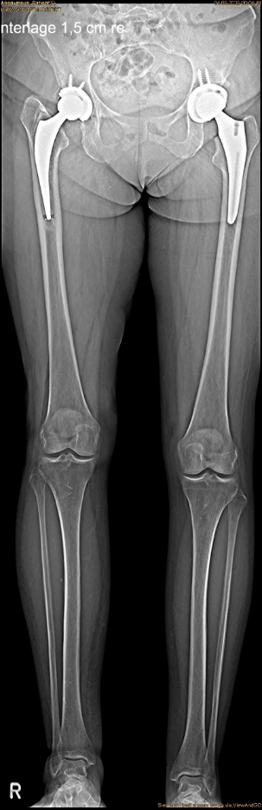
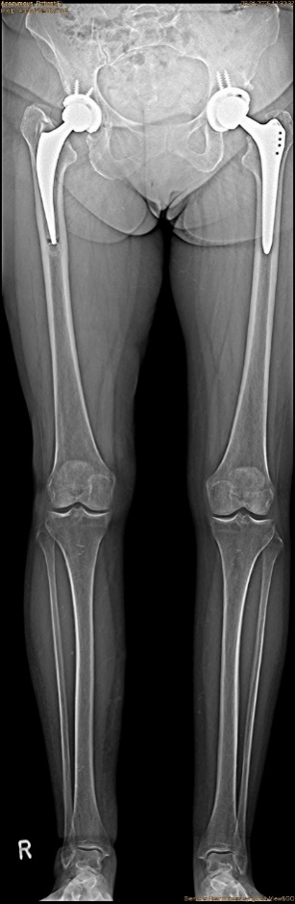
Multitom Rax True2scale Body Scan¹
Diagnostic Findings & Results
Results
True2scale Body Scan¹ revealed a 25 mm
leg-length discrepancy
StudyID: 5aag661
StudyID: 5aag660
      Confirmed anatomical leg-length discrepancy
      Revision surgery
Follow-up scan after revision
Residual leg-length discrepancy of 10 mm with increasing subsidence/loosening of the right hip
      Planning of revision surgery on the right side
Pre-surgery
Post-surgery
Pad of 1.5 cm (below right foot)
The products/features (mentioned herein) are not commercially available in all countries.
Their future availability cannot be guaranteed. | 1 Option

Slide 8

“The T2S scan makes it possible
to objectify the patient’s subjective sensations and to reliably confirm
or rule out diagnoses.”¹
Manuel Scholl, MD
Orthopedic Hospital Schloss Werneck, Germany
1 The statements by Siemens Healthineers customers described herein are based on results that were achieved in the customer’s unique setting. Since there is no “typical” hospital and many variables exist (e.g., hospital size, case mix, level of IT adoption) there can be no guarantee that other customers will achieve the same results.

Slide 9
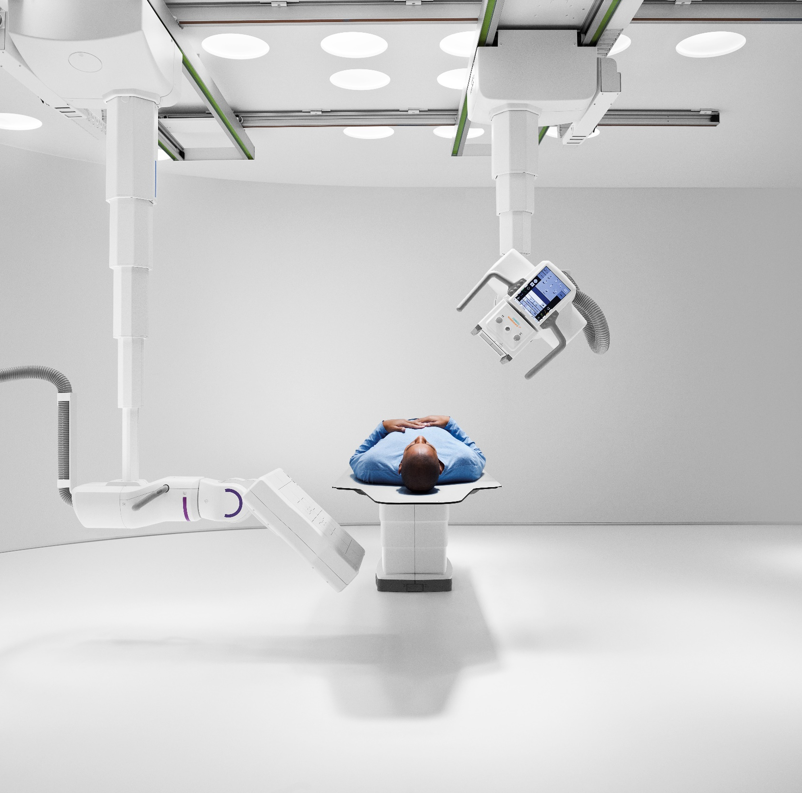
The products/features (mentioned herein) are not commercially available in all countries. Their future availability cannot
be guaranteed. True2scale Body Scan
is an option.
Results from case studies are not predictive of results in other cases. Results in other cases may vary.
Manuel Scholl is employed by an institution that receives financial support from Siemens Healthineers for collaborations.

